Slide 1
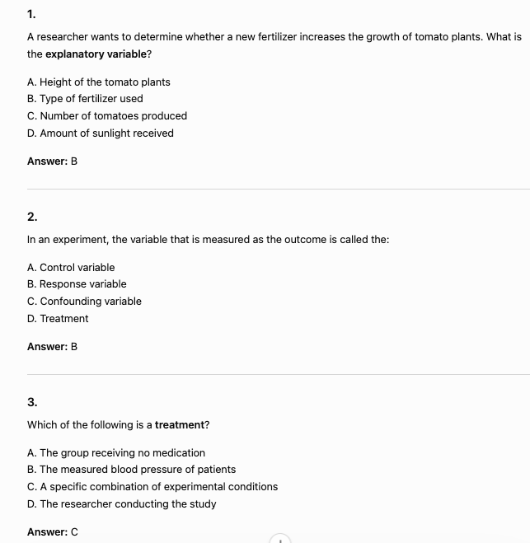
Introduction to Experimental Design

Slide 2
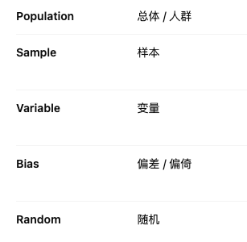

Slide 3
Experimental design is the process of planning an experiment to study cause-and-effect relationships.
Good experiments use random assignment to reduce bias.
Key principles include control, replication, and randomization
Researchers compare treatments to determine their effects.
Well-designed experiments allow for valid conclusions about causation.

Slide 4
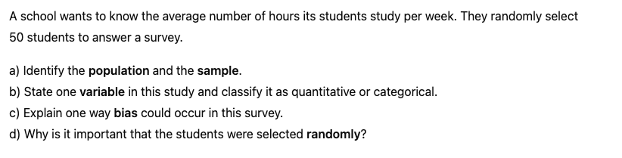

Slide 5
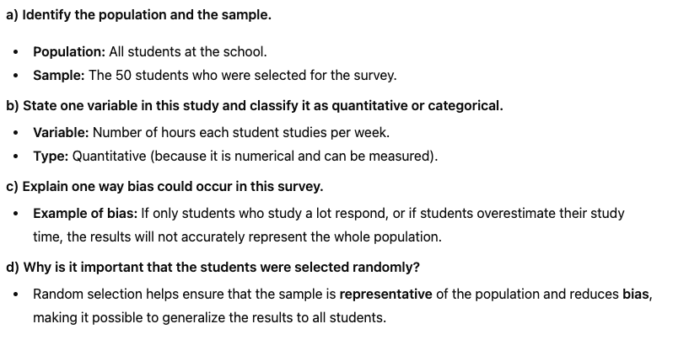

Slide 6
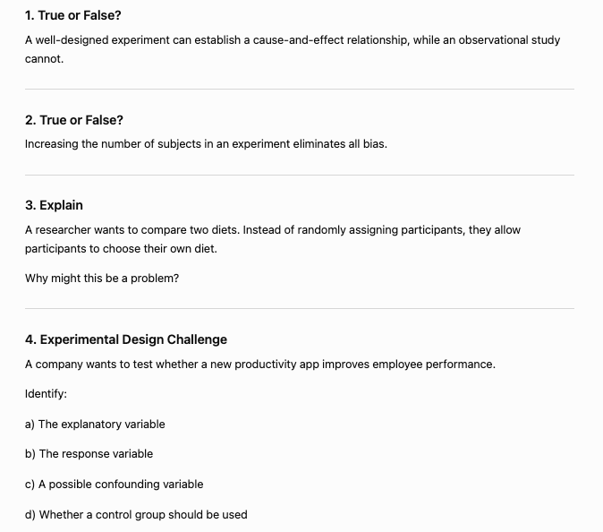
Stretch and Challenge Questions

Slide 7


Slide 8
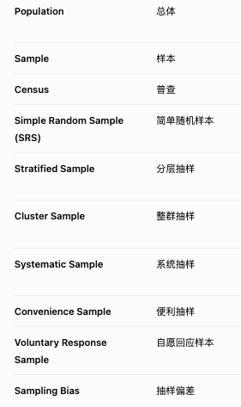
Sampling

Slide 9
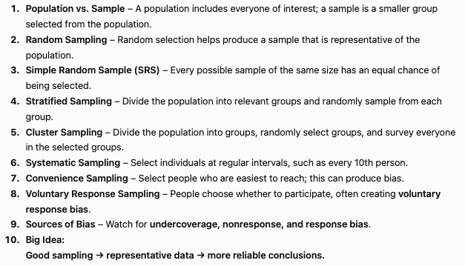

Slide 10
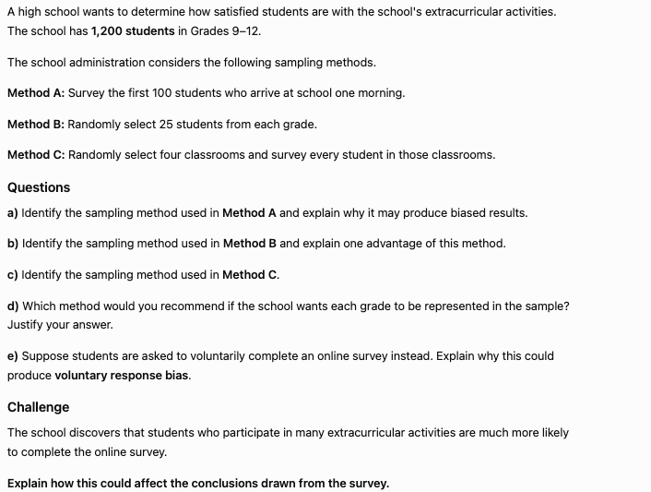

Slide 11
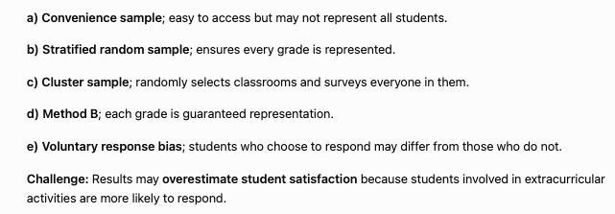

Slide 12
TRUE or FALSE
Random assignment supports cause-and-effect conclusions.
Random assignment means that researchers randomly place participants into different treatment groups in an experiment.

Slide 13
TRUE or FALSE
A control group can receive a placebo or an existing treatment.

Slide 14
TRUE or FALSE
Replication reduces the influence of random variation.

Slide 15
TRUE or FALSE
Blocking controls for variation from an important characteristic.
This reduces the effect of that characteristic on the response variable, making it easier to determine whether differences are actually caused by the treatment.

