Slide 1
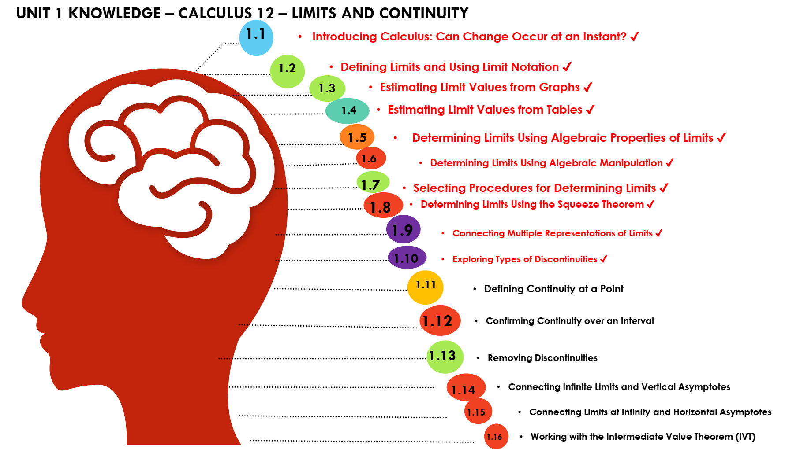

Slide 2
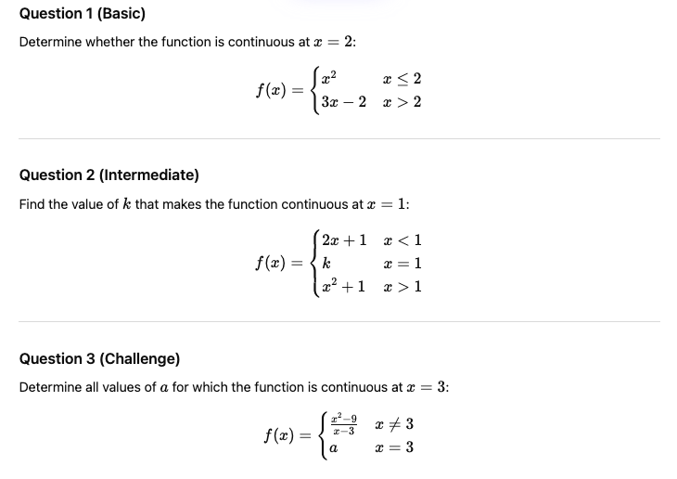
2

Slide 3
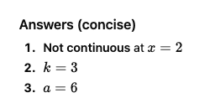

Slide 4
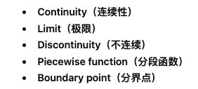

Slide 5
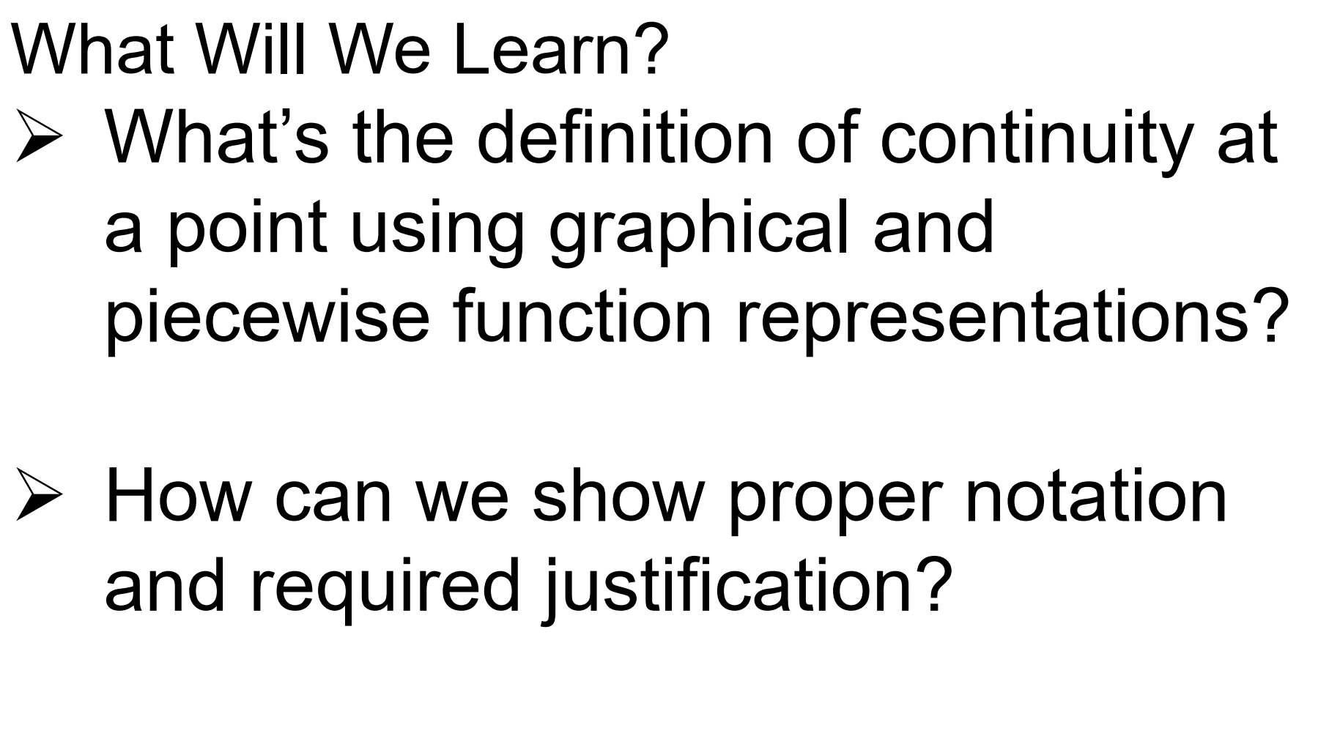

Slide 6
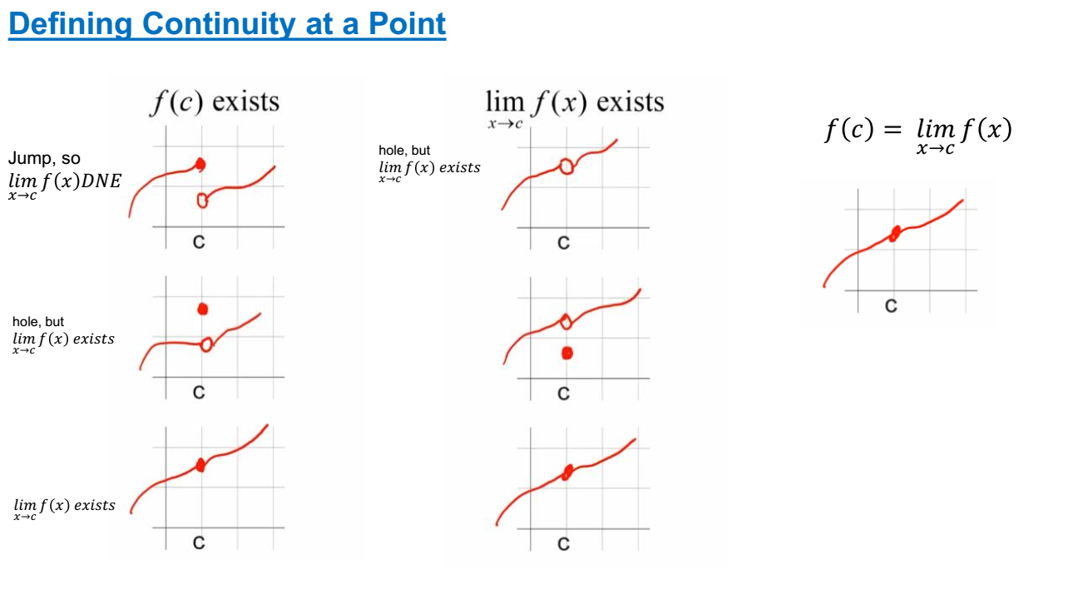
DRAW THE FOLLOWING GRAPHS

Slide 7
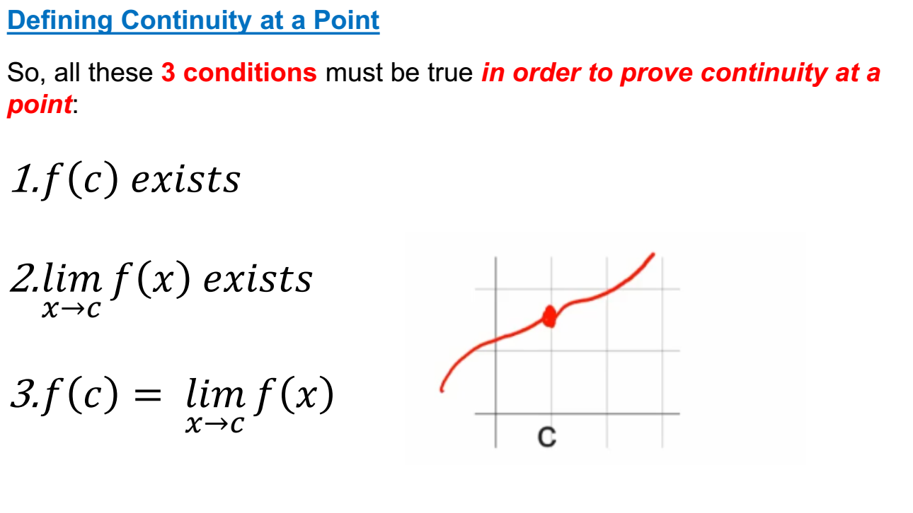

Slide 8
Let’s see an example!

Slide 9
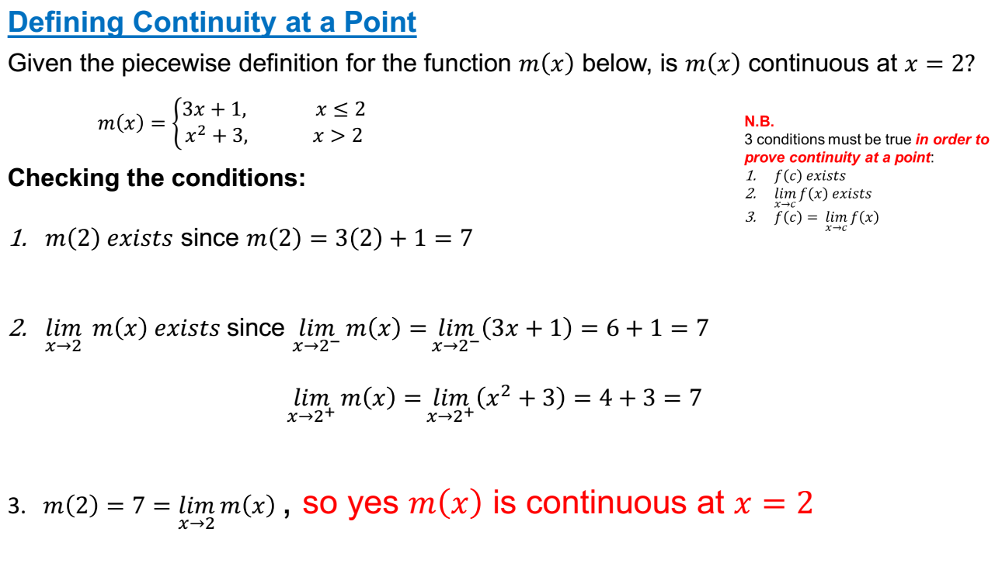

Slide 10
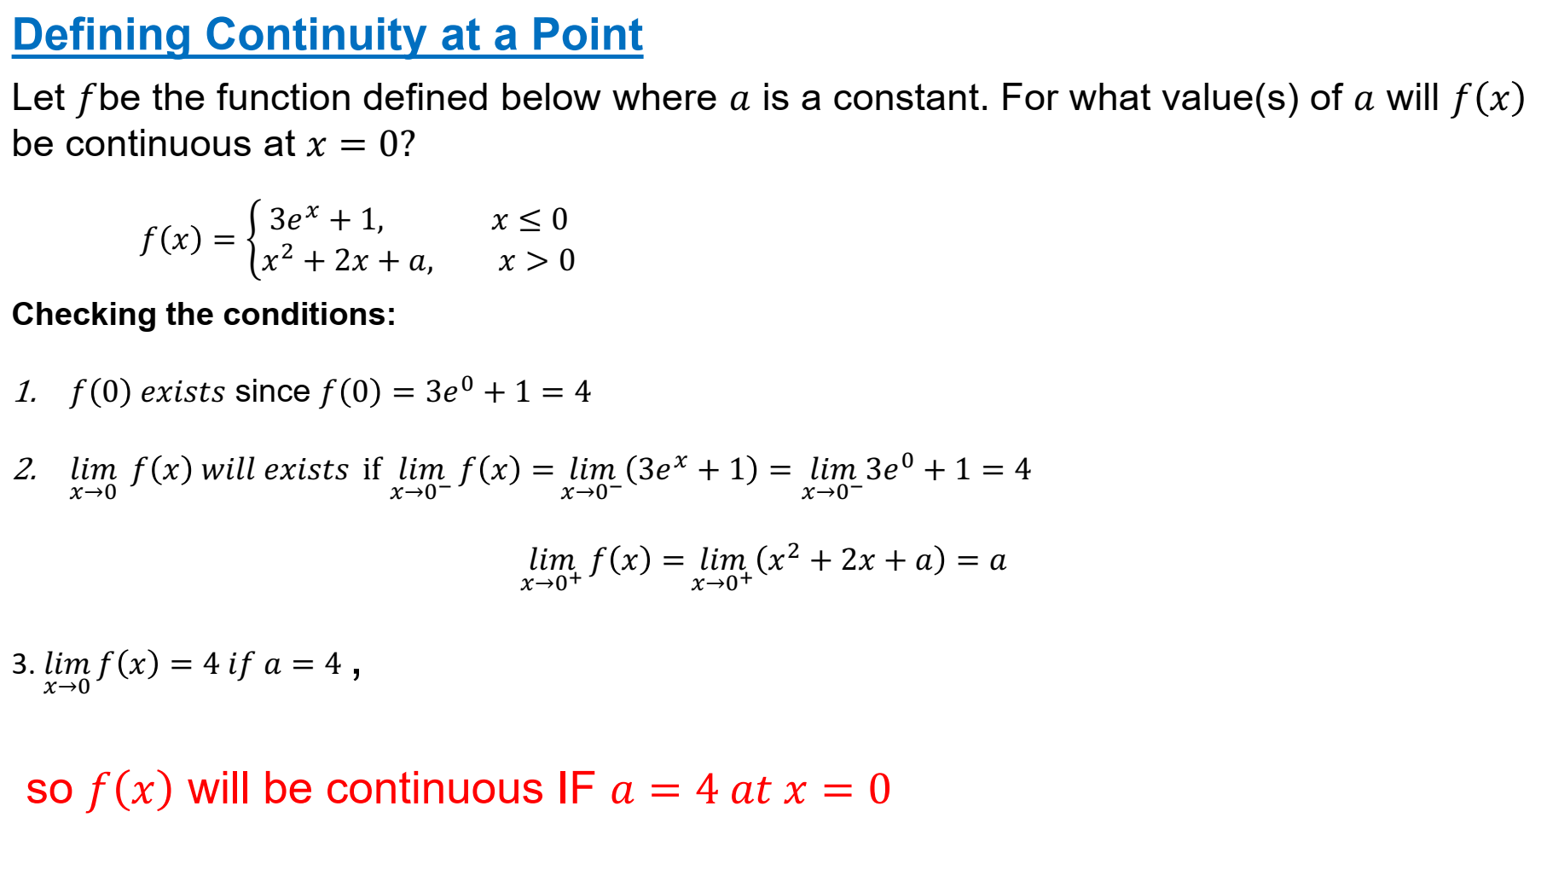

Slide 11
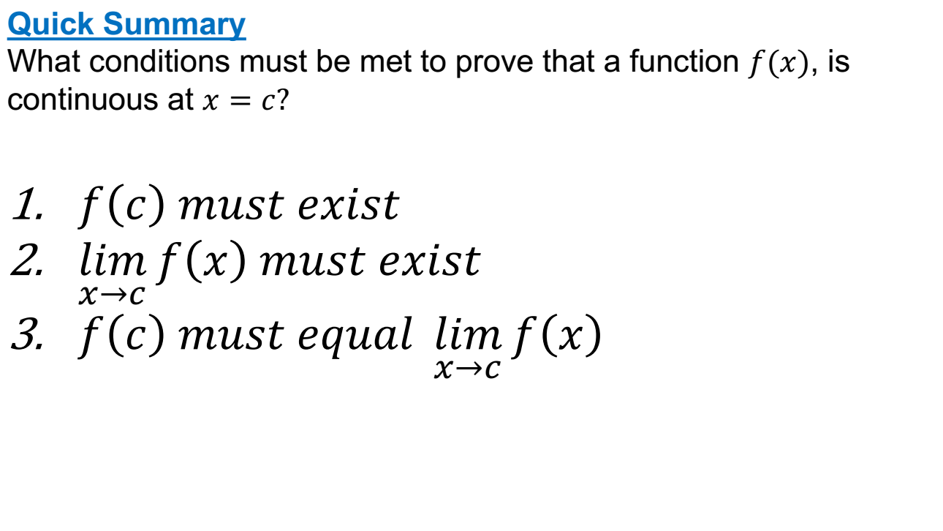

Slide 12
Next-> What Will We Learn?
We’ll use graphical and analytical representations of functions to determine whether or not functions are continuous at specific points.

Slide 13
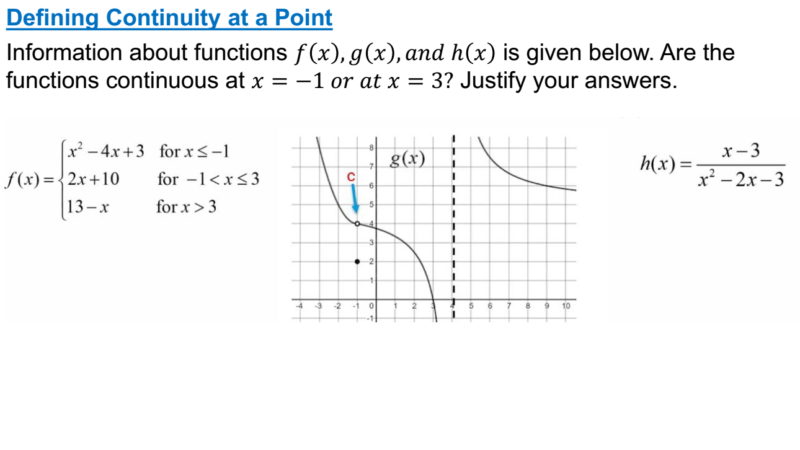

Slide 14
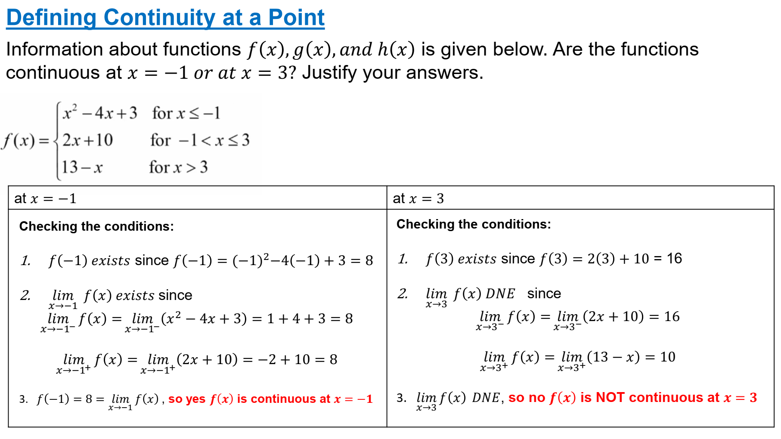

Slide 15
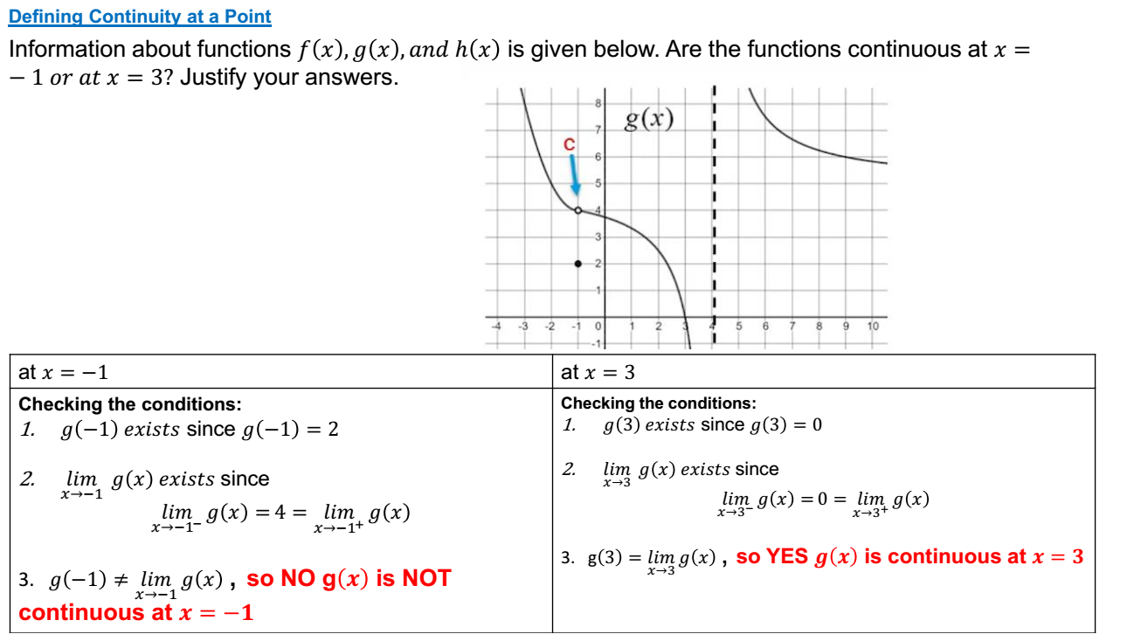

Slide 16
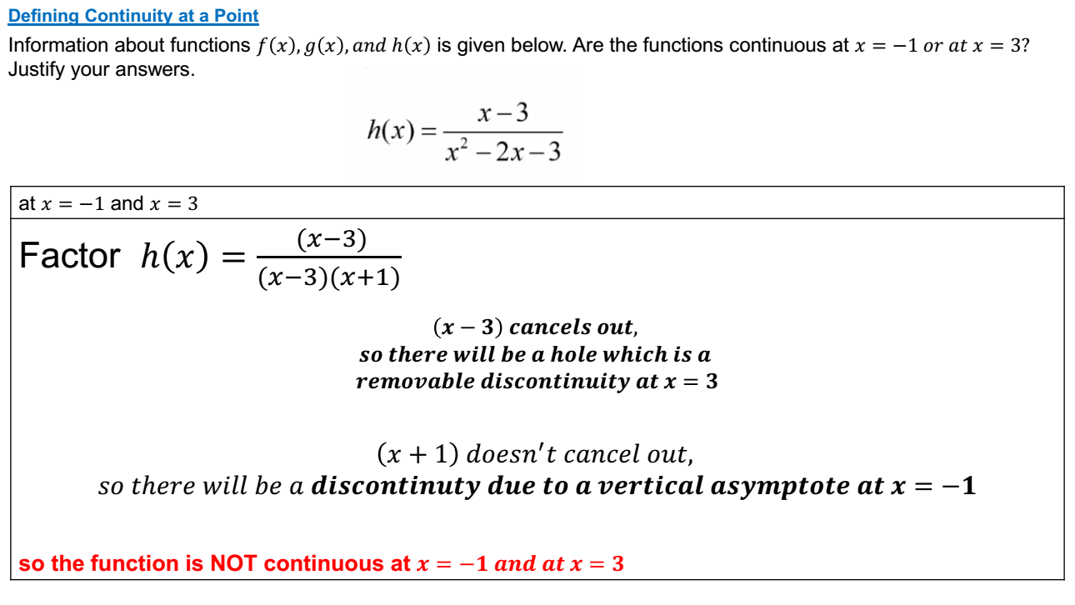

Slide 17
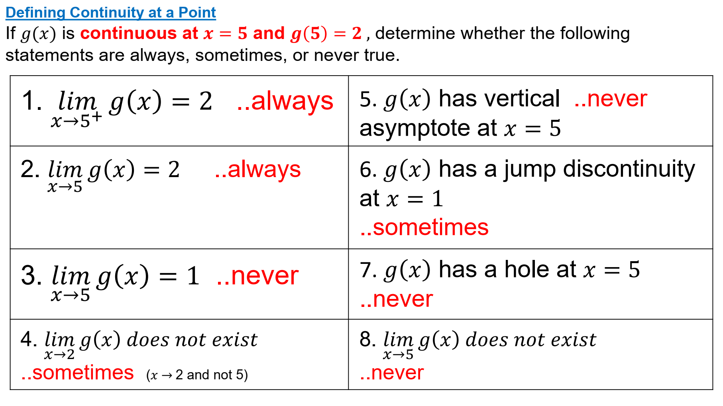

Slide 18
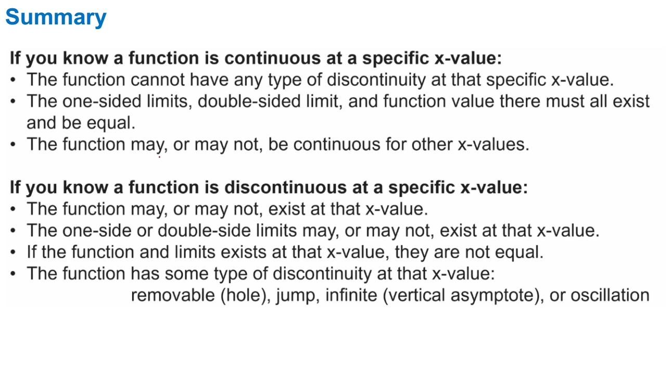

Slide 19
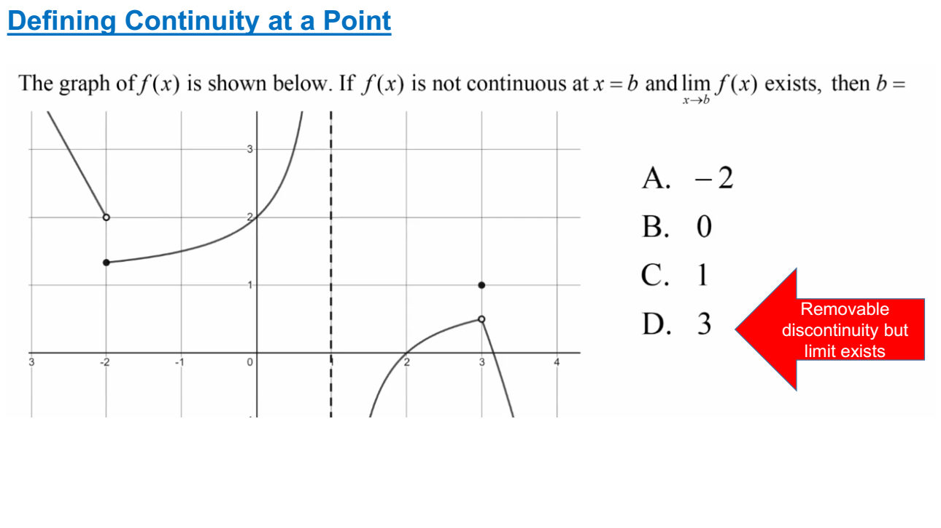

Slide 20
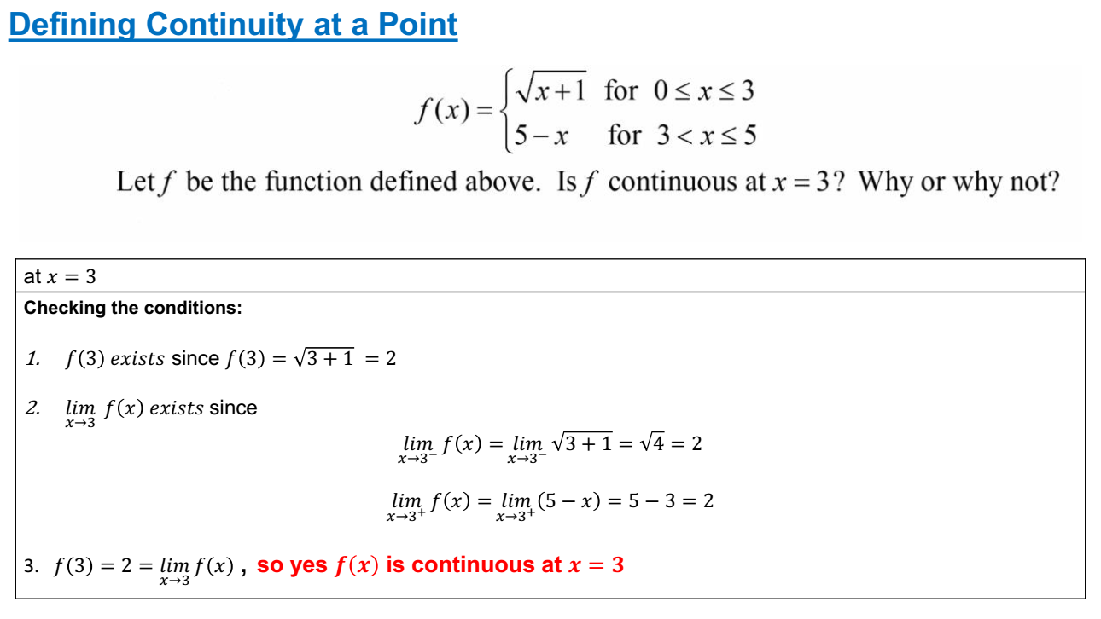

Slide 21
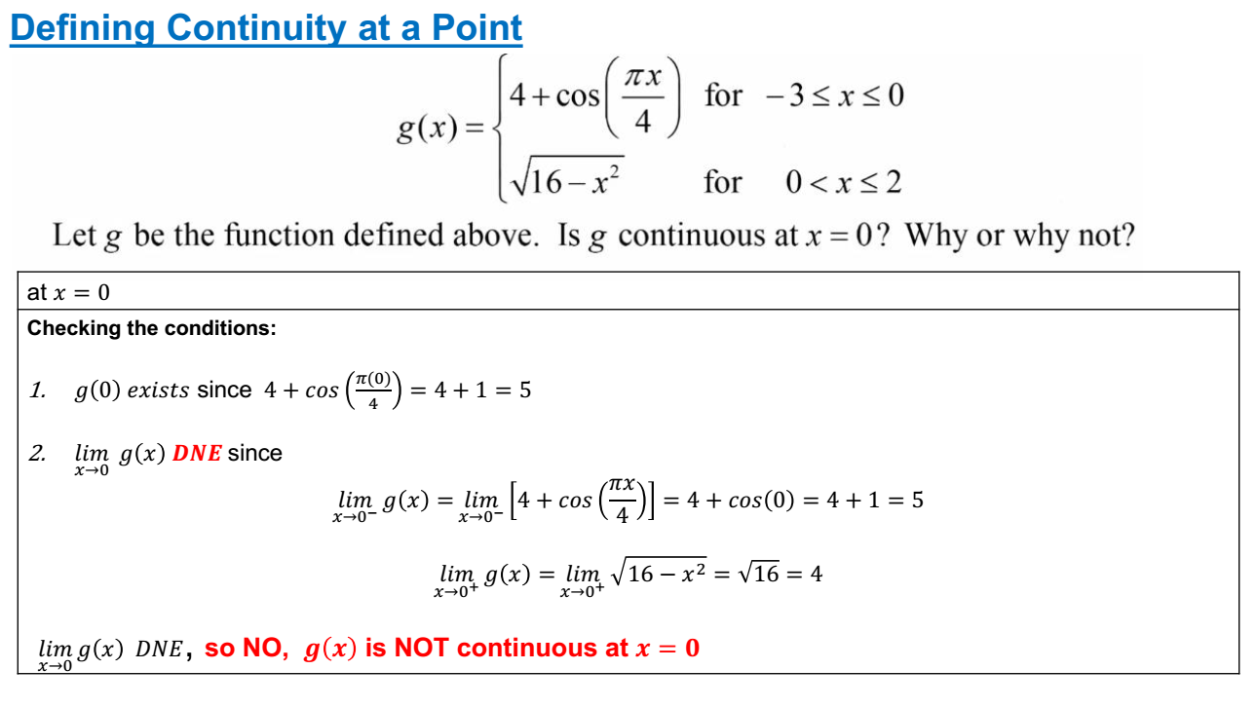

Slide 22
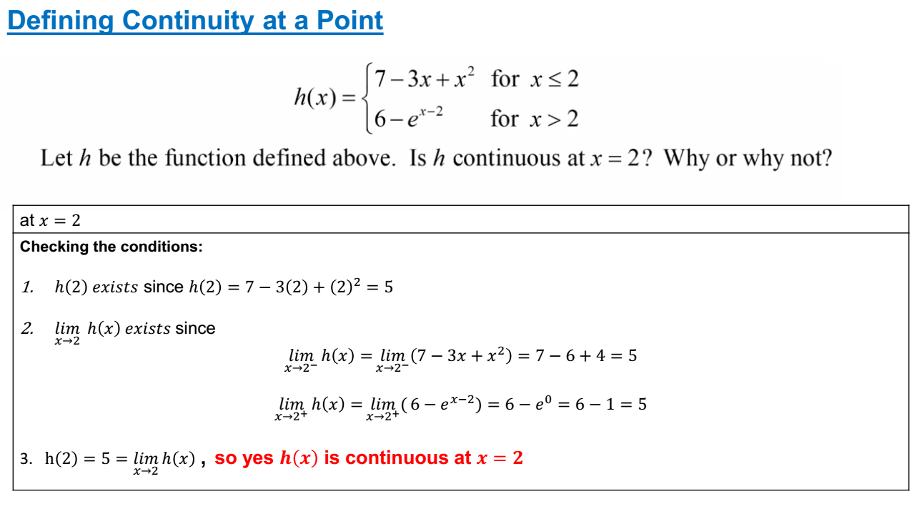

Slide 23
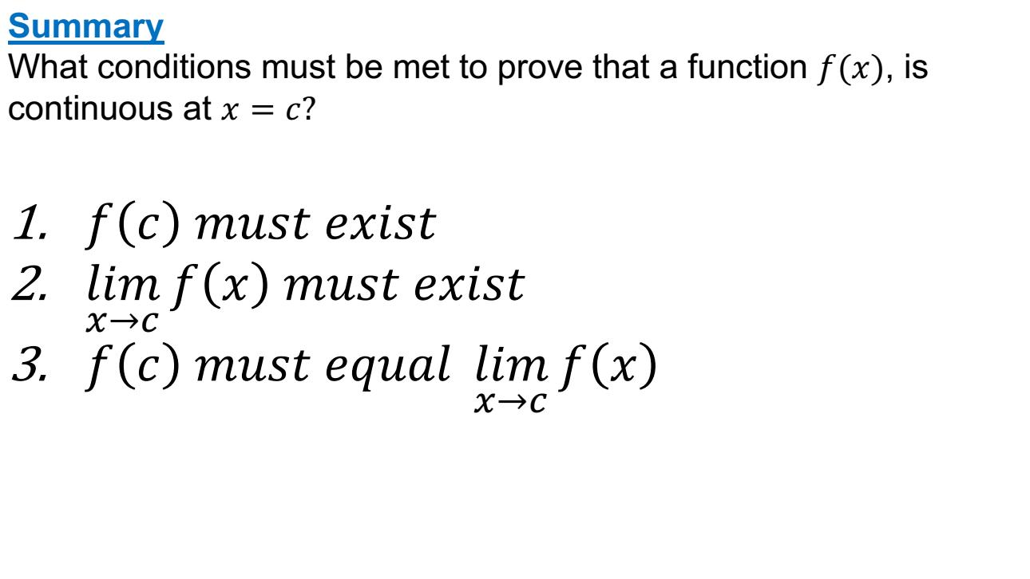

Slide 24
TRUE OR FALSE
A function f is continuous at x=a if f(a) is defined.
FALSE

Slide 25
TRUE OR FALSE
Removable discontinuities occur when a limit exists but the function value is different or undefined.
TRUE

Slide 26
TRUE OR FALSE
All functions with no breaks, holes, or jumps are continuous everywhere.
TRUE

