Slide 1
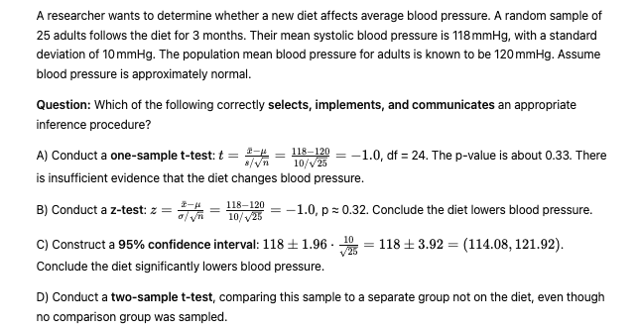
A

Slide 2
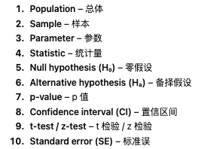

Slide 3
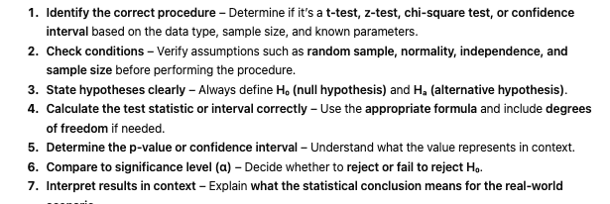

Slide 4
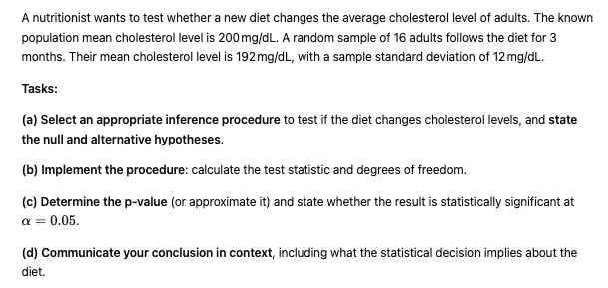

Slide 5
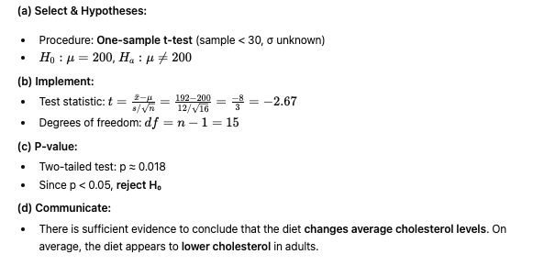

Slide 6
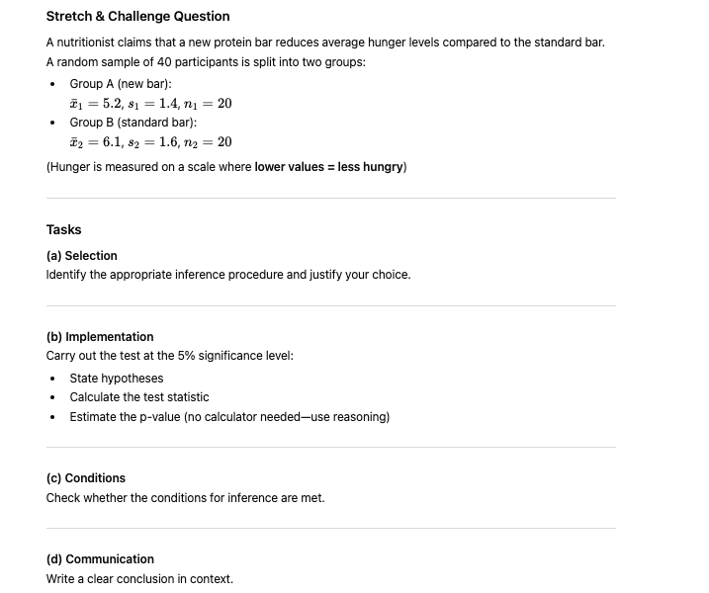

Slide 7
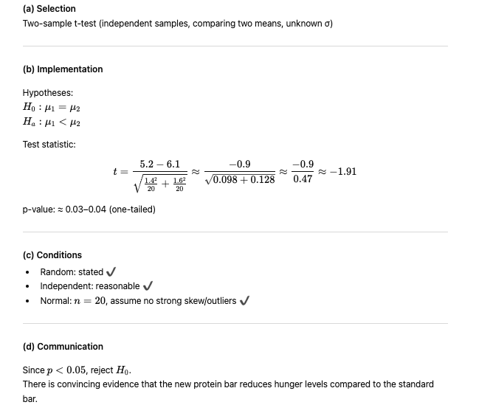

Slide 9
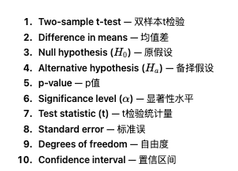
Two sample inference

Slide 10
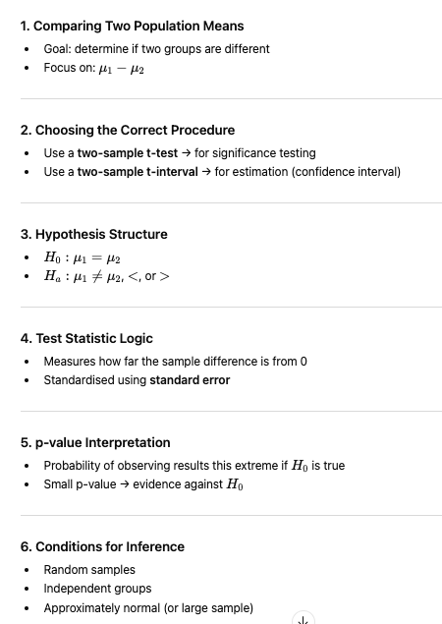

Slide 11
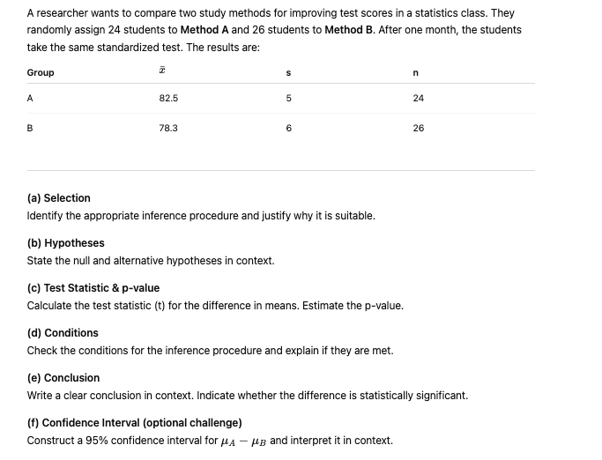

Slide 12
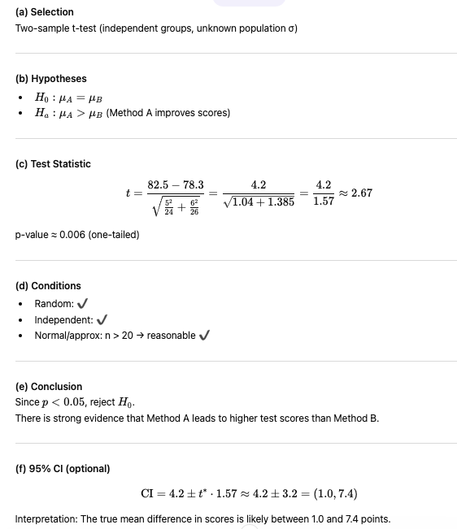

Slide 14
TRUE or FALSE
You should first identify whether the data come from an experiment or an observational study.
TRUE

Slide 15
TRUE or FALSE
The p-value is compared to the significance level to make a decision.
TRUE

Slide 16
TRUE or FALSE
The statistic is used to estimate a population parameter.
TRUE

