Slide 1
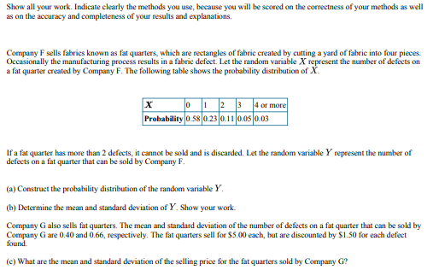

Slide 2
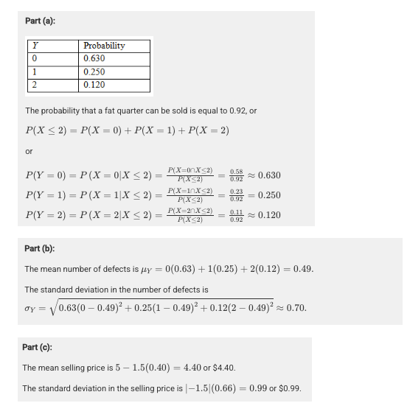

Slide 3
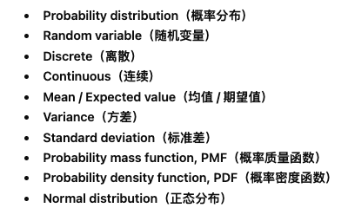
Probability Distributions

Slide 4
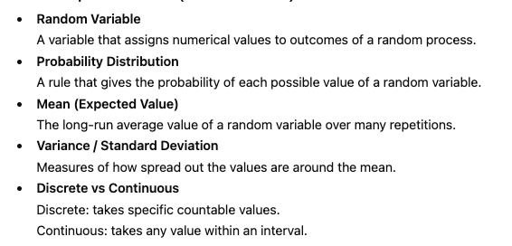

Slide 5
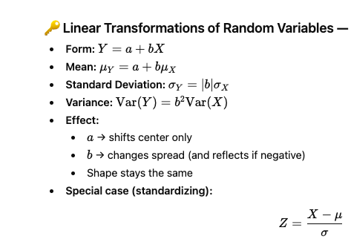

Slide 6
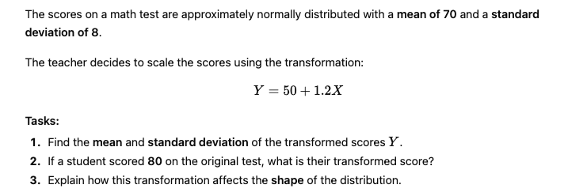
AP exam question

Slide 7
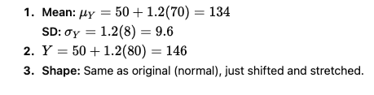

Slide 8
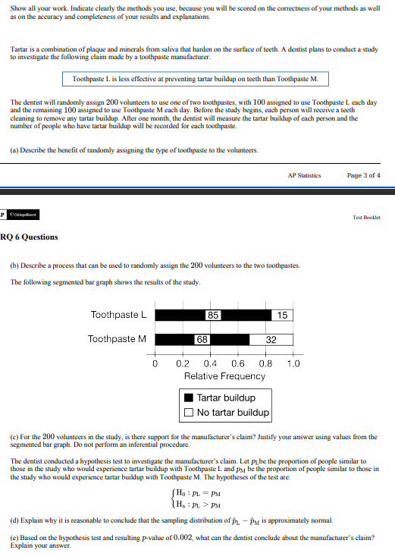

Slide 11
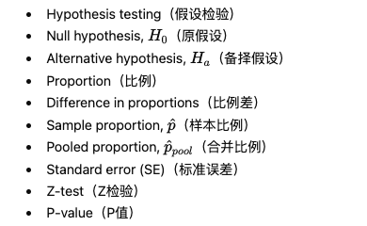

Slide 12
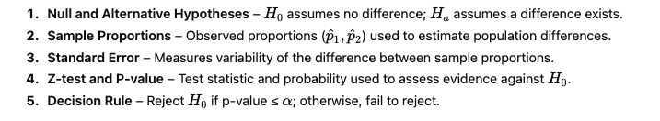

Slide 13
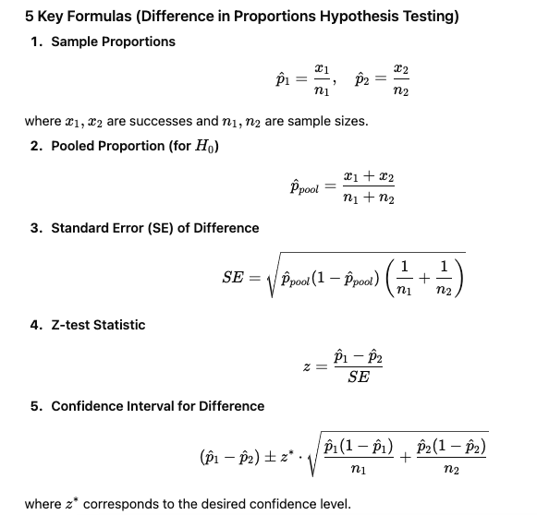

Slide 14
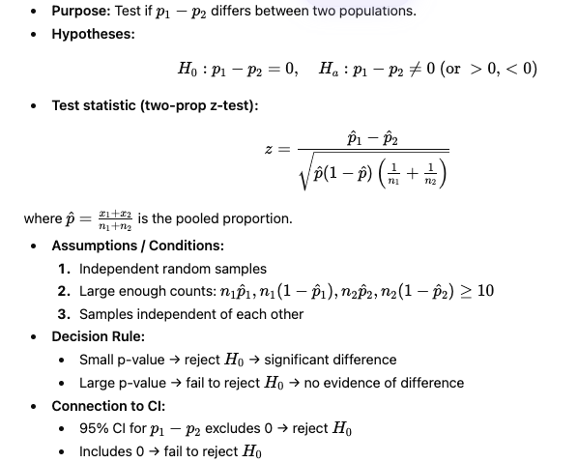

Slide 15
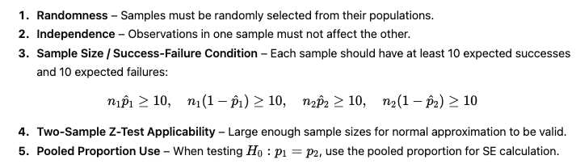
Key Criteria

Slide 16
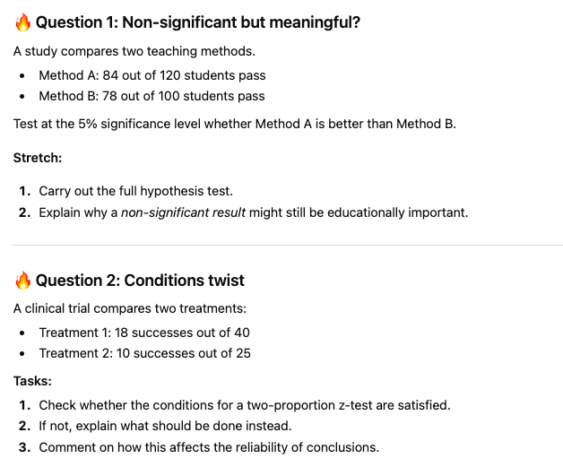
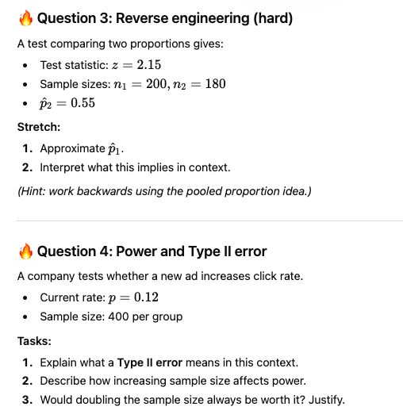

Slide 17
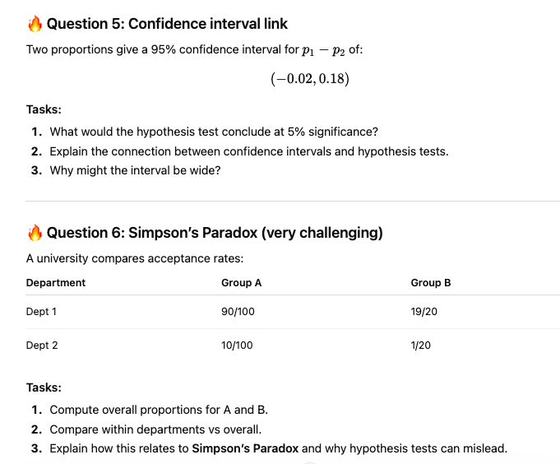

Slide 18
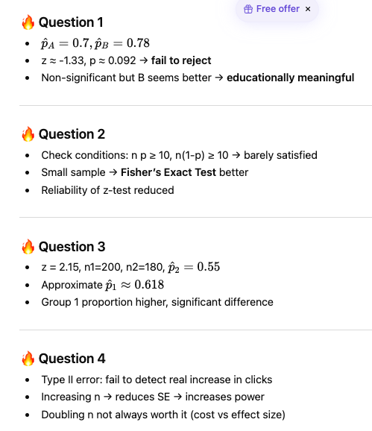
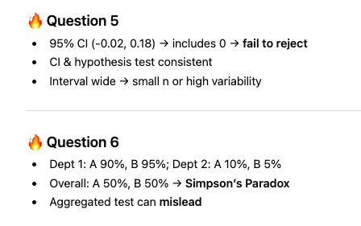

Slide 19

TRUE or FALSE
A researcher conducts a two-proportion z-test to compare the pass rates of two teaching methods. She uses independent random samples of 50 students each. The z-test assumes that the counts of successes and failures in both groups are at least 10.
Statement:
“If the sample sizes were smaller, but the proportions of successes were the same, the z-test would still be valid.”

Slide 20

TRUE or FALSE
A clinical trial compares two treatments with independent random samples. The null hypothesis is H0:p1−p2=0.
Statement:
“A p-value of 0.03 means there is a 3% chance that the null hypothesis is true.”

Slide 21
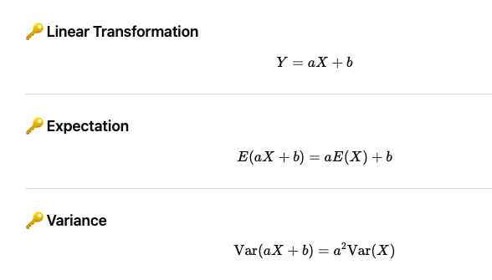
Key Formula

Slide 22
