Slide 1
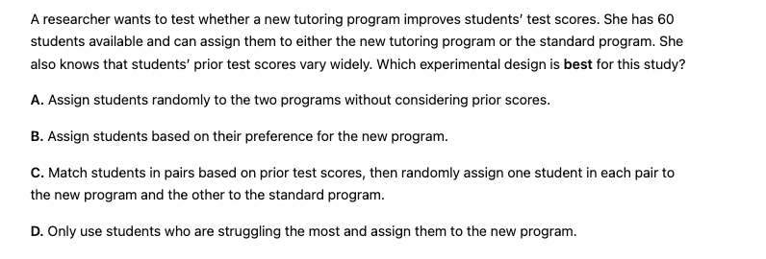
Selecting an Experimental Design

Slide 2
Selecting an Experimental Design
C

Slide 3
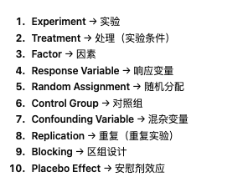

Slide 4
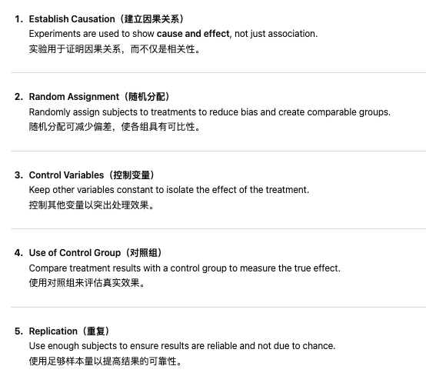

Slide 9
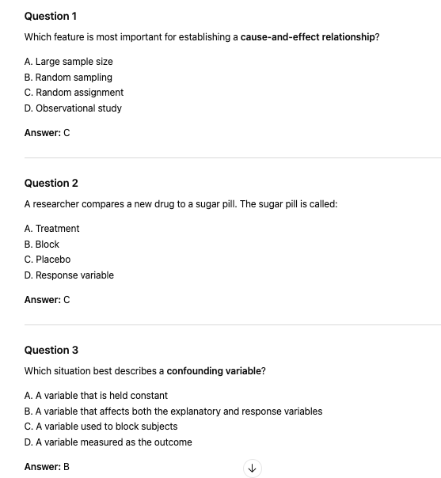

Slide 12
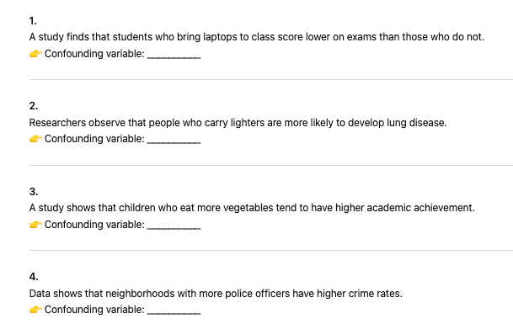
What is the cofounding variable

Slide 13
What is the cofounding variable
Student motivation / prior ability
Smoking
Family background/parental education/income
Population density/urbanisation

Slide 15
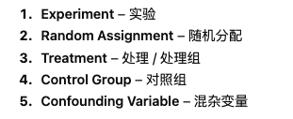
Selecting an Experiment Design

Slide 16
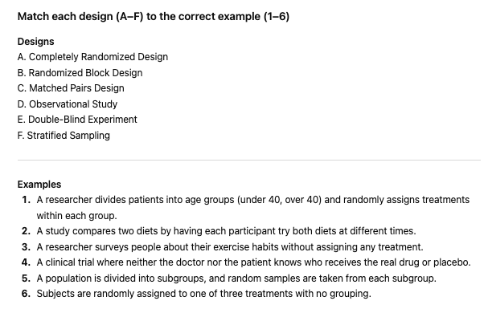
Matching Exercise

Slide 17
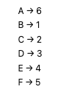
Matching Exercise

Slide 18
Clearly define the response variable and treatments.
Use random assignment to assign experimental units to treatments.
Choose a design that controls for confounding variables.
Decide whether to use completely randomized, randomized block, or matched pairs designs.
Ensure sufficient replication to allow meaningful comparisons.

Slide 19
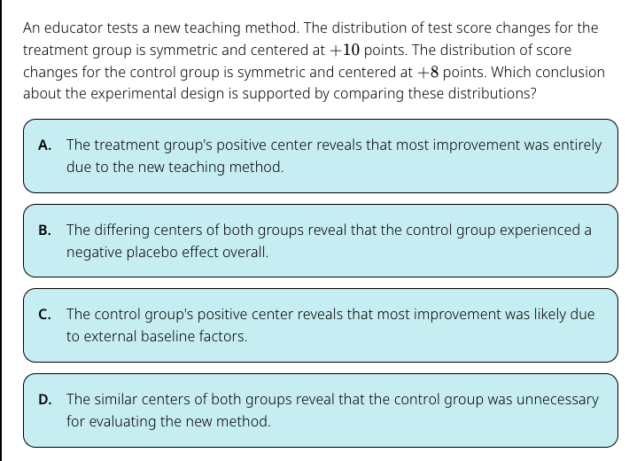
C

Slide 20
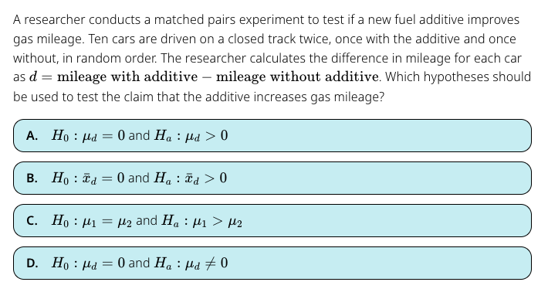
A

Slide 21
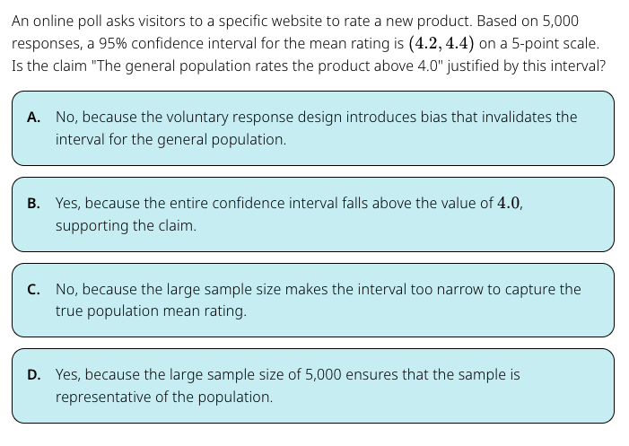
A

Slide 22
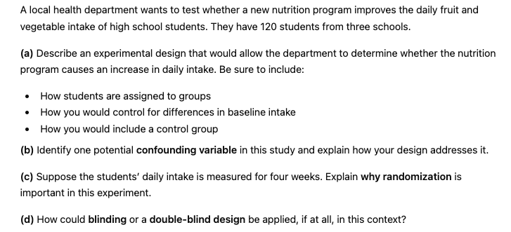

Slide 23
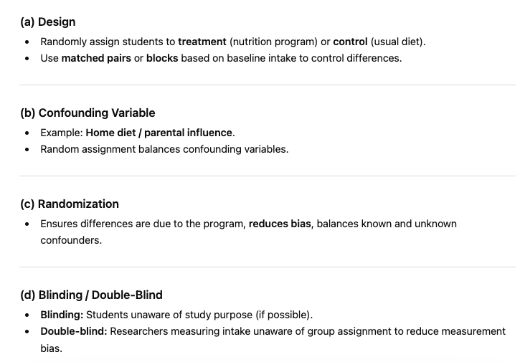

Slide 24
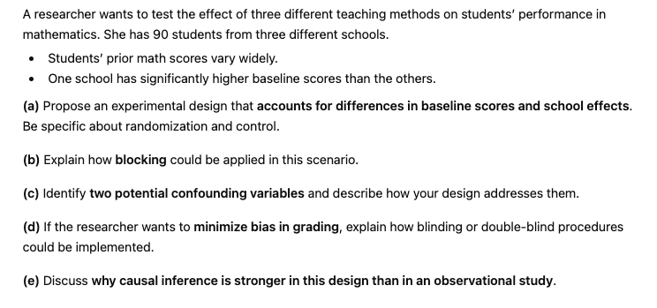
Stretch and Challenge

Slide 25
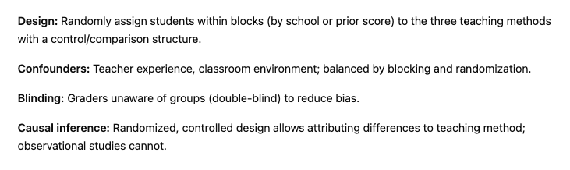

Slide 26
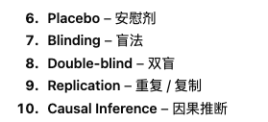
Experiments and Causal Influence

Slide 27
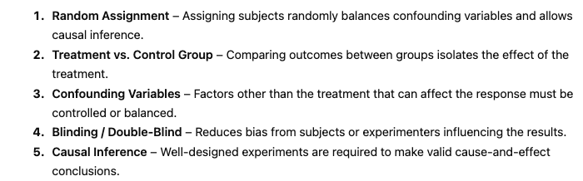

Slide 28
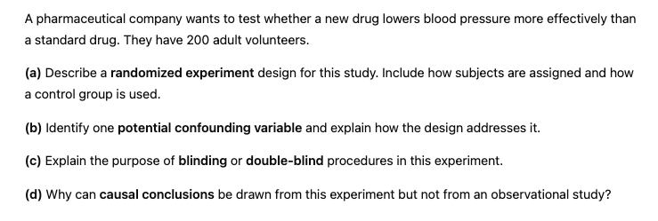

Slide 29
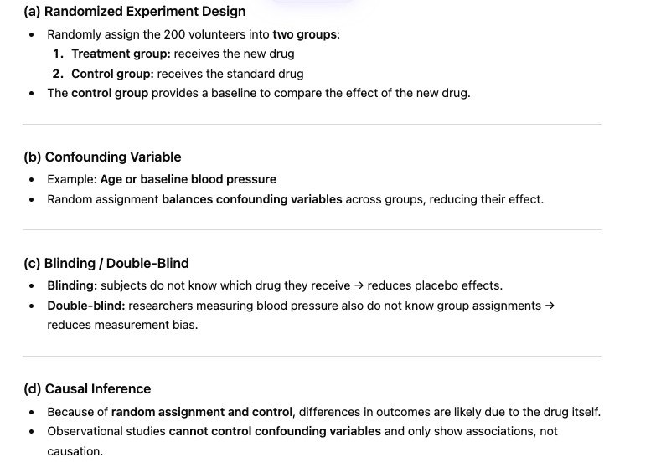

Slide 30
True or False
A completely randomized experiment with a large sample always eliminates the effects of confounding variables.
False -randomization reduces, but doesn’t always eliminate, confounding

Slide 31
True or False
Blocking is only useful in experiments with a very small sample size.
False -blocking is useful in any experiment to reduce variability

Slide 32
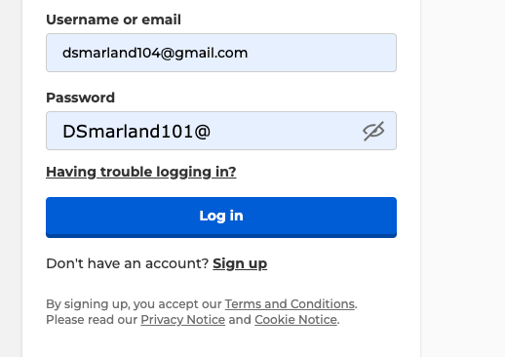
https://create.kahoot.it/auth/login

