Slide 1
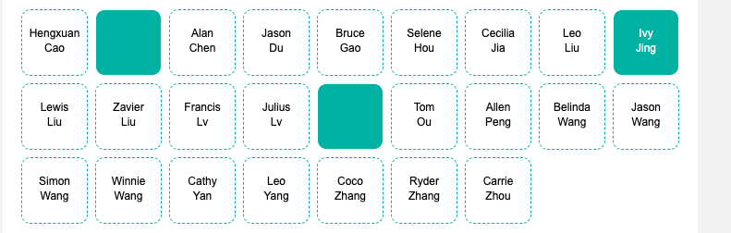

Slide 2

IGCSE Factorisation
Dr J Frost (jfrost@tiffin.kingston.sch.uk)
Objectives: (from the specification)
Last modified: 22nd August 2015

Slide 3
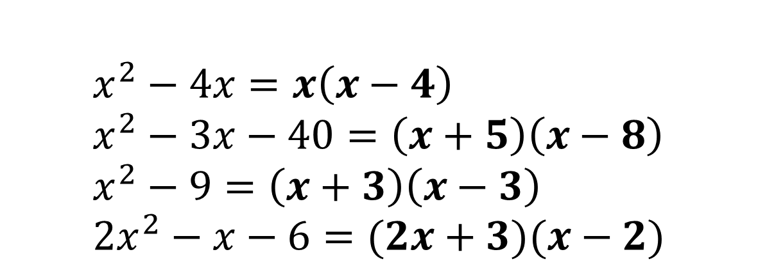
RECAP
$$x^{2}−4x=x\left(x−4\right) \\ x^{2}−3x−40=\left(x+5\right)\left(x−8\right) \\ x^{2}−9=\left(x+3\right)\left(x−3\right) \\ 2x^{2}−x−6=(2x+3)(x−2)$$
?
?
?
?

Slide 4
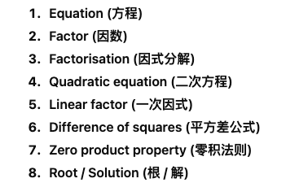

Slide 5
What makes this topic Further Maths-ey?
#2: Sometimes require ‘intelligent guessing’ of brackets.
#1: Sometimes require multiple factorisation steps (e.g. combo of common factor/difference of two squares)
#3: Sometimes require ‘refactorisation’ of expressions not fully expanded.

Slide 6
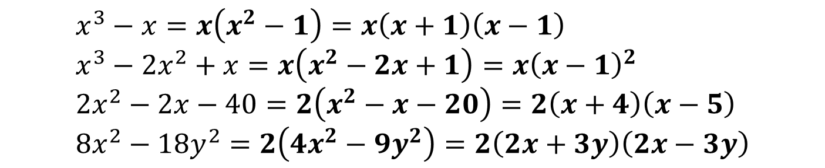
#1 :: Multi-step factorisations
1
Factorising out single term: $x^{2}+2xy→x(x+2y)$
2
Simple quadratic factorisation: $x^{2}+3x+2→\left(x+2\right)\left(x+1\right)$
3
Difference Of Two Squares: $9x^{2}−4y^{2}=\left(3x+2y\right)\left(3x−2y\right)$
4
Splitting Middle Term: ${2x}^{2}−3x+2→\left(2x+1\right)\left(x−2\right)$
5
Pairwise: $x^{4}−x^{3}+x−1→\left(x^{3}+1\right)\left(x−1\right)$
Sometimes we can apply multiple types of factorisation. Which do you think we can use for the following?
?
$$x^{3}−x=x\left(x^{2}−1\right)=x\left(x+1\right)\left(x−1\right) \\ x^{3}−2x^{2}+x=x\left(x^{2}−2x+1\right)=x{\left(x−1\right)}^{2} \\ 2x^{2}−2x−40=2\left(x^{2}−x−20\right)=2\left(x+4\right)\left(x−5\right) \\ 8x^{2}−18y^{2}=2\left(4x^{2}−9y^{2}\right)=2\left(2x+3y\right)\left(2x−3y\right)$$
?
?
?
Bro Tip: Always check first whether there’s a common term.

Slide 7
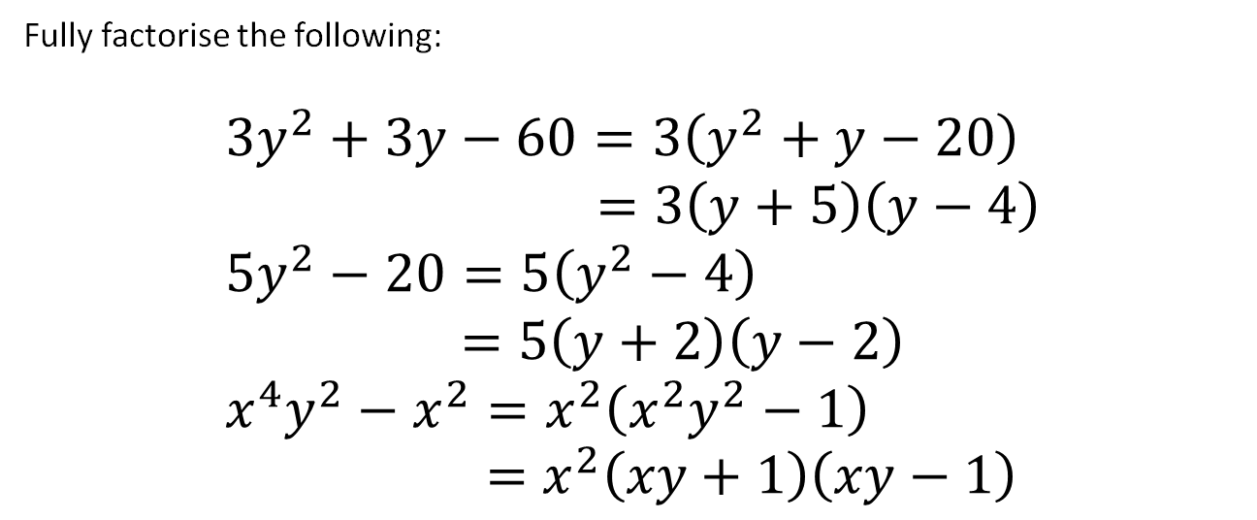
Test Your Understanding
Fully factorise the following:
$$3y^{2}+3y−60=3\left(y^{2}+y−20\right) \\ =3\left(y+5\right)\left(y−4\right) \\ 5y^{2}−20=5\left(y^{2}−4\right) \\ =5\left(y+2\right)\left(y−2\right) \\ x^{4}y^{2}−x^{2}=x^{2}\left(x^{2}y^{2}−1\right) \\ =x^{2}\left(xy+1\right)\left(xy−1\right)$$
?
?
?

Slide 8
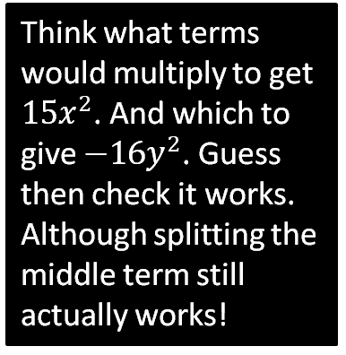
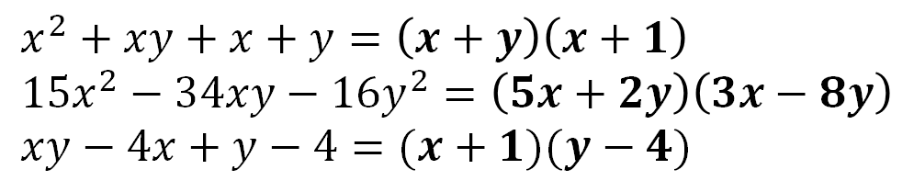
#2 :: ‘Intelligent Guessing’
(or as I sometimes call it, ‘Going Commando’)
Sometimes your best bet is just simply ‘guessing’ the brackets, by considering what terms you’d get in your expansion.
$$x^{2}+xy+x+y=\left(x+y\right)\left(x+1\right) \\ 15x^{2}−34xy−16y^{2}=\left(5x+2y\right)\left(3x−8y\right) \\ xy−4x+y−4=(x+1)(y−4)$$
?
?
Think what terms would multiply to get $15x^{2}$. And which to give $−16y^{2}$. Guess then check it works.
Although splitting the middle term still actually works!
?

Slide 9
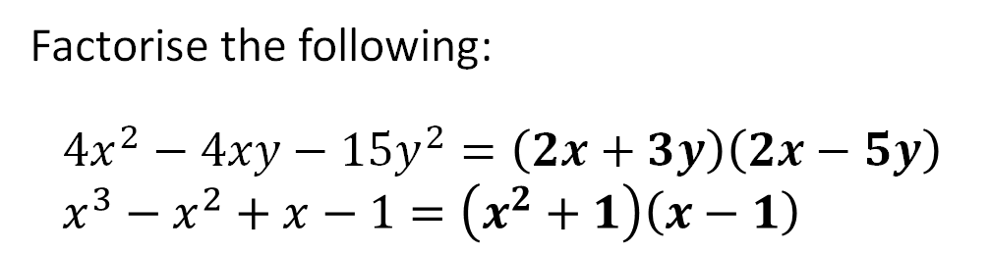
Test Your Understanding
Factorise the following:
$$4x^{2}−4xy−15y^{2}=\left(2x+3y\right)\left(2x−5y\right) \\ x^{3}−x^{2}+x−1=\left(x^{2}+1\right)\left(x−1\right)$$
?
?

Slide 10
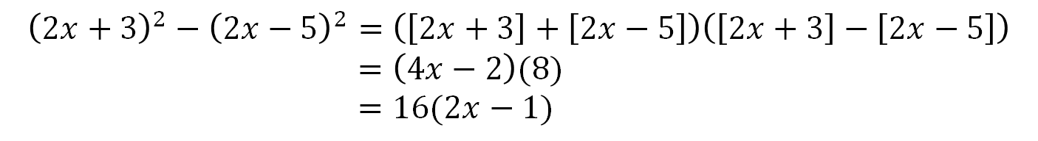
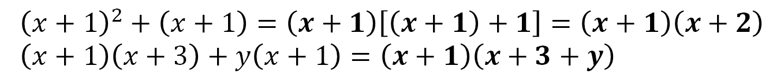
#3 :: ‘Refactorising’
Sometimes parts of the expressions are factorised in some way.
This may require us to expand everything out and factorise from scratch, but sometimes we can factorise more easily without expanding.
Just identify a common term to factor out:
?
$${\left(x+1\right)}^{2}+\left(x+1\right)=\left(x+1\right)\left[\left(x+1\right)+1\right]=\left(x+1\right)\left(x+2\right) \\ \left(x+1\right)\left(x+3\right)+y\left(x+1\right)=\left(x+1\right)\left(x+3+y\right)$$
?
We may have the difference of two squares:
?
$${\left(2x+3\right)}^{2}−{\left(2x−5\right)}^{2}=\left(\left[2x+3\right]+\left[2x−5\right]\right)\left(\left[2x+3\right]−\left[2x−5\right]\right) \\ =\left(4x−2\right)(8) \\ =16(2x−1)$$
(Although some students might feel more comfortable just expanding that one out first)

Slide 11
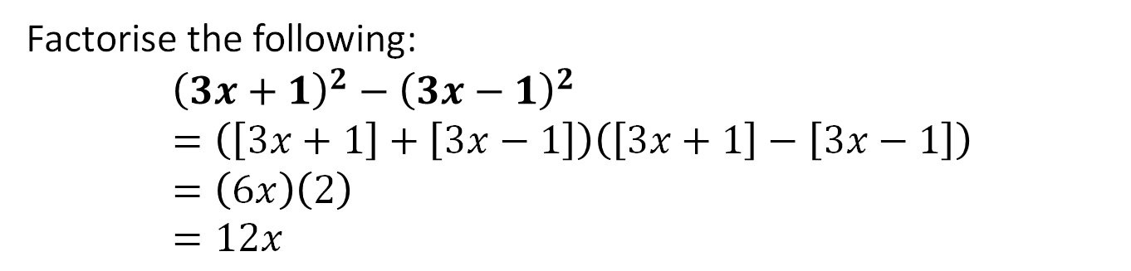

Test Your Understanding
[June 2012 Paper 1] Factorise the following:
$${\left(x+y\right)}^{2}+\left(x+y\right)\left(2x+5y\right) \\ =\left(x+y\right)\left(x+y+2x+5y\right) \\ =\left(x+y\right)\left(3x+6y\right) \\ =3(x+y)(x+2y)$$
?
Factorise the following:
$${\left(3x+1\right)}^{2}−{\left(3x−1\right)}^{2} \\ =\left(\left[3x+1\right]+\left[3x−1\right]\right)\left(\left[3x+1\right]−\left[3x−1\right]\right) \\ =\left(6x\right)\left(2\right) \\ =12x$$
?

Slide 12
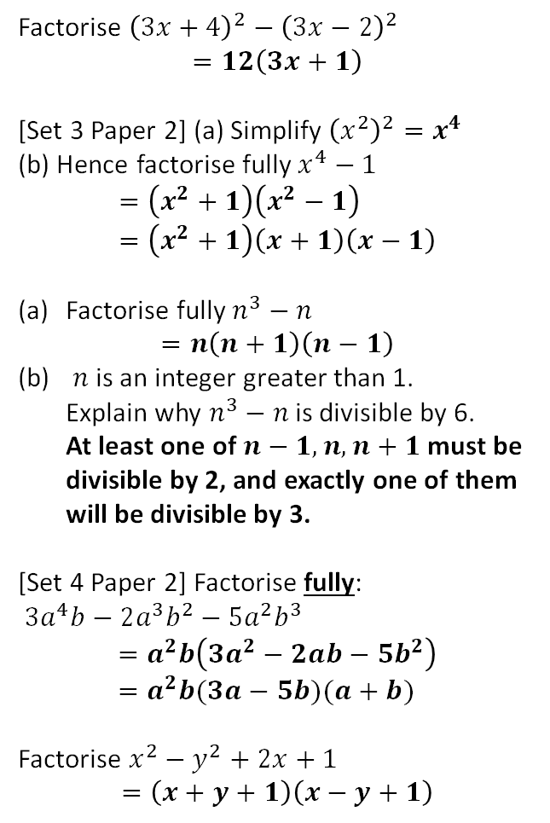
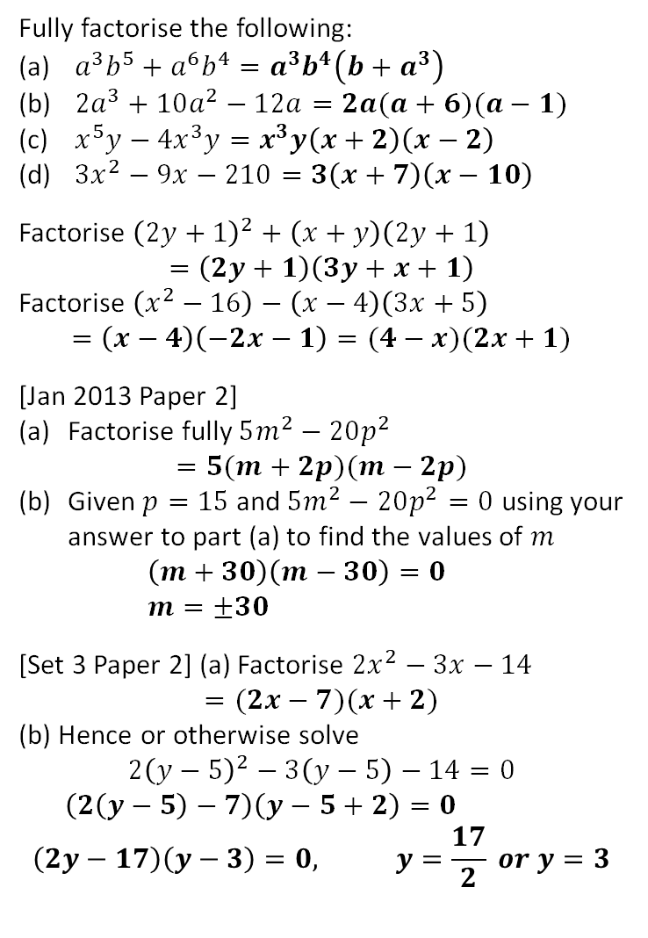
Exercises
1
Fully factorise the following:
$a^{3}b^{5}+a^{6}b^{4}=a^{3}b^{4}\left(b+a^{3}\right)$
$2a^{3}+10a^{2}−12a=2a(a+6)(a−1)$
$x^{5}y−4x^{3}y=x^{3}y\left(x+2\right)\left(x−2\right)$
$3x^{2}−9x−210=3\left(x+7\right)\left(x−10\right)$
Factorise ${\left(2y+1\right)}^{2}+\left(x+y\right)\left(2y+1\right)$
$$=\left(2y+1\right)\left(3y+x+1\right)$$
Factorise $\left(x^{2}−16\right)−\left(x−4\right)\left(3x+5\right)$
$$=\left(x−4\right)\left(−2x−1\right)=(4−x)(2x+1)$$
[Jan 2013 Paper 2]
Factorise fully $5m^{2}−20p^{2}$
$=5(m+2p)(m−2p)$
Given $p=15$ and $5m^{2}−20p^{2}=0$ using your answer to part (a) to find the values of $m$
$\left(m+30\right)\left(m−30\right)=0$
$m=±30$
[Set 3 Paper 2] (a) Factorise $2x^{2}−3x−14$
$$=(2x−7)(x+2)$$
(b) Hence or otherwise solve
$$2{\left(y−5\right)}^{2}−3\left(y−5\right)−14=0$$
$\left(2\left(y−5\right)−7\right)\left(y−5+2\right)=0$
$$\left(2y−17\right)\left(y−3\right)=0, y=\frac{17}{2} or y=3$$
?
6
Factorise ${\left(3x+4\right)}^{2}−{\left(3x−2\right)}^{2}$
$$=12\left(3x+1\right)$$
[Set 3 Paper 2] (a) Simplify ${\left(x^{2}\right)}^{2}=x^{4}$
(b) Hence factorise fully $x^{4}−1$
$$=\left(x^{2}+1\right)\left(x^{2}−1\right) \\ =\left(x^{2}+1\right)\left(x+1\right)\left(x−1\right)$$
Factorise fully $n^{3}−n$
$=n\left(n+1\right)\left(n−1\right)$
$n$ is an integer greater than 1.
Explain why $n^{3}−n$ is divisible by 6.
At least one of $n−1,n,n+1$ must be divisible by 2, and exactly one of them will be divisible by 3.
[Set 4 Paper 2] Factorise fully:
$3a^{4}b−2a^{3}b^{2}−5a^{2}b^{3}$
$$=a^{2}b\left(3a^{2}−2ab−5b^{2}\right) \\ =a^{2}b(3a−5b)(a+b)$$
Factorise $x^{2}−y^{2}+2x+1$
$$=\left(x+y+1\right)\left(x−y+1\right)$$
?
?
?
7
?
?
2
?
?
3
?
8
4
?
?
?
?
9
5
?
?
?
N
?

