Slide 1
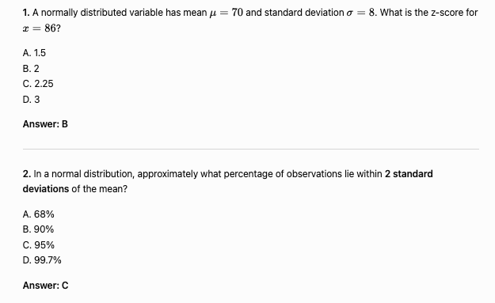
Normal Distribution

Slide 2
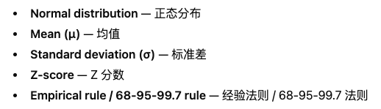

Slide 3
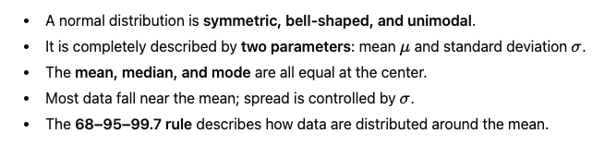

Slide 4
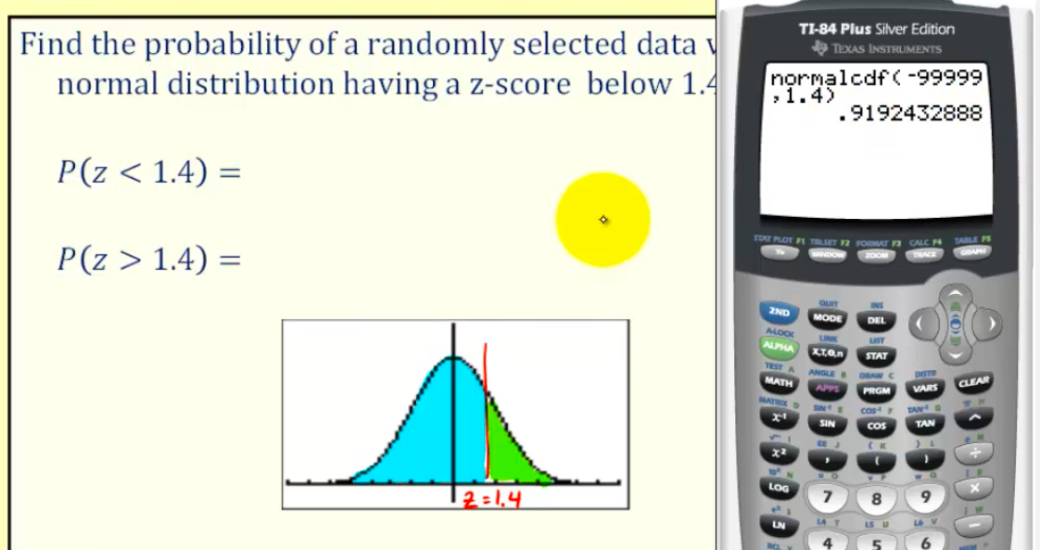
Finding the Probabilities

Slide 5
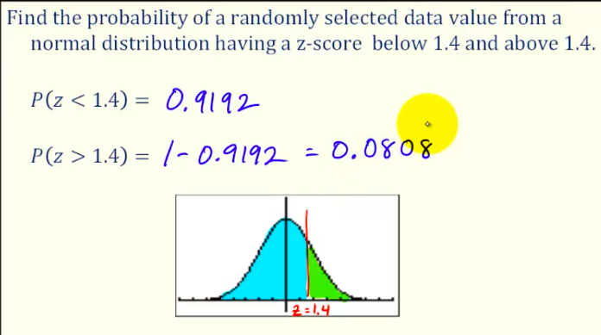

Slide 6
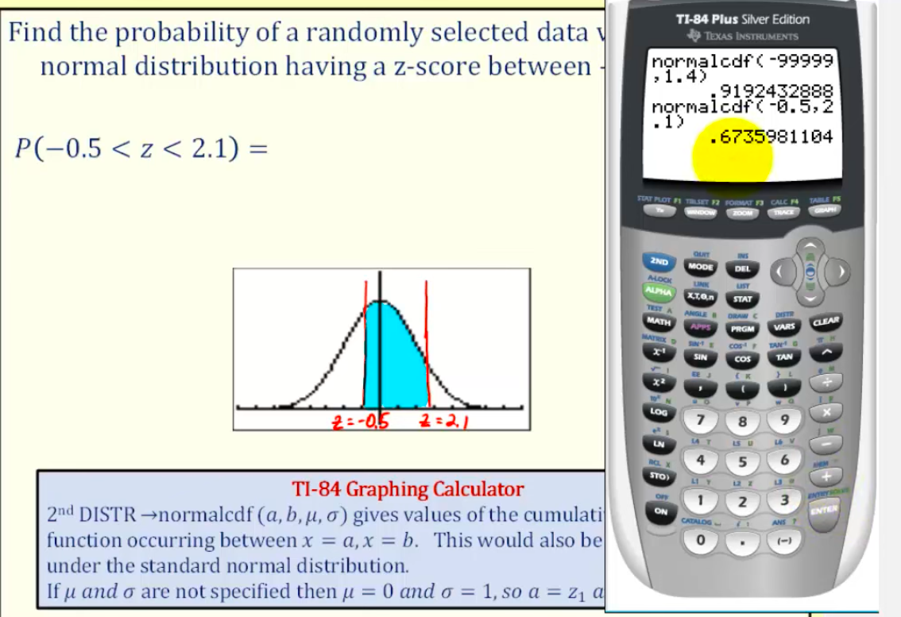

Slide 7
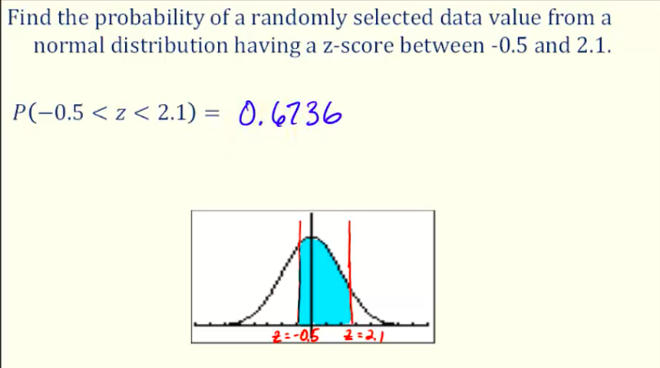

Slide 8
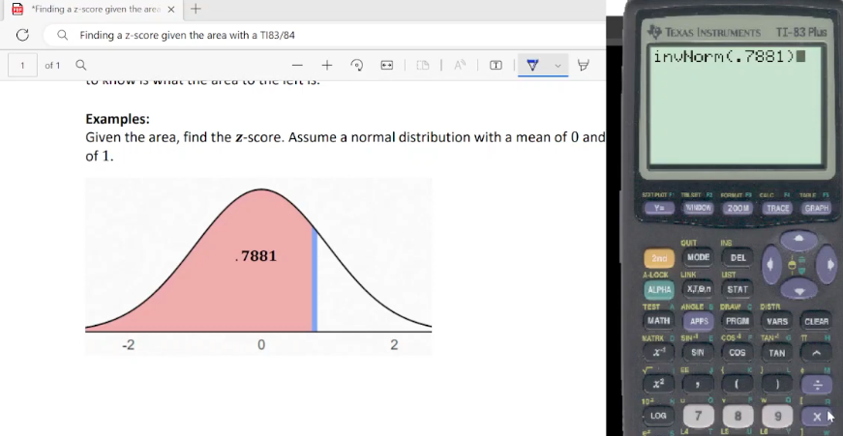

Slide 9
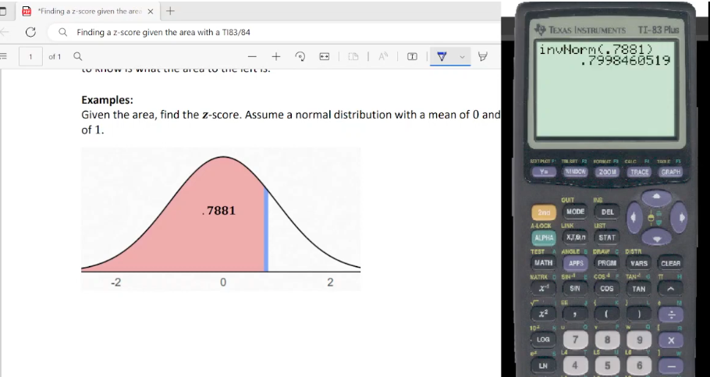

Slide 10
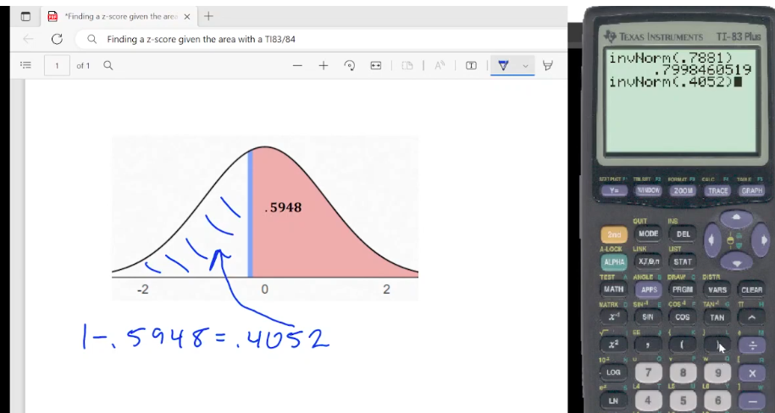

Slide 11
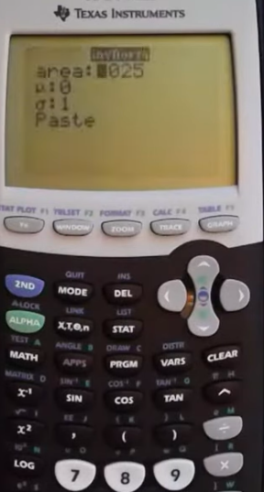

Slide 12
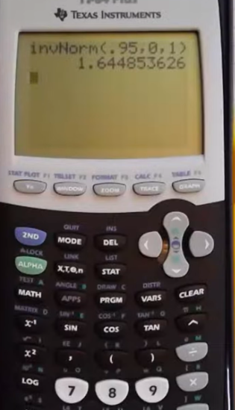

Slide 13
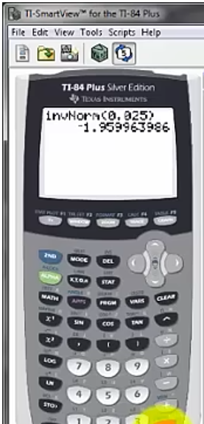
Finding the Z score

Slide 14
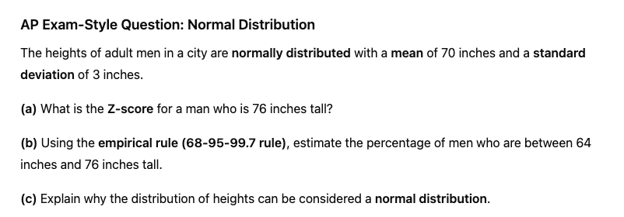

Slide 16
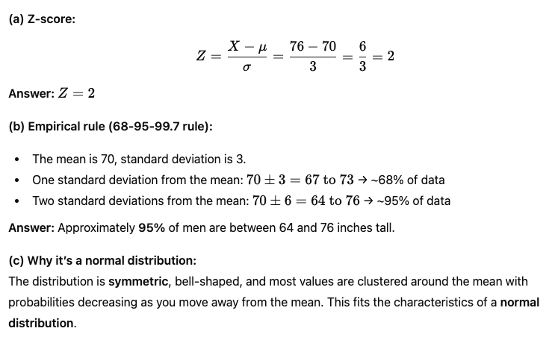

Slide 17
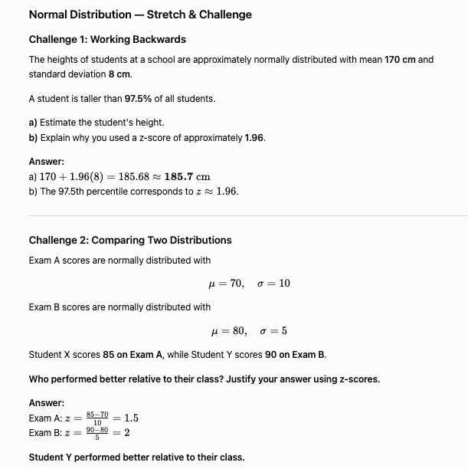
Stretch and Challenge Question

Slide 18
Stretch and Challenge Question

Slide 19
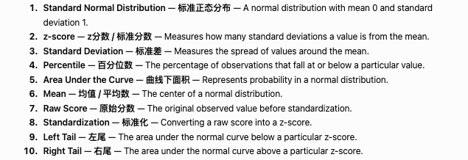

Slide 20
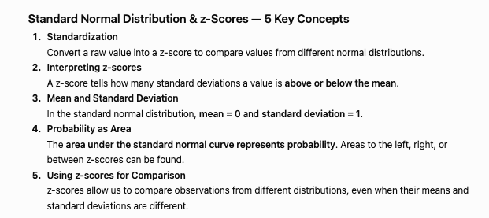

Slide 21
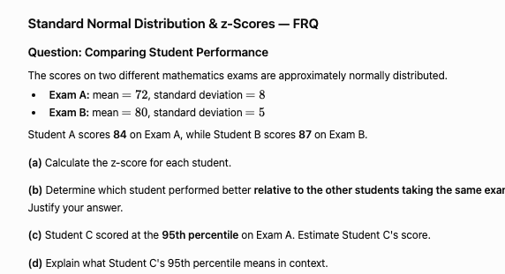

Slide 22
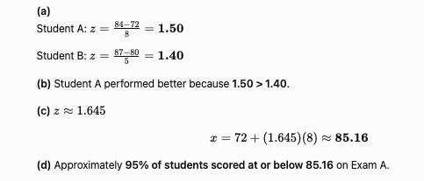

Slide 23
TRUE or FALSE
True or False: The standard normal distribution has a mean of 0 and a standard deviation of 1.

Slide 24
TRUE or FALSE
True or False: A z-score of 2 means the observation is 2 units above the mean.

Slide 25
TRUE or FALSE
True or False: A negative z-score indicates that the observation is below the mean.

