Slide 1
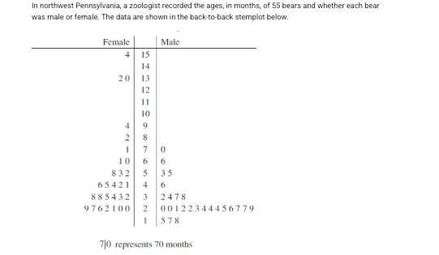

Slide 2
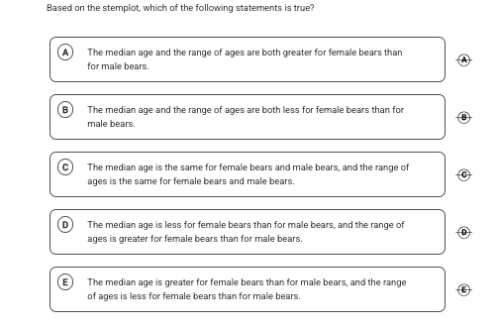
A

Slide 3
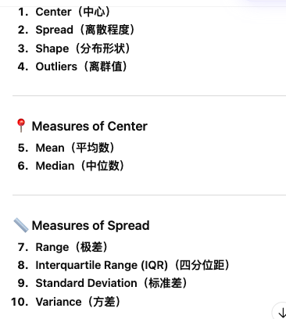
Comparing Distributions

Slide 4
Use graphs and numerical summaries to make comparisons.
Compare shape (including skewness and modality).
Compare center (mean or median) in context.
Compare spread (IQR or standard deviation).
Note outliers or unusual features and make conclusions in context.

Slide 5
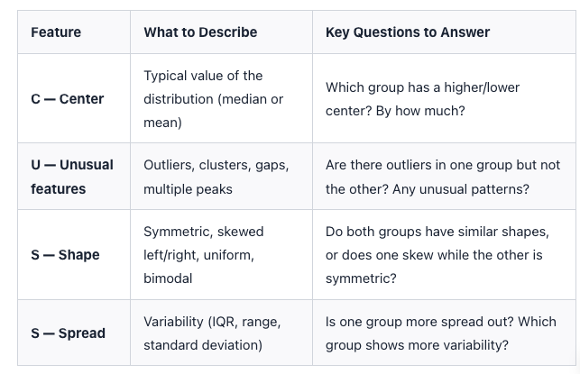

Slide 6
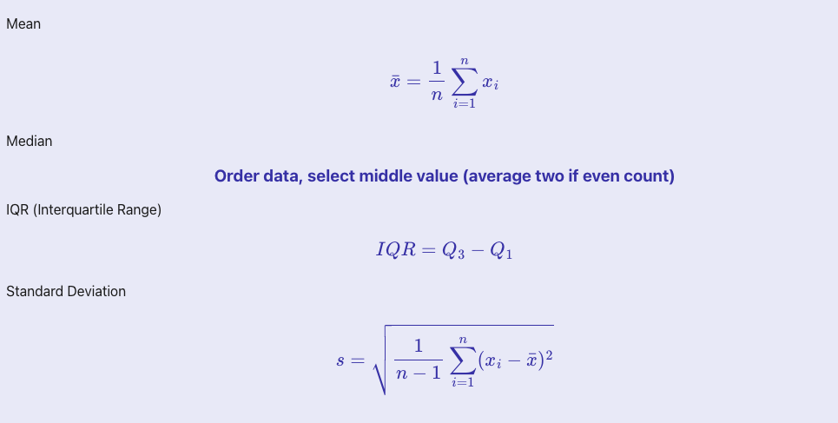

Slide 7
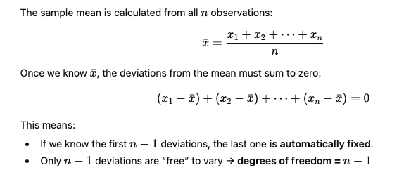
Degrees of freedom is n- 1

Slide 8
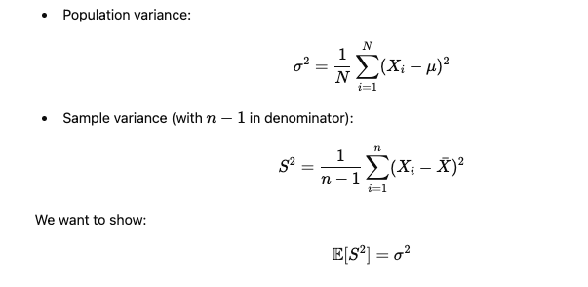

Slide 9
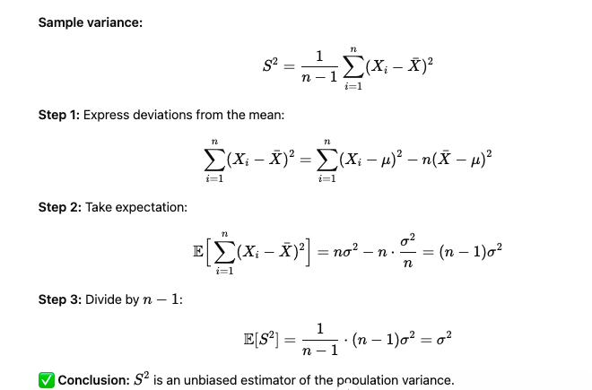

Slide 10
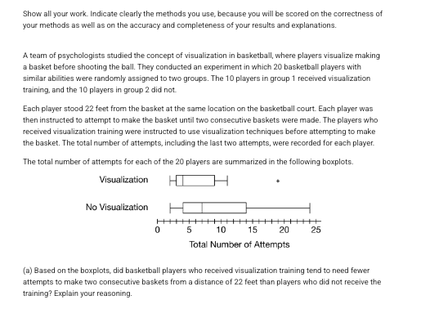

Slide 11


Slide 12
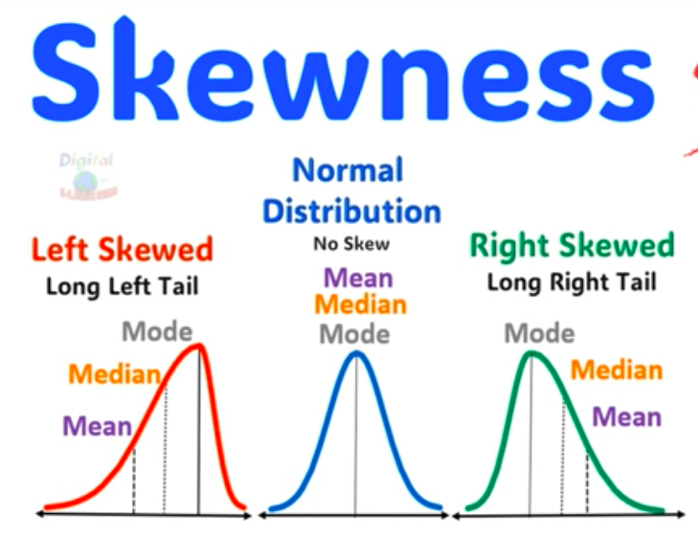

Slide 13
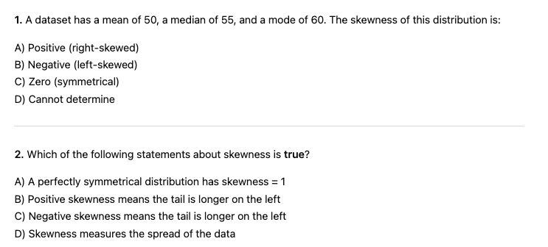
B
C

Slide 14
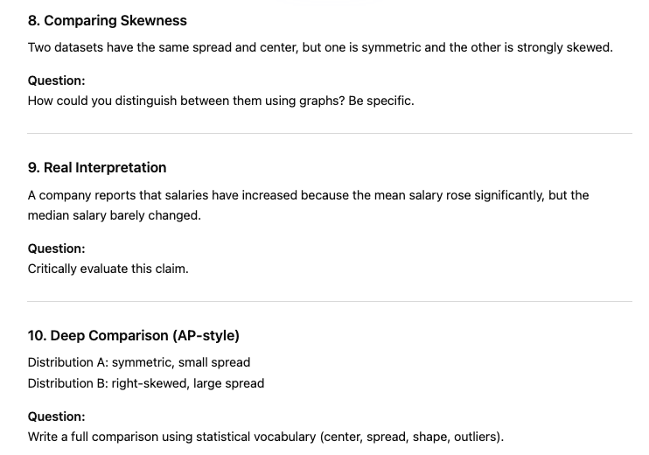
STRETCH and CHALLENGE

Slide 15
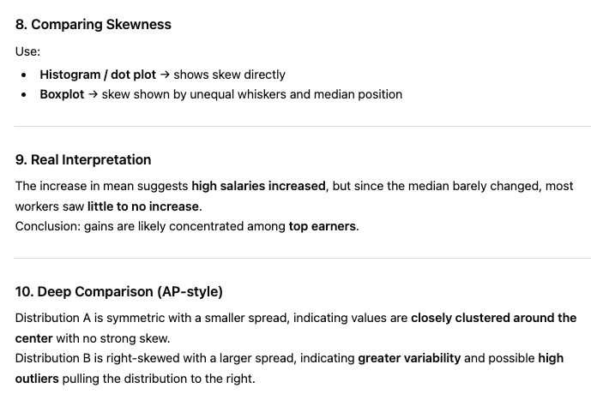

Slide 16
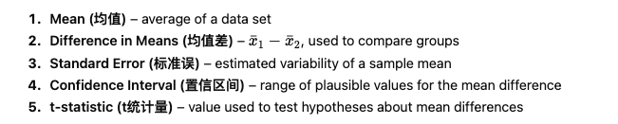
Comparing Two Means

Slide 17
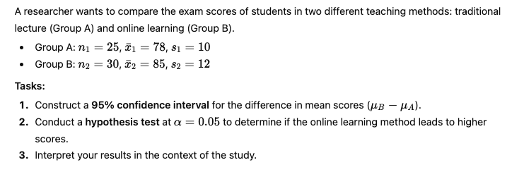

Slide 18
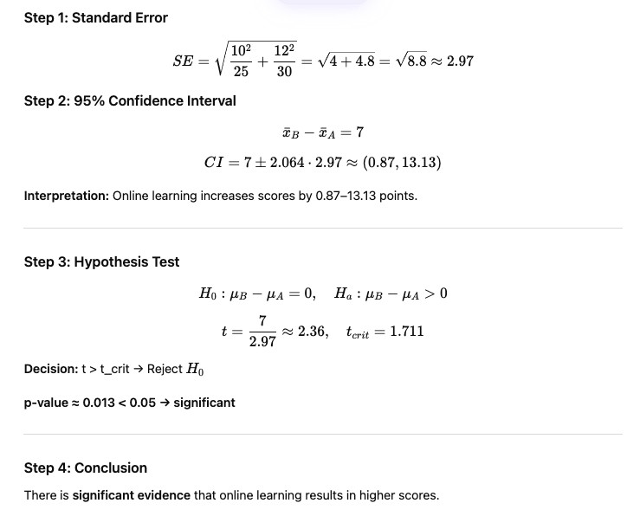

Slide 19
TRUE or False
FALSE

Slide 20
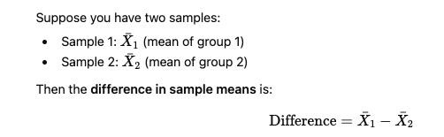
TRUE or False
TRUE

Slide 21
True or False
TRUE

