Slide 1
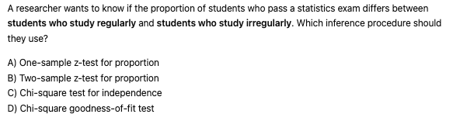
B

Slide 2
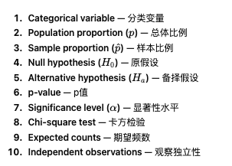

Slide 3
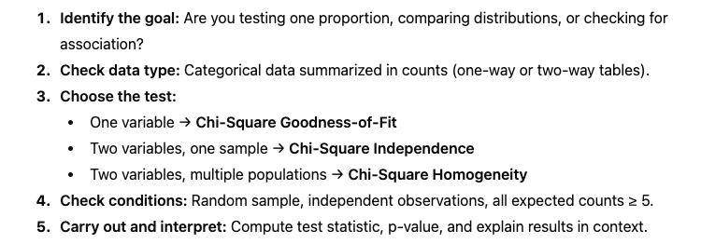

Slide 4
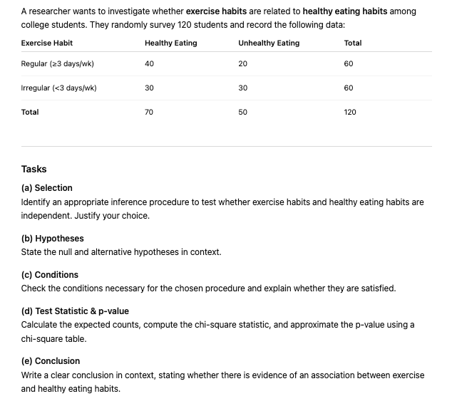

Slide 5
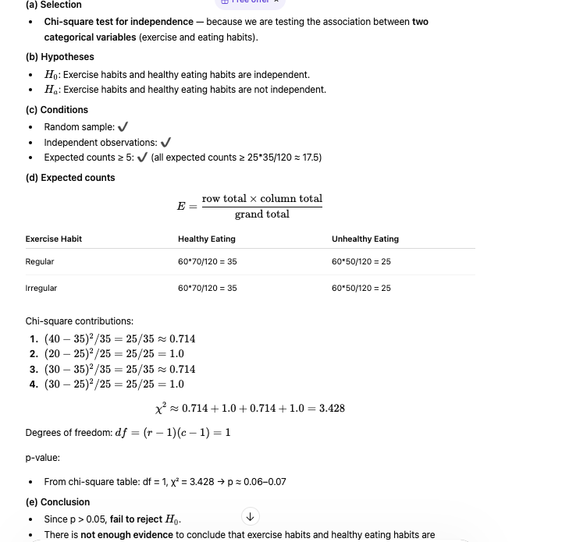

Slide 7
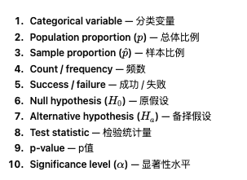
Proportion and Counts

Slide 8
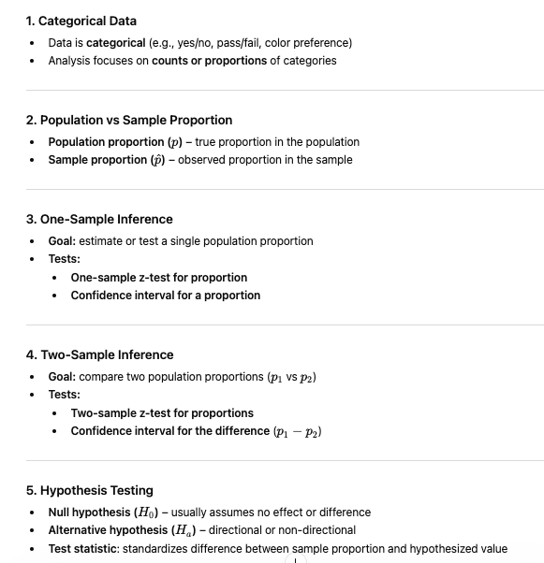

Slide 10
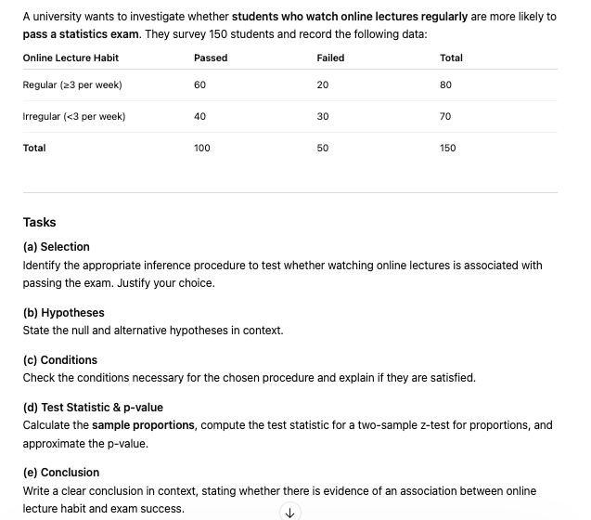

Slide 11
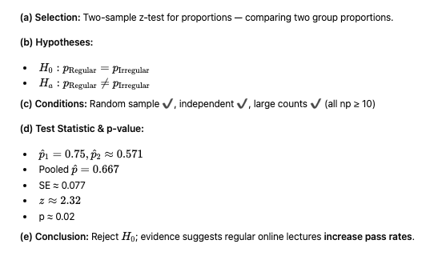

Slide 13
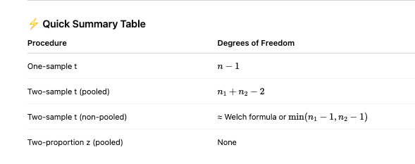

Slide 14
TRUE
TRUE or FALSE
Categorical data is analysed using proportions rather than means.

Slide 15
TRUE
TRUE or FALSE
Expected counts should be at least 5for chi-square tests.

Slide 16
TRUE
TRUE or FALSE
The null hypothesis for chi-square tests often assumes no association or no difference.

