Slide 1
Starter Questions
1. Factorise and solve x² + 7x + 10 = 0
2. Factorise and solve x² – 49 = 0
3. Solve 3x + 5 < 17
4. Solve 2x + 3 ≤ 5x – 9
5. Factorise and solve x² – 2x – 15 = 0
6. Factorise and solve 5x² – 13x – 6 = 0

Slide 2
Starter Questions Answers
1. Factorise and solve x² + 7x + 10 = 0
x = -5 x = -2
2. Factorise and solve x² – 49 = 0
x = -7 x = 7
3. Solve 3x + 5 < 17
x < 4
4. Solve 2x + 3 ≤ 5x – 9
x ≥ 4
5. Factorise and solve x² – 2x – 15 = 0
x = 5 x = -3
6. Factorise and solve 5x² – 13x – 6 = 0
x = 3 x = -0.4

Slide 3
Solve:
x² – 10x + 16 < 0
(x – 8)(x – 2) < 0
x = 8 x = 2
Critical Values

Slide 4
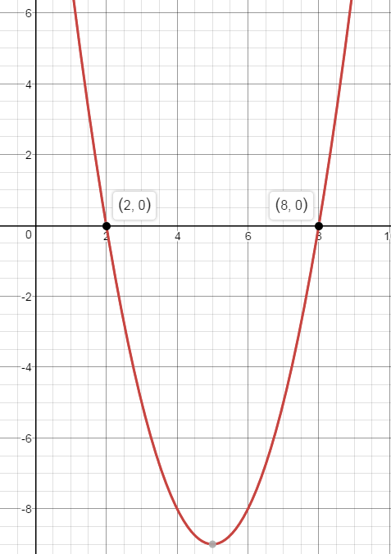
Solve:
x² – 10x + 16 < 0
(x – 8)(x – 2) < 0
x = 8 x = 2
Draw a sketch of the quadratic. Mark on the points where it crosses the x-axis.

Slide 5
Solve:
x² – 10x + 16 < 0
(x – 8)(x – 2) < 0
x = 8 x = 2
Shade the part of the graph below the x – axis as the inequality is < 0.

Slide 6
Solve:
x² – 10x + 16 < 0
(x – 8)(x – 2) < 0
x = 8 x = 2
2 < x < 8
So this is the answer.

Slide 7
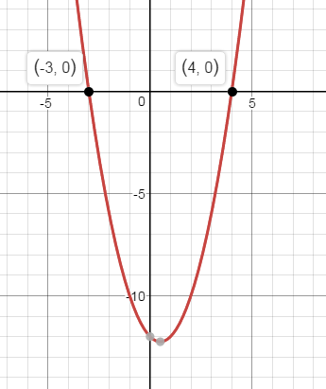
Solve:
x² – x – 12 ≥ 0
(x + 3)(x – 4) ≥ 0
x = -3 x = 4
This time the quadratic is ≥ 0 so we shade above the x –axis.

Slide 8
Solve:
x² – x – 12 ≥ 0
(x + 3)(x – 4) ≥ 0
x = -3 x = 4
x ≤ -3 x ≥ 4
So this is the answer.

Slide 9
Try these:
1. x² – 9 < 0
2. x² + x – 6 > 0
3. 3x² + 7x + 2 ≤ 0

Slide 10
Answers:
1. x² – 9 < 0
-3 < x < 3
2. x² + x – 6 > 0
x < -3 x > 2
3. 3x² + 7x + 2 ≤ 0
-2 ≤ x ≤ -¹/₃

Slide 11
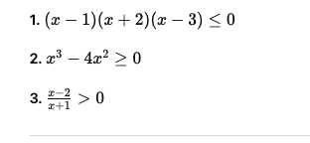
Further questions

Slide 12
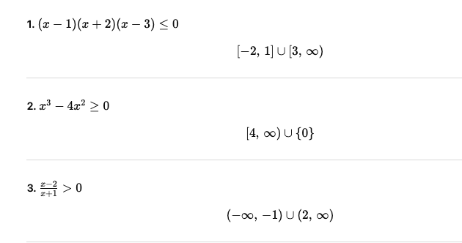

Slide 13
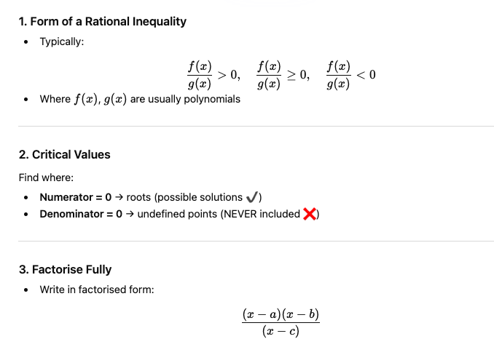
Rational Inequalities

Slide 14
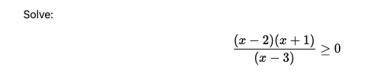


Slide 15
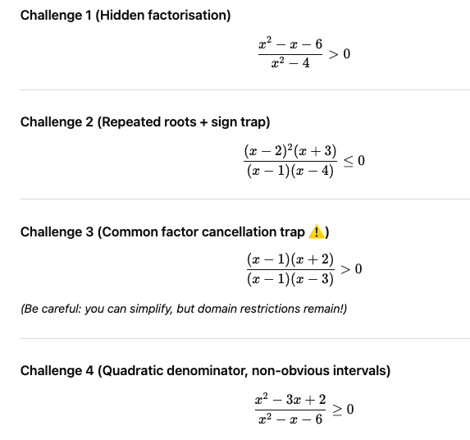

Slide 16


Slide 17

Modulus Inequality

Slide 18
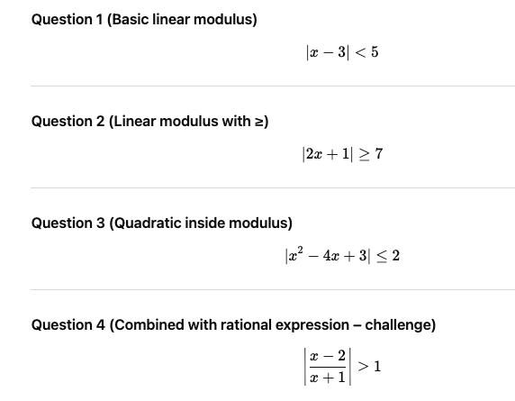

Slide 19
