Slide 1


Slide 2
Unit 1 knowledge – AP CALCULUS AB– limits and continuity
1.1
Introducing Calculus: Can Change Occur at an Instant?
1.2
Defining Limits and Using Limit Notation
1.3
Estimating Limit Values from Graphs
1.4
Estimating Limit Values from Tables
1.5
Determining Limits Using Algebraic Properties of Limits
1.6
Determining Limits Using Algebraic Manipulation
1.7
Selecting Procedures for Determining Limits
1.8
Determining Limits Using the Squeeze Theorem
1.9
Connecting Multiple Representations of Limits
1.10
Exploring Types of Discontinuities
1.11
Defining Continuity at a Point
1.12
Confirming Continuity over an Interval
1.13
Removing Discontinuities
1.14
Connecting Infinite Limits and Vertical Asymptotes
1.15
Connecting Limits at Infinity and Horizontal Asymptotes
1.16
Working with the Intermediate Value Theorem (IVT)

Slide 3
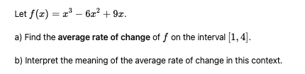

TURN and TALK

Slide 4
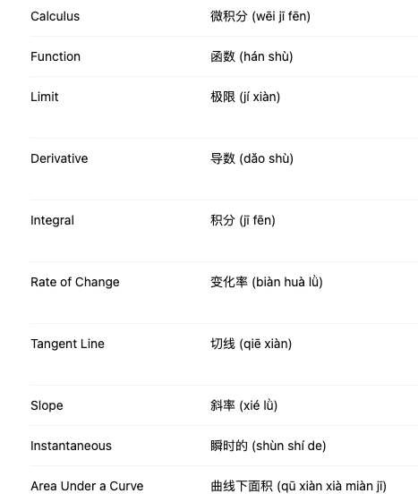
Can change occur at an instant?

Slide 5
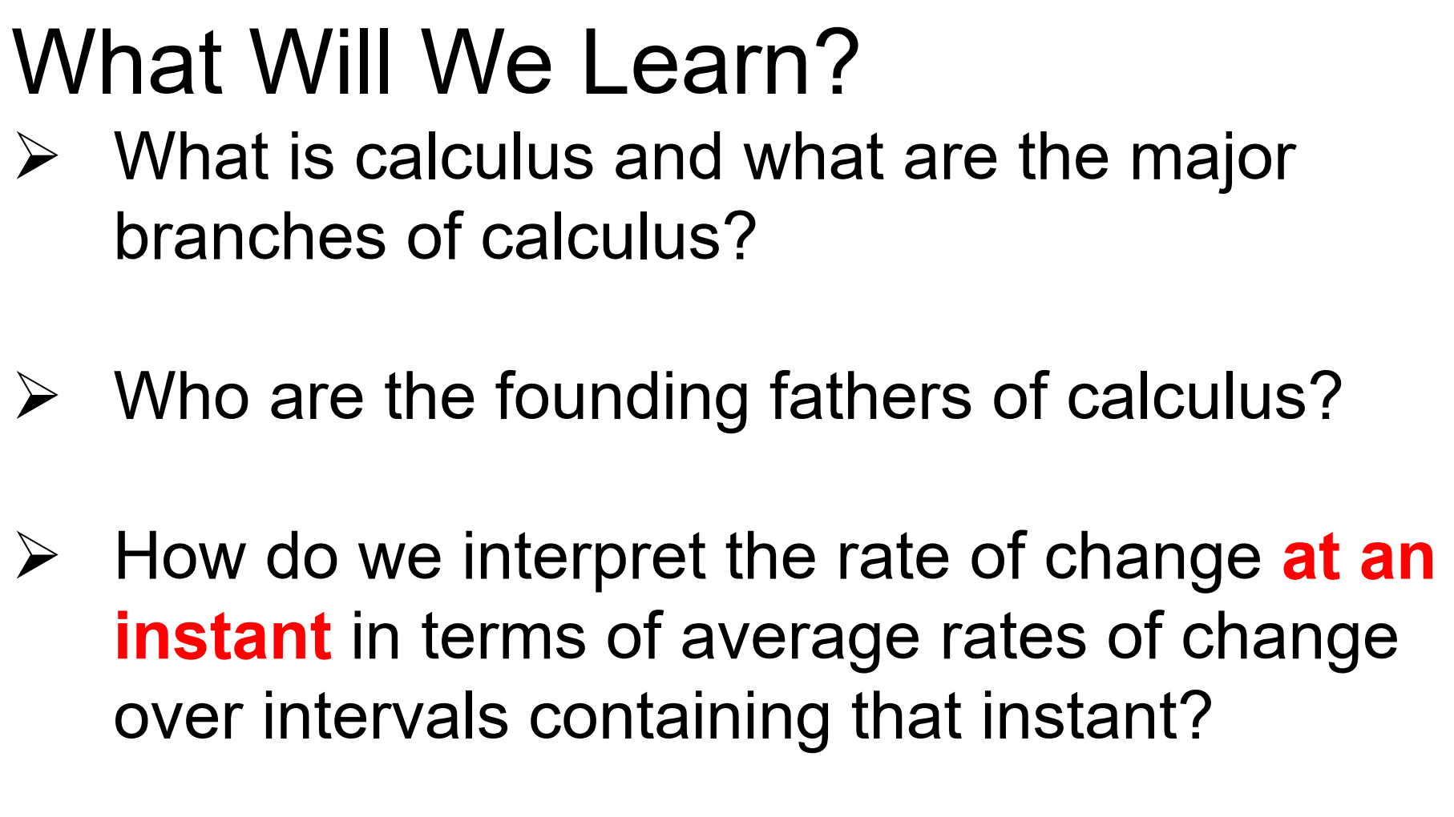

Slide 6
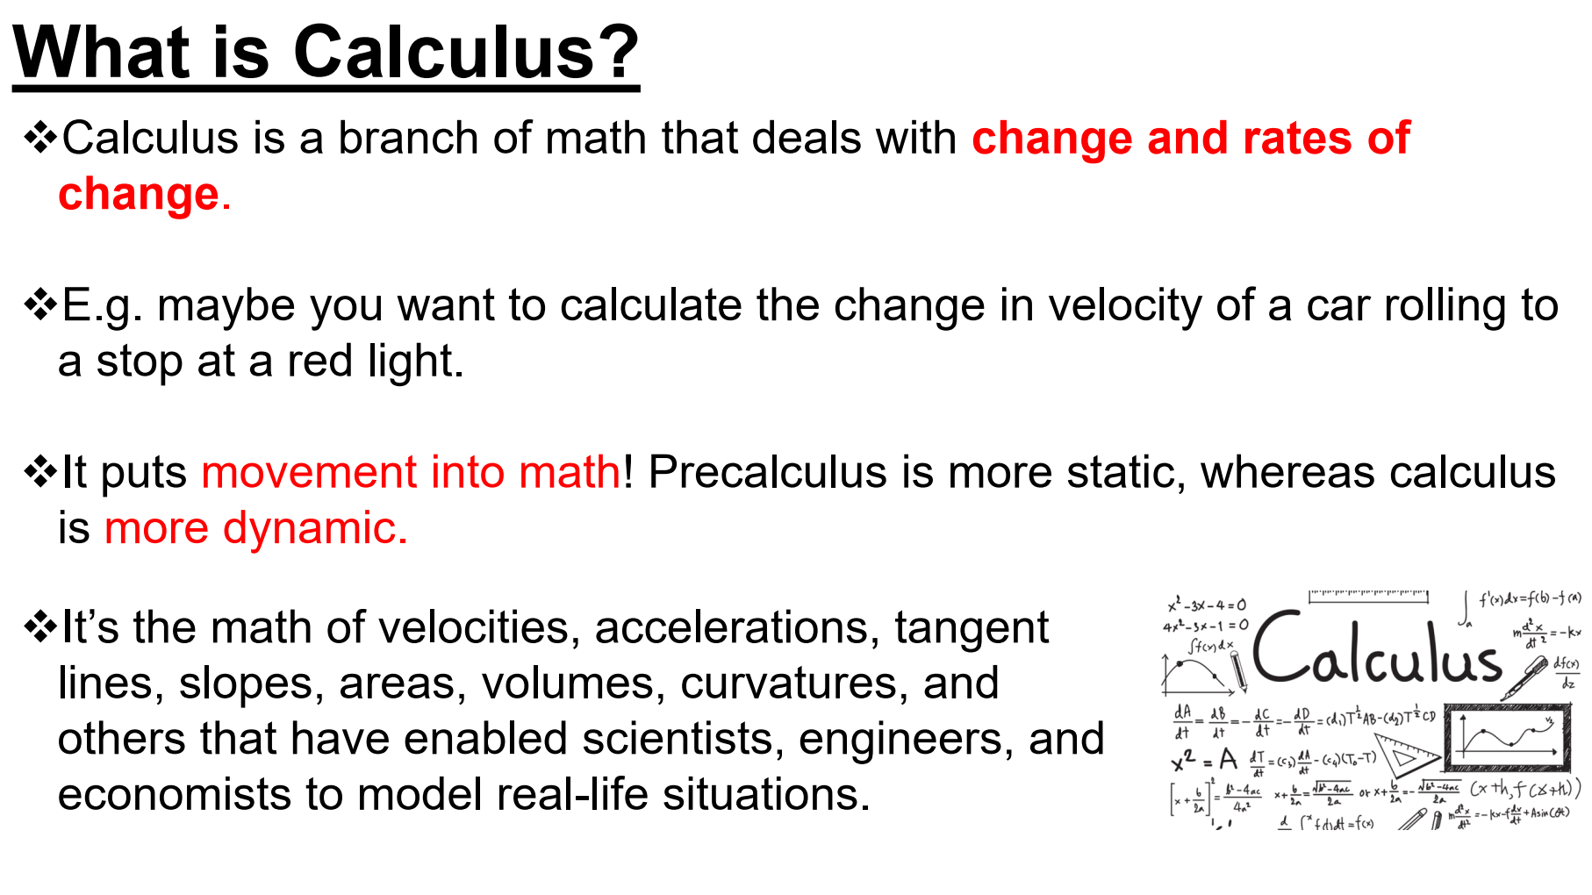

Slide 7
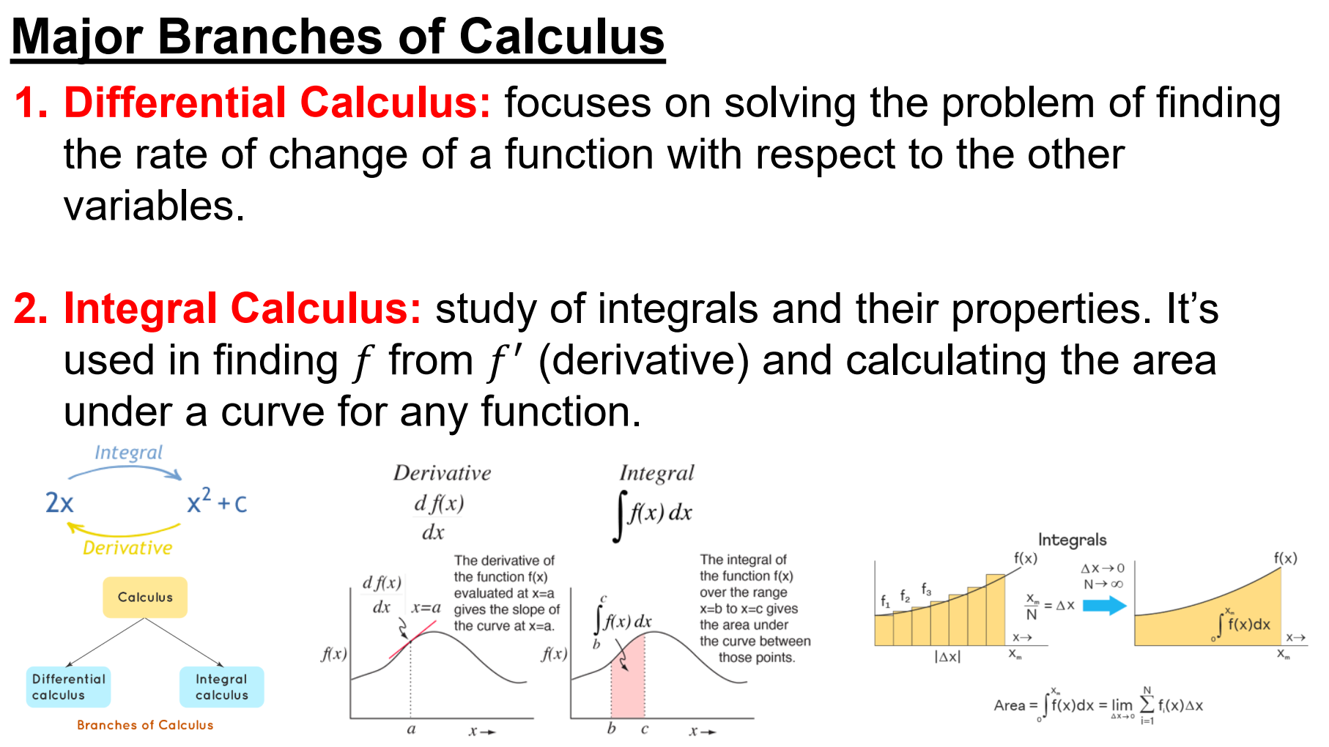

Slide 8
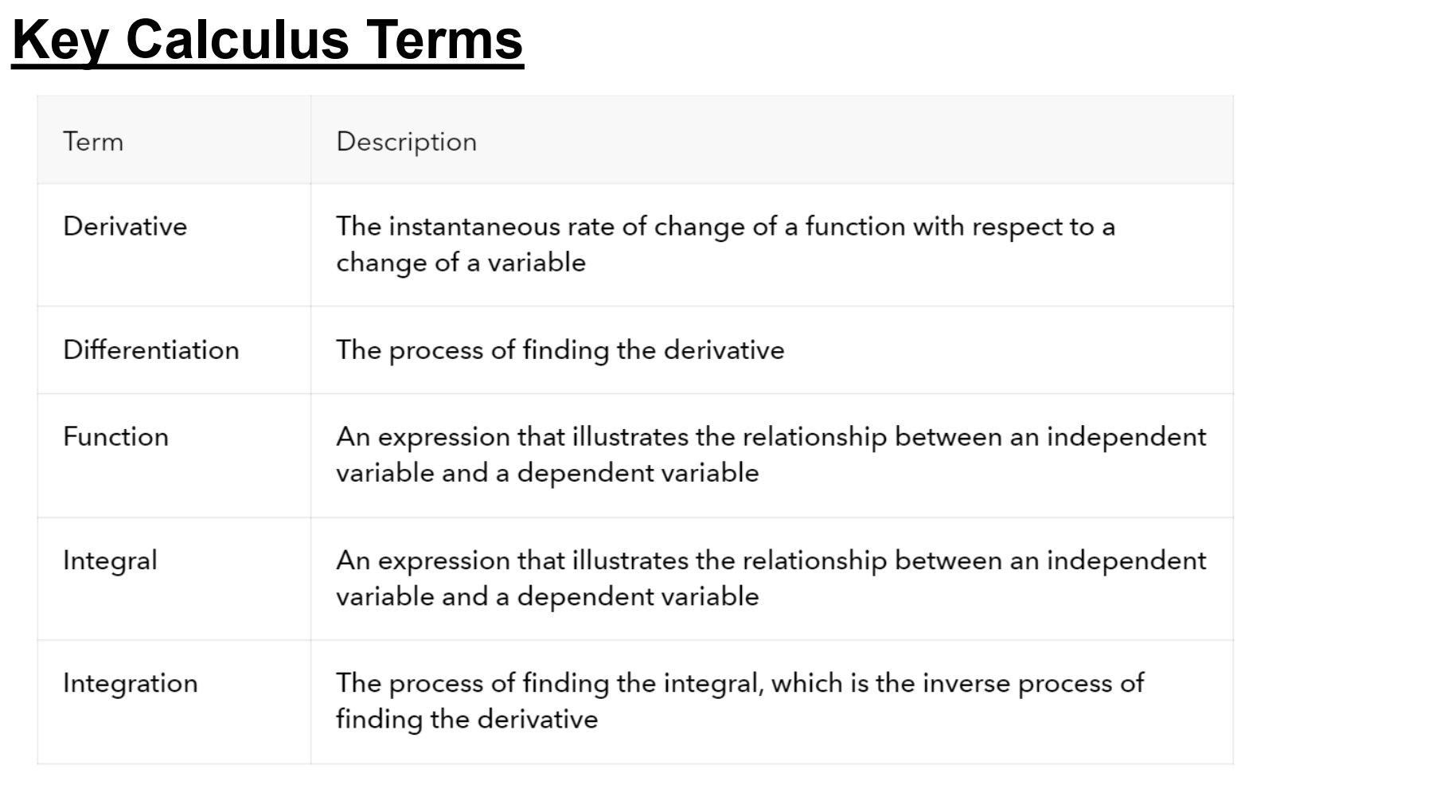

Slide 9
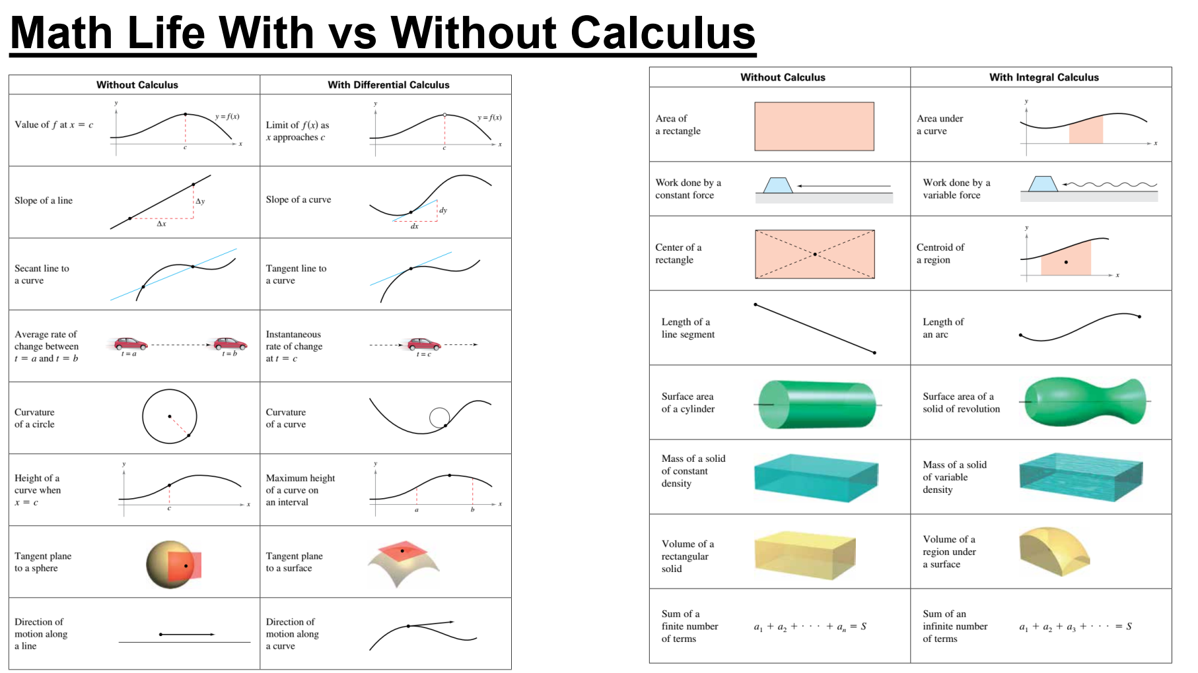

Slide 10
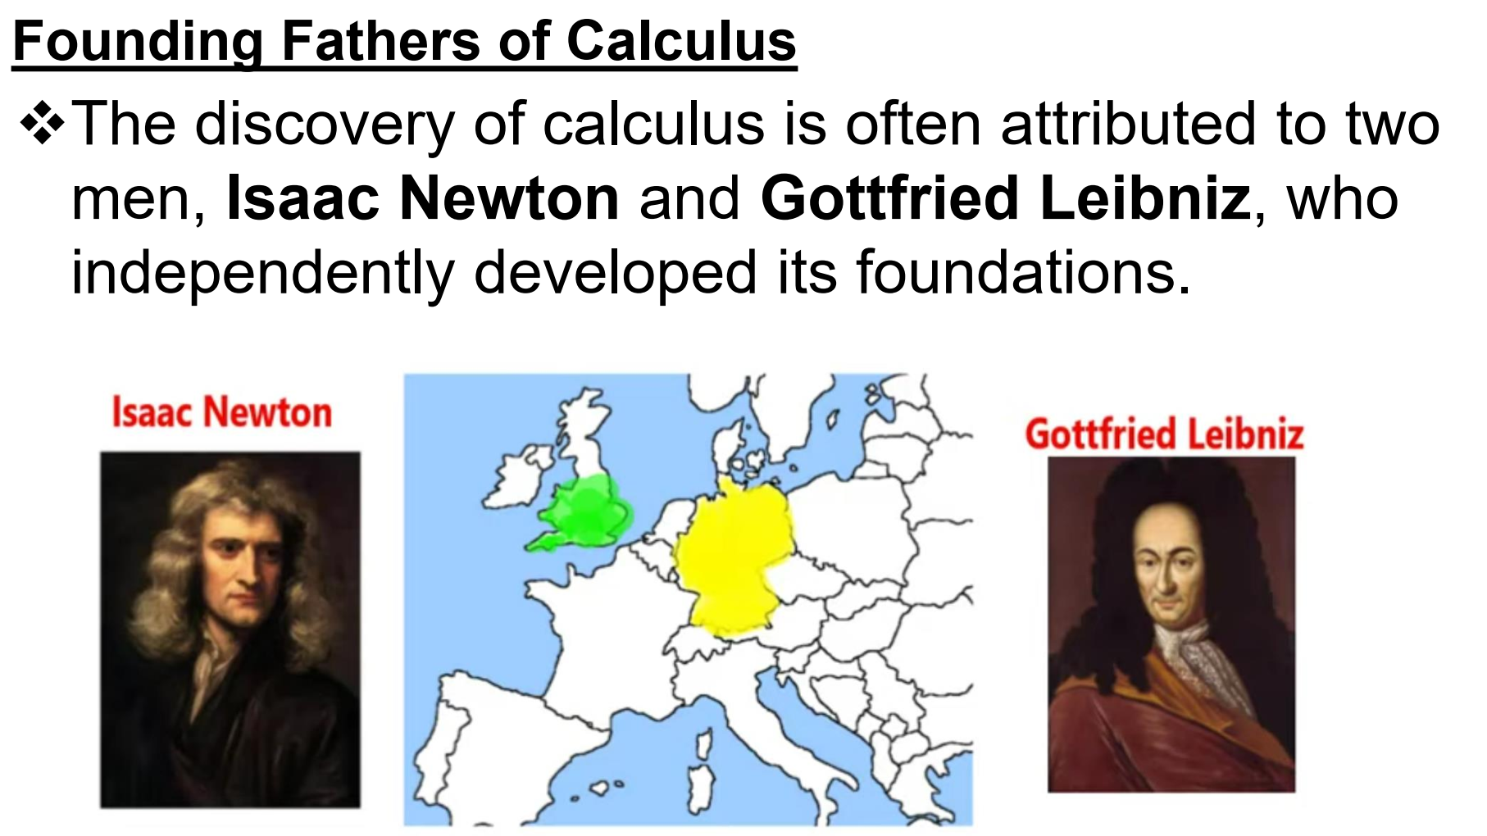

Slide 11
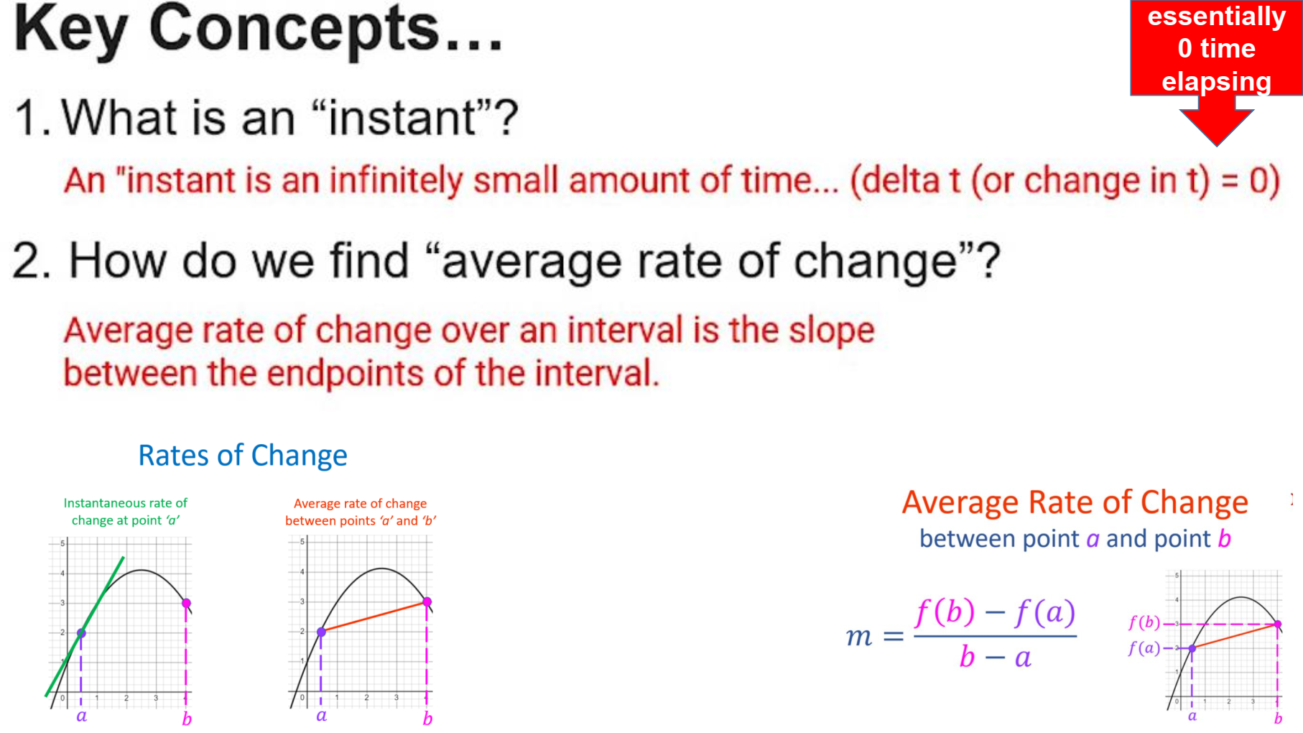

Slide 12


Slide 13
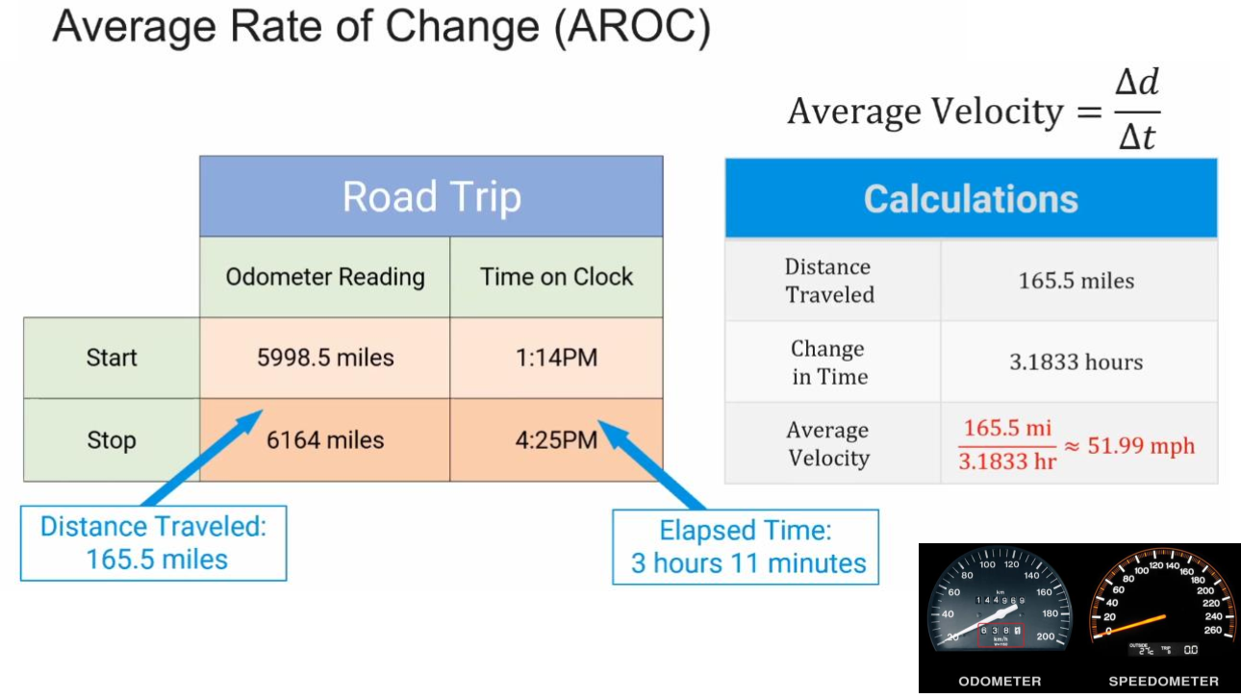

Slide 14
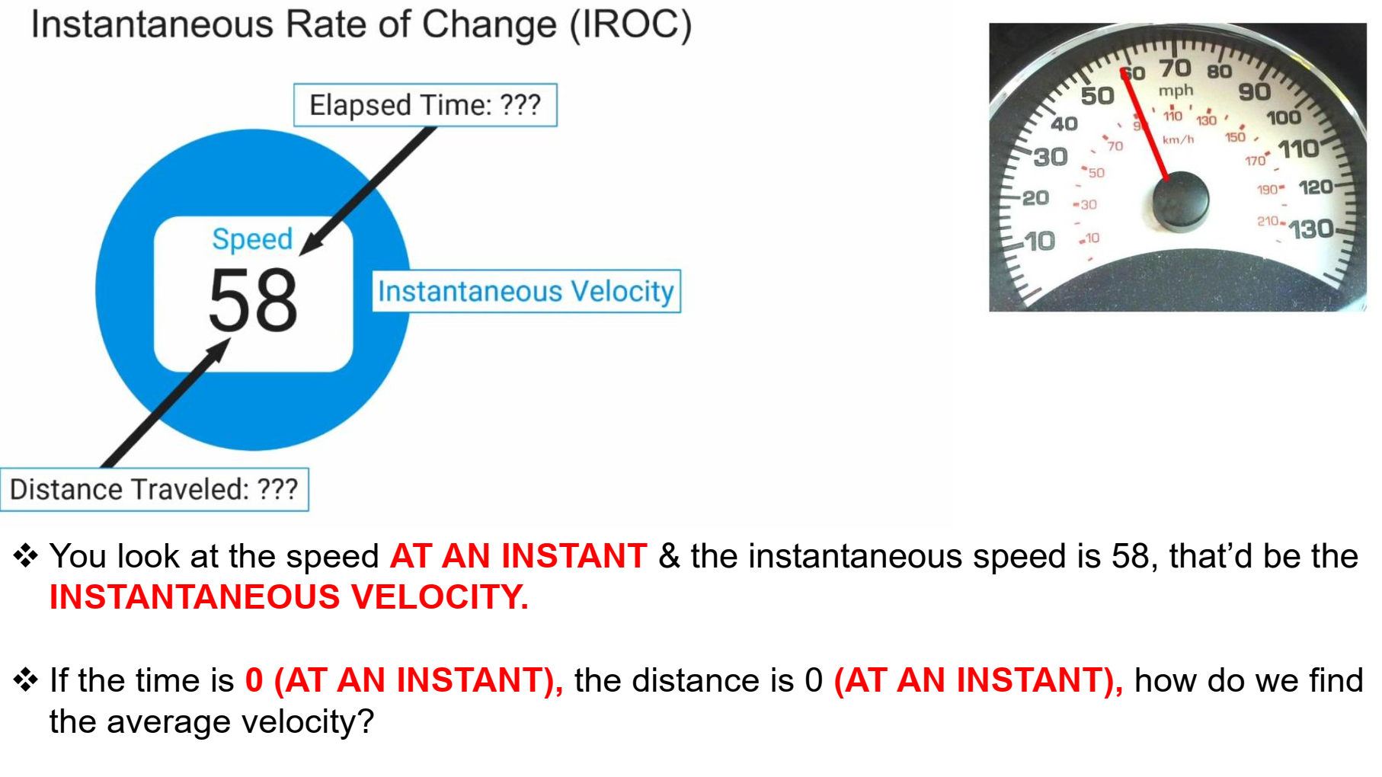

Slide 15
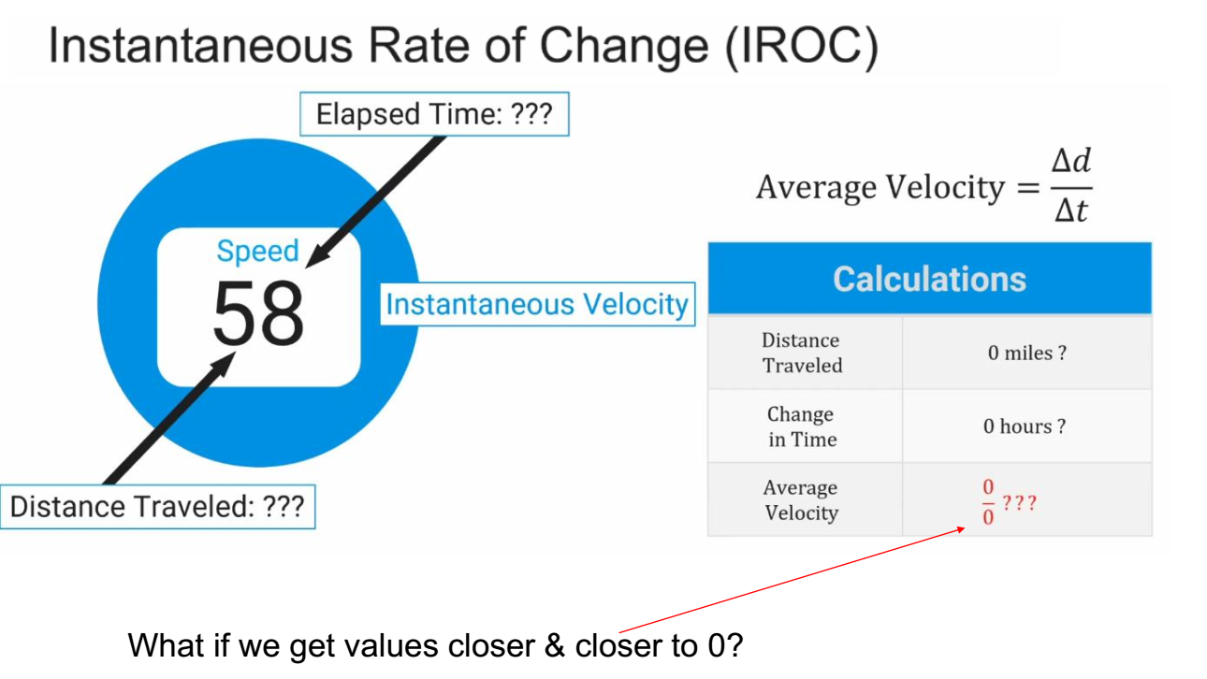

Slide 16
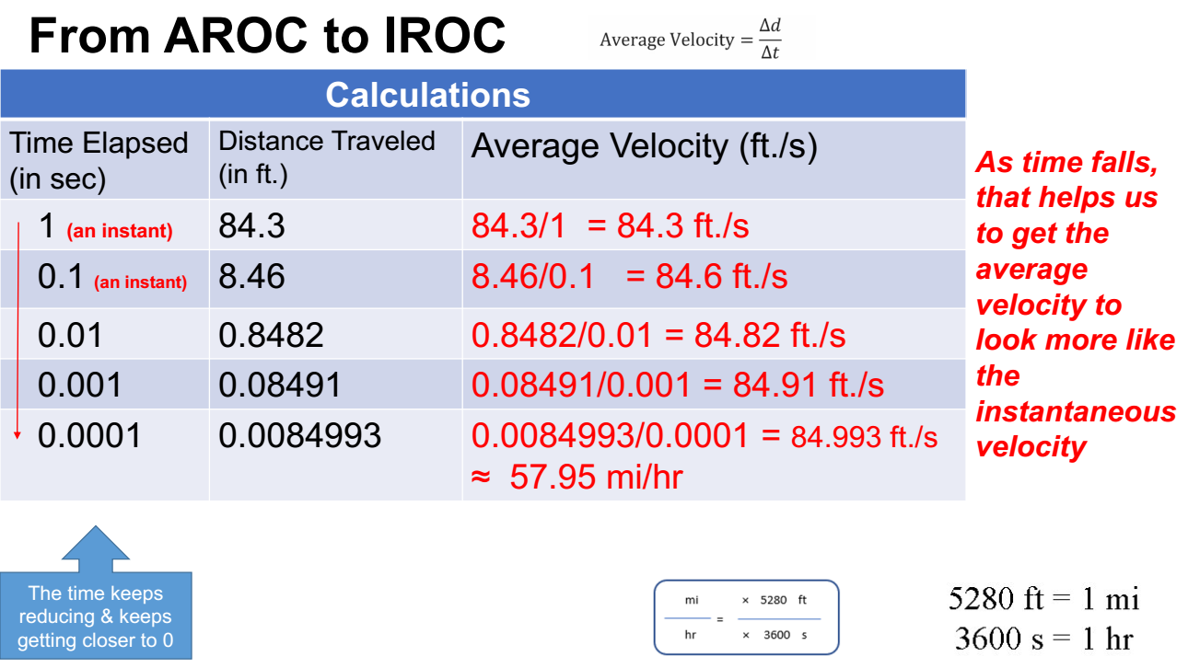

Slide 17
Let’s see some examples!

Slide 18
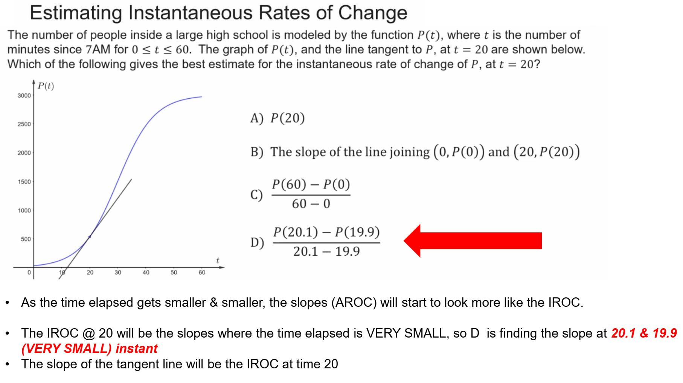

Slide 19
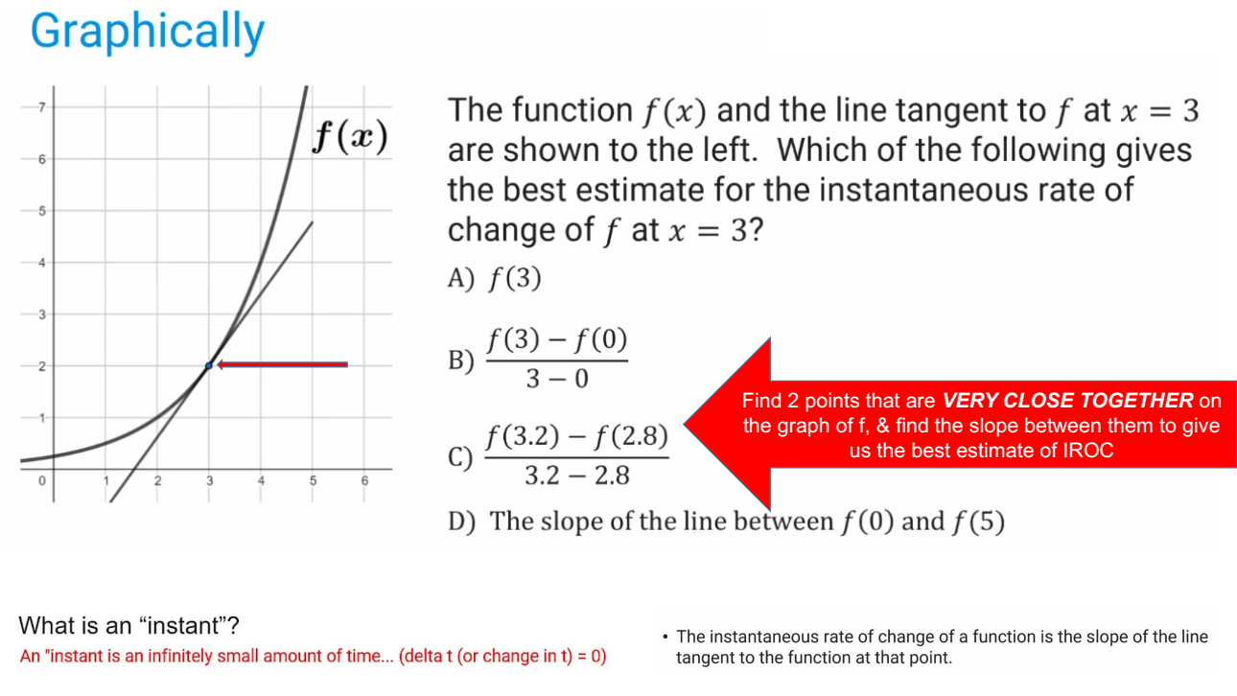

Slide 20
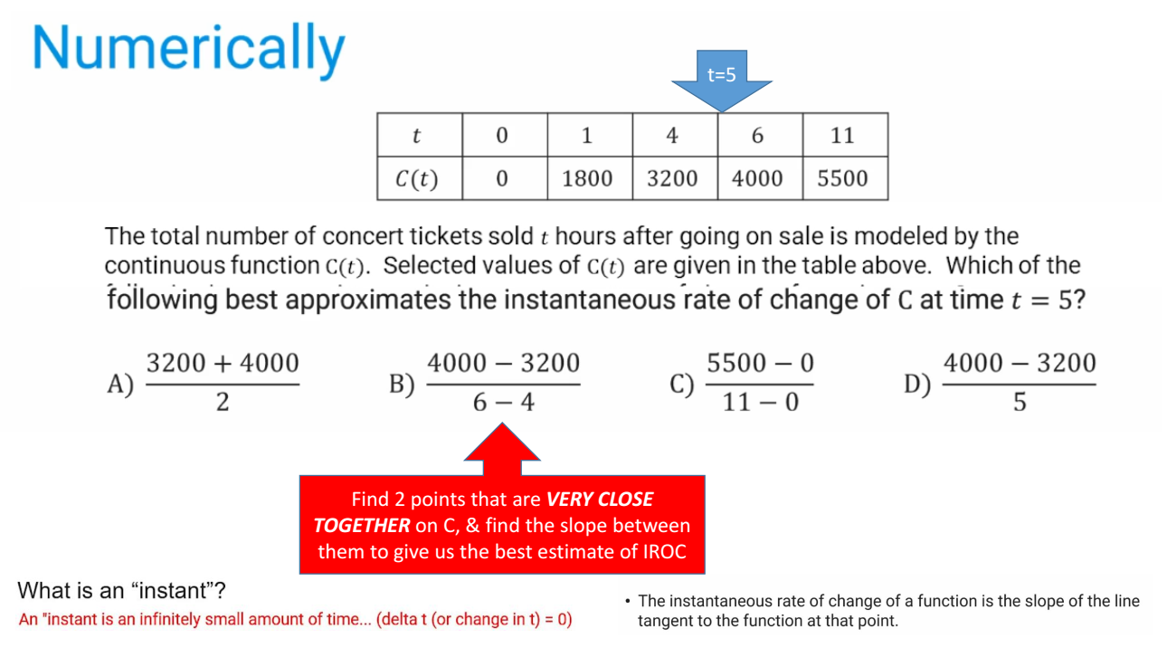

Slide 21
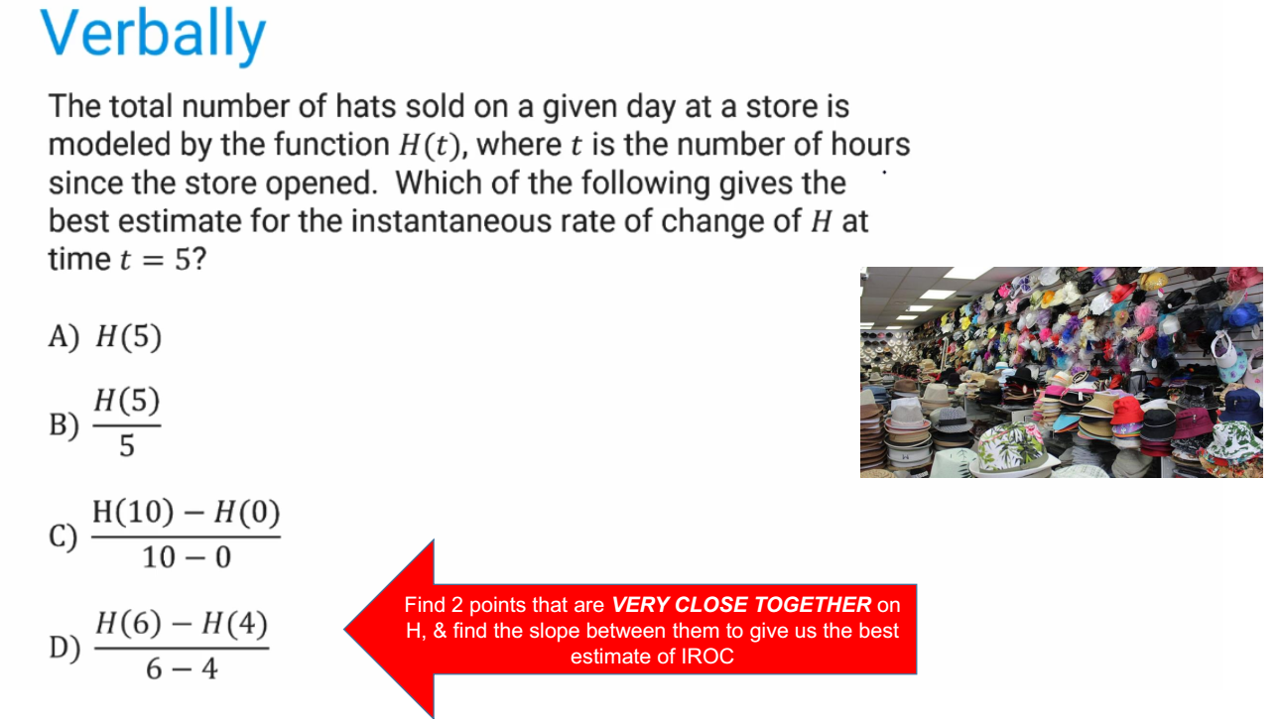

Slide 22
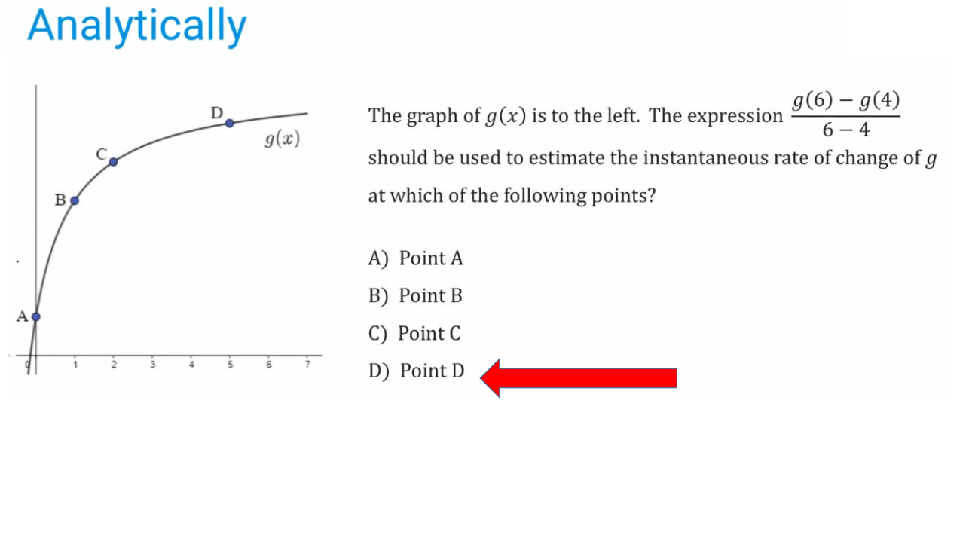

Slide 23
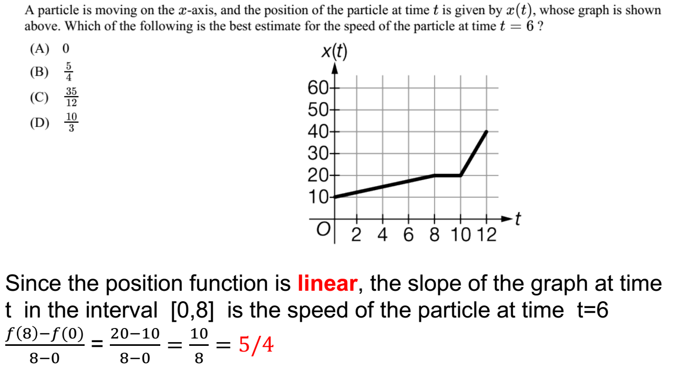

Slide 24
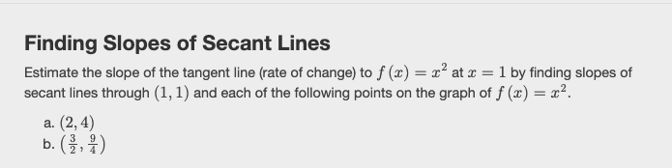

Slide 25
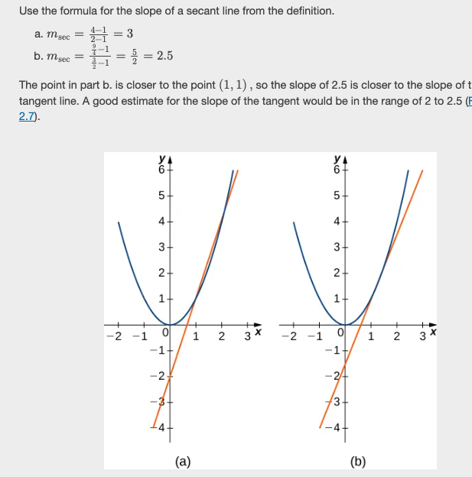

Slide 26
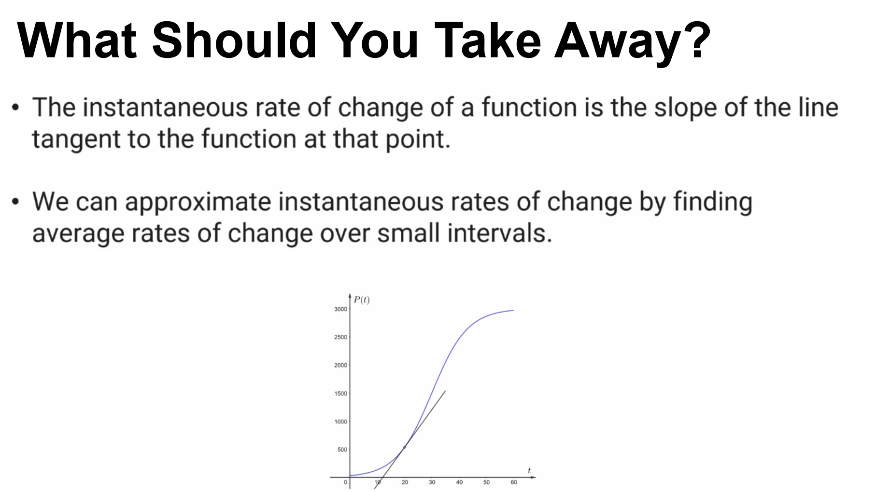

Slide 27
TRUE or FALSE
The instantaneous rate of change of a function at a point is equal to the slope of the tangent line at that point.
TRUE

Slide 28
TRUE or FALSE
The average rate of change over an interval is always the same as the instantaneous rate of change at the midpoint of the interval.
FALSE

Slide 29
TRUE or FALSE
If a function is constant, its instantaneous rate of change is zero everywhere.
TRUE

