Slide 1
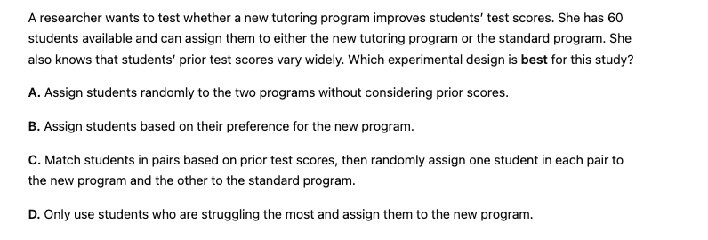
C

Slide 2
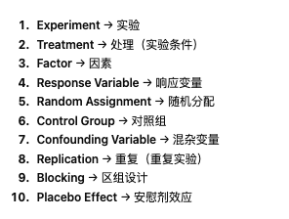

Slide 3
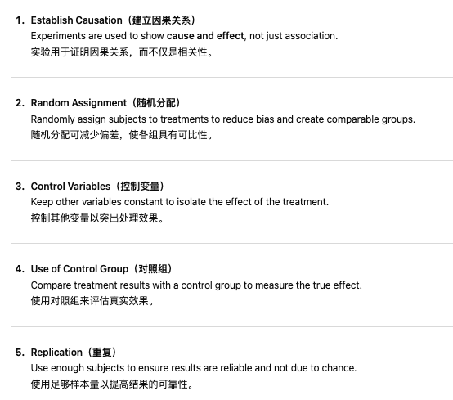

Slide 8
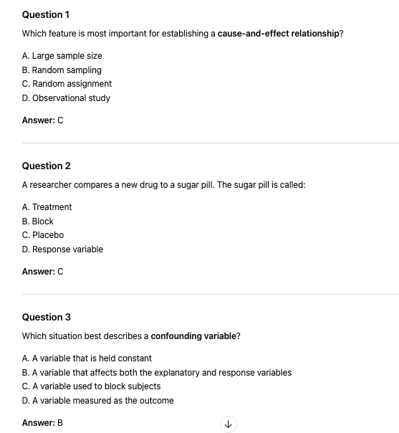

Slide 11
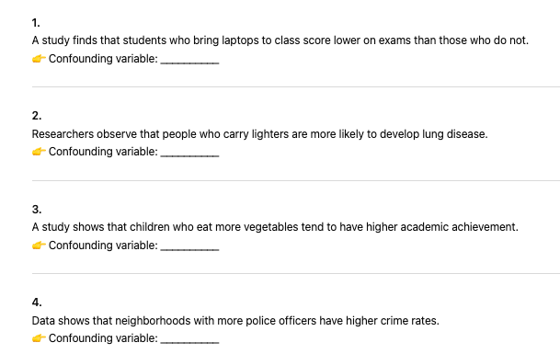
What is the cofounding variable
Student motivation / prior ability
Smoking
Family background/parental education/income
Population density/urbanisation

Slide 13
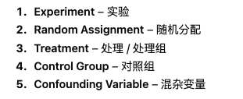
Selecting an Experiment Design

Slide 14
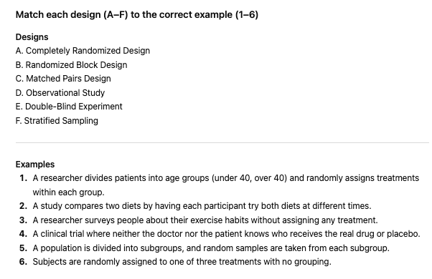
Matching Exercise

Slide 15
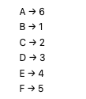
Matching Exercise

Slide 16
Clearly define the response variable and treatments.
Use random assignment to assign experimental units to treatments.
Choose a design that controls for confounding variables.
Decide whether to use completely randomized, randomized block, or matched pairs designs.
Ensure sufficient replication to allow meaningful comparisons.

Slide 17
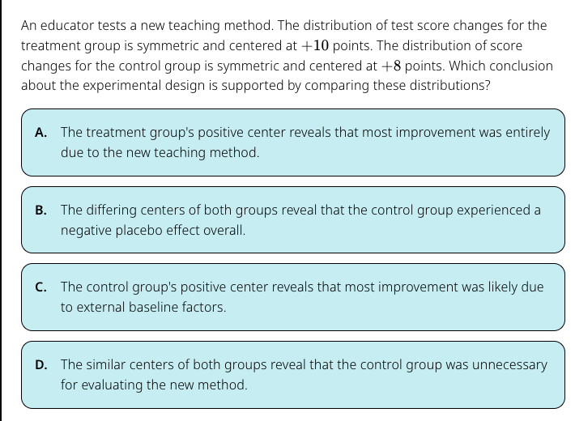
C

Slide 18
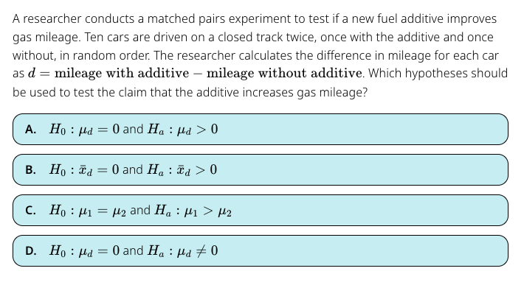
A

Slide 19
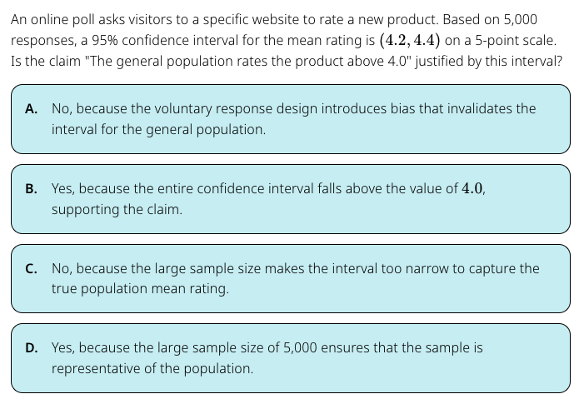
A

Slide 20
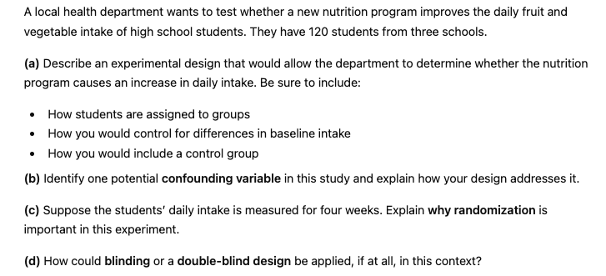

Slide 21
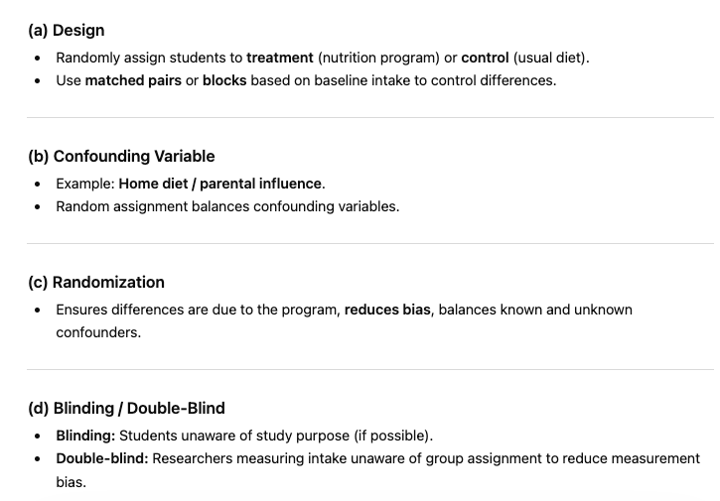

Slide 22
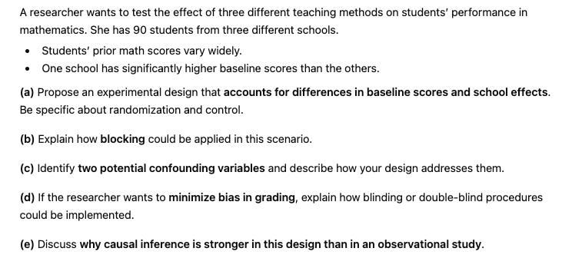
Stretch and Challenge

Slide 23
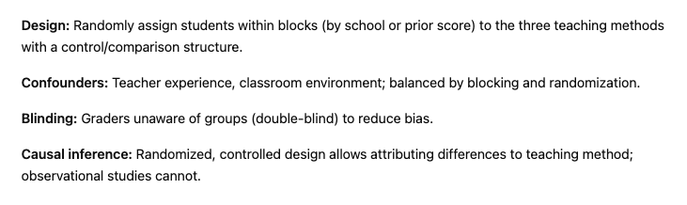

Slide 24
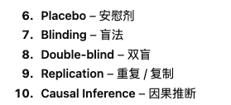
Experiments and Causal Influence

Slide 25
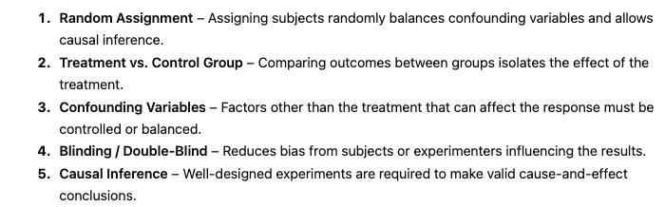

Slide 26
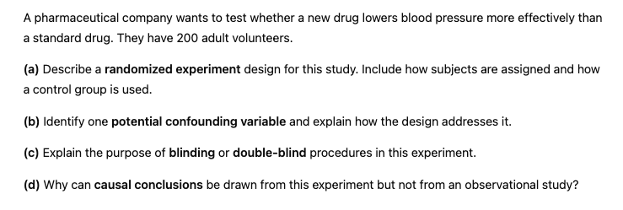

Slide 27
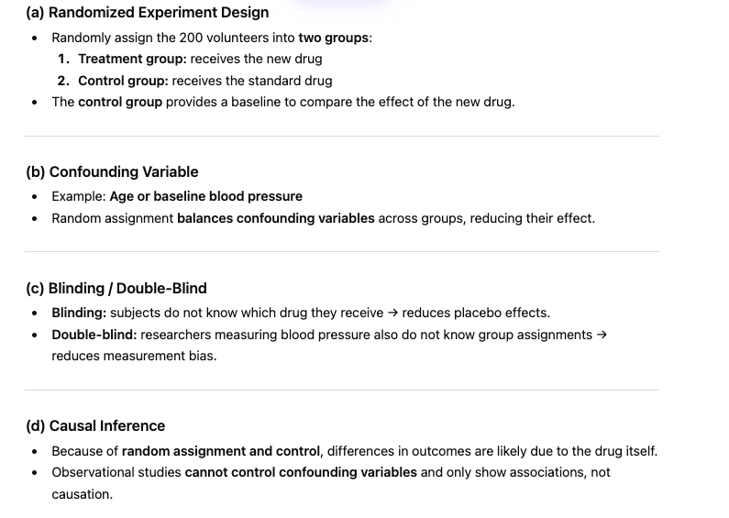

Slide 28
True or False
A completely randomized experiment with a large sample always eliminates the effects of confounding variables.
False -randomization reduces, but doesn’t always eliminate, confounding

Slide 29
True or False
Blocking is only useful in experiments with a very small sample size.
False -blocking is useful in any experiment to reduce variability

