Slide 1
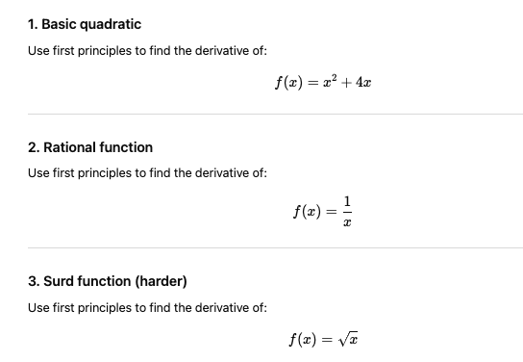
Turn and Talk

Slide 2
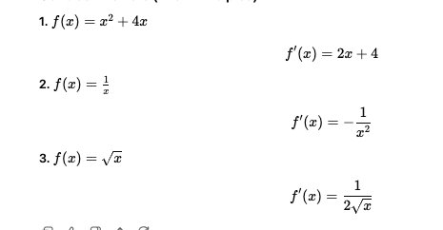

Slide 3
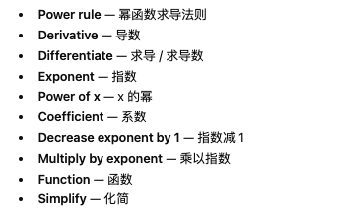

Slide 4
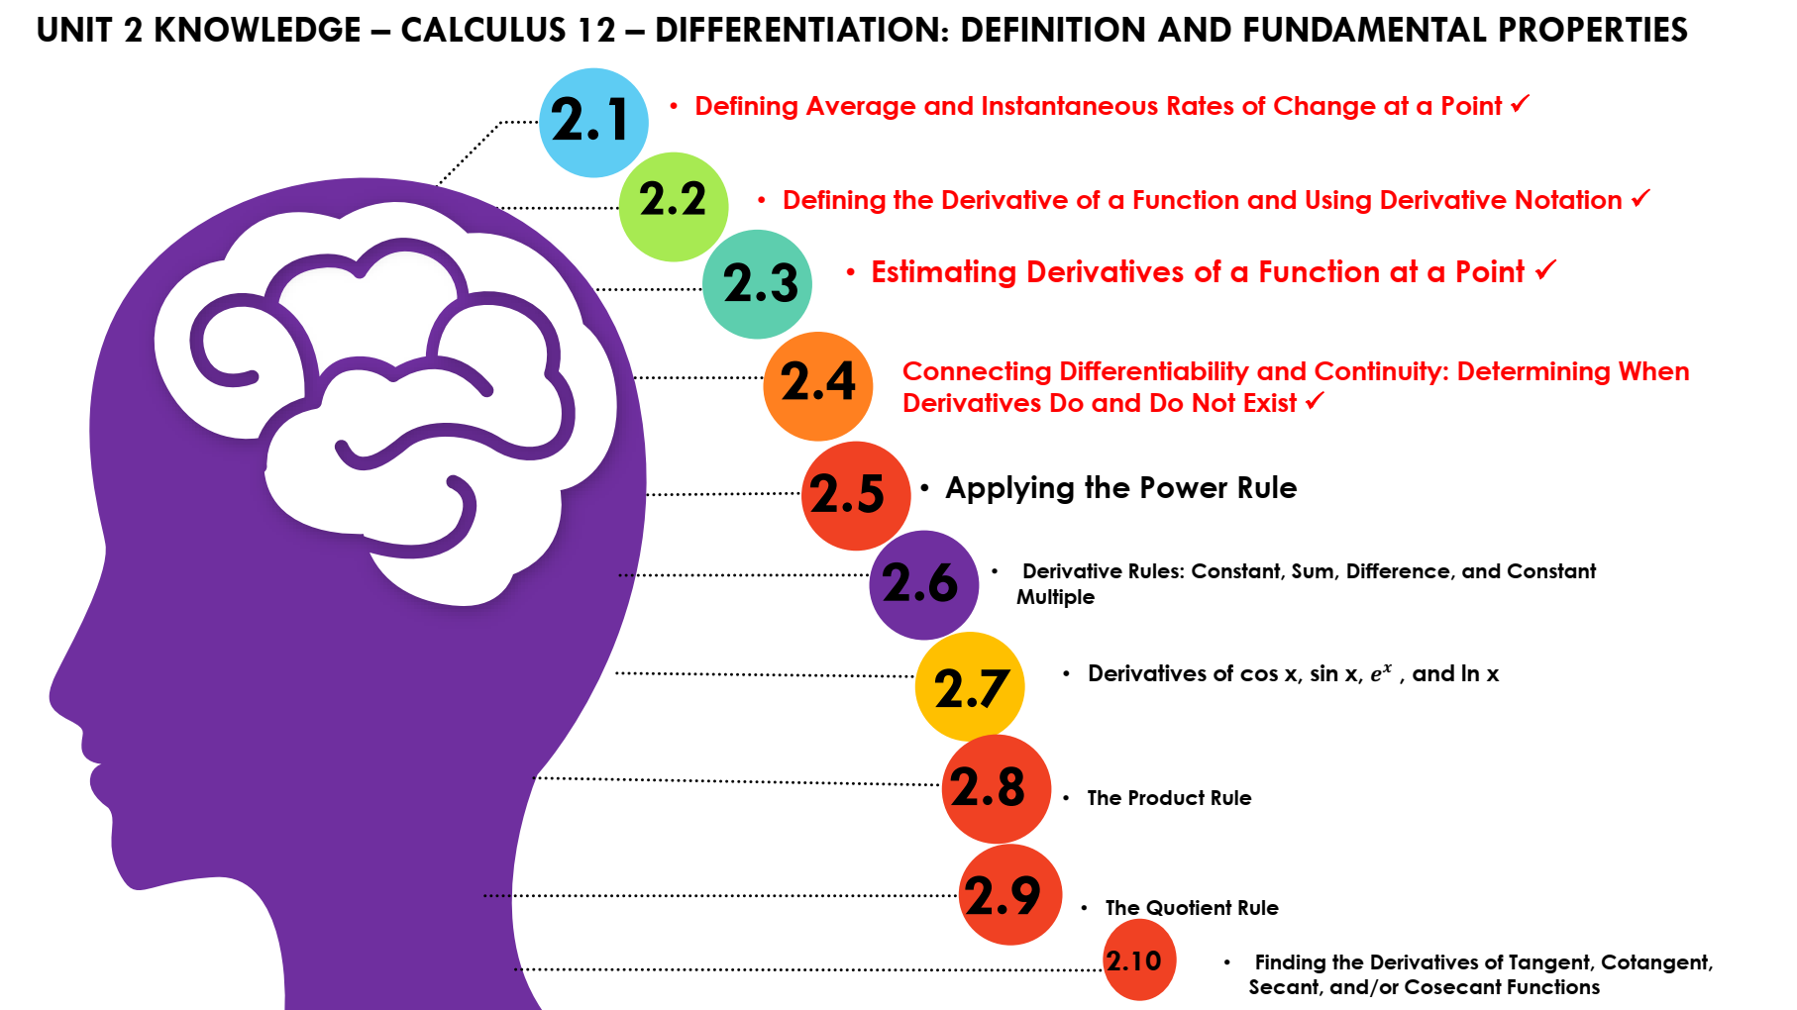

Slide 5
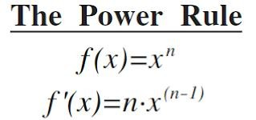
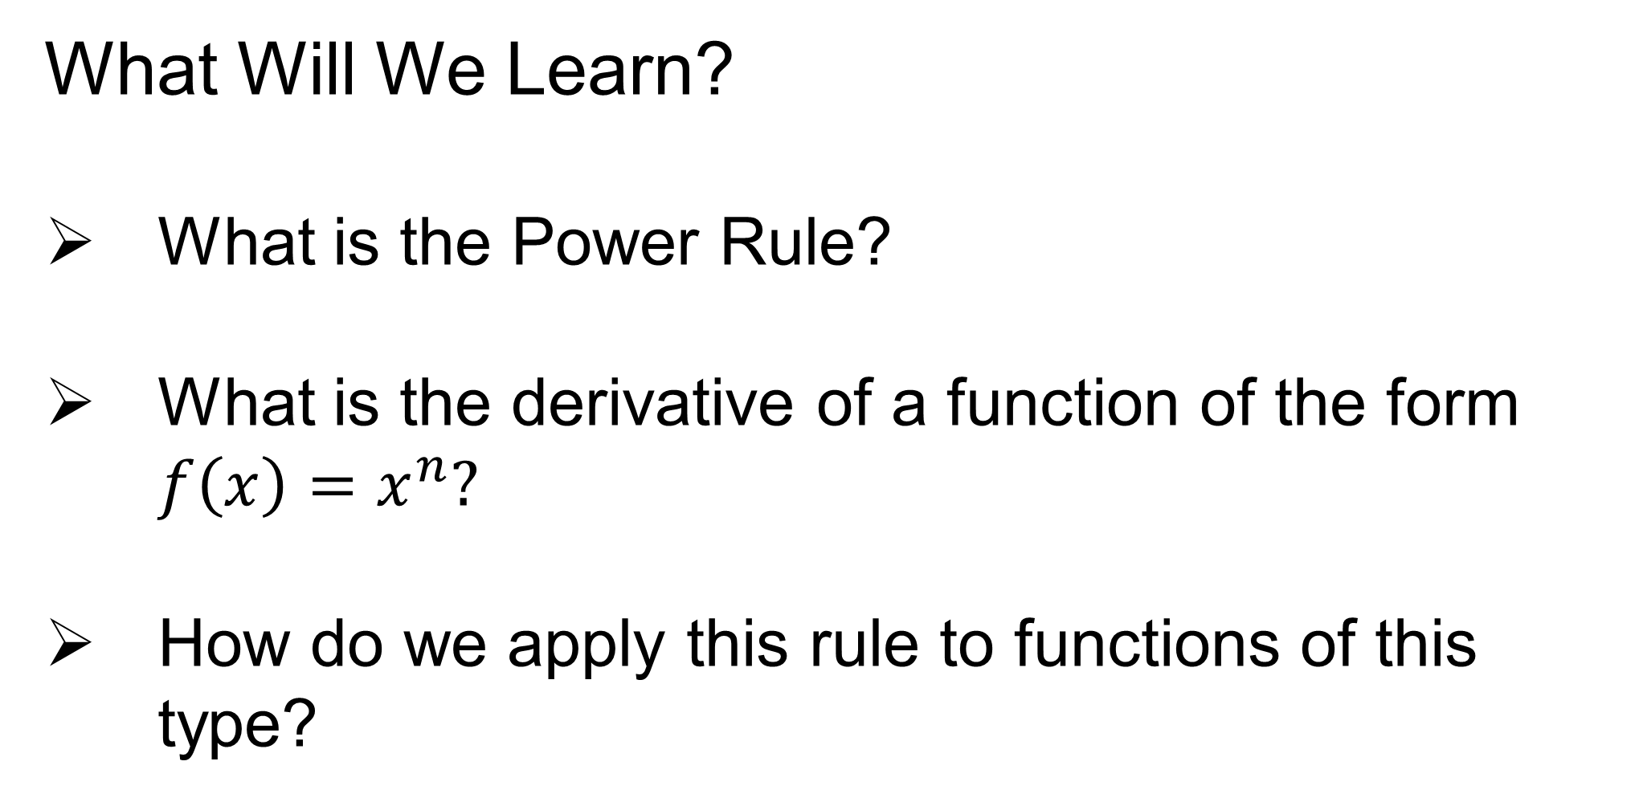
What Will We Learn?
What is the Power Rule?
What is the derivative of a function of the form $f\left(x\right)=x^{n}?$
How do we apply this rule to functions of this type?

Slide 6
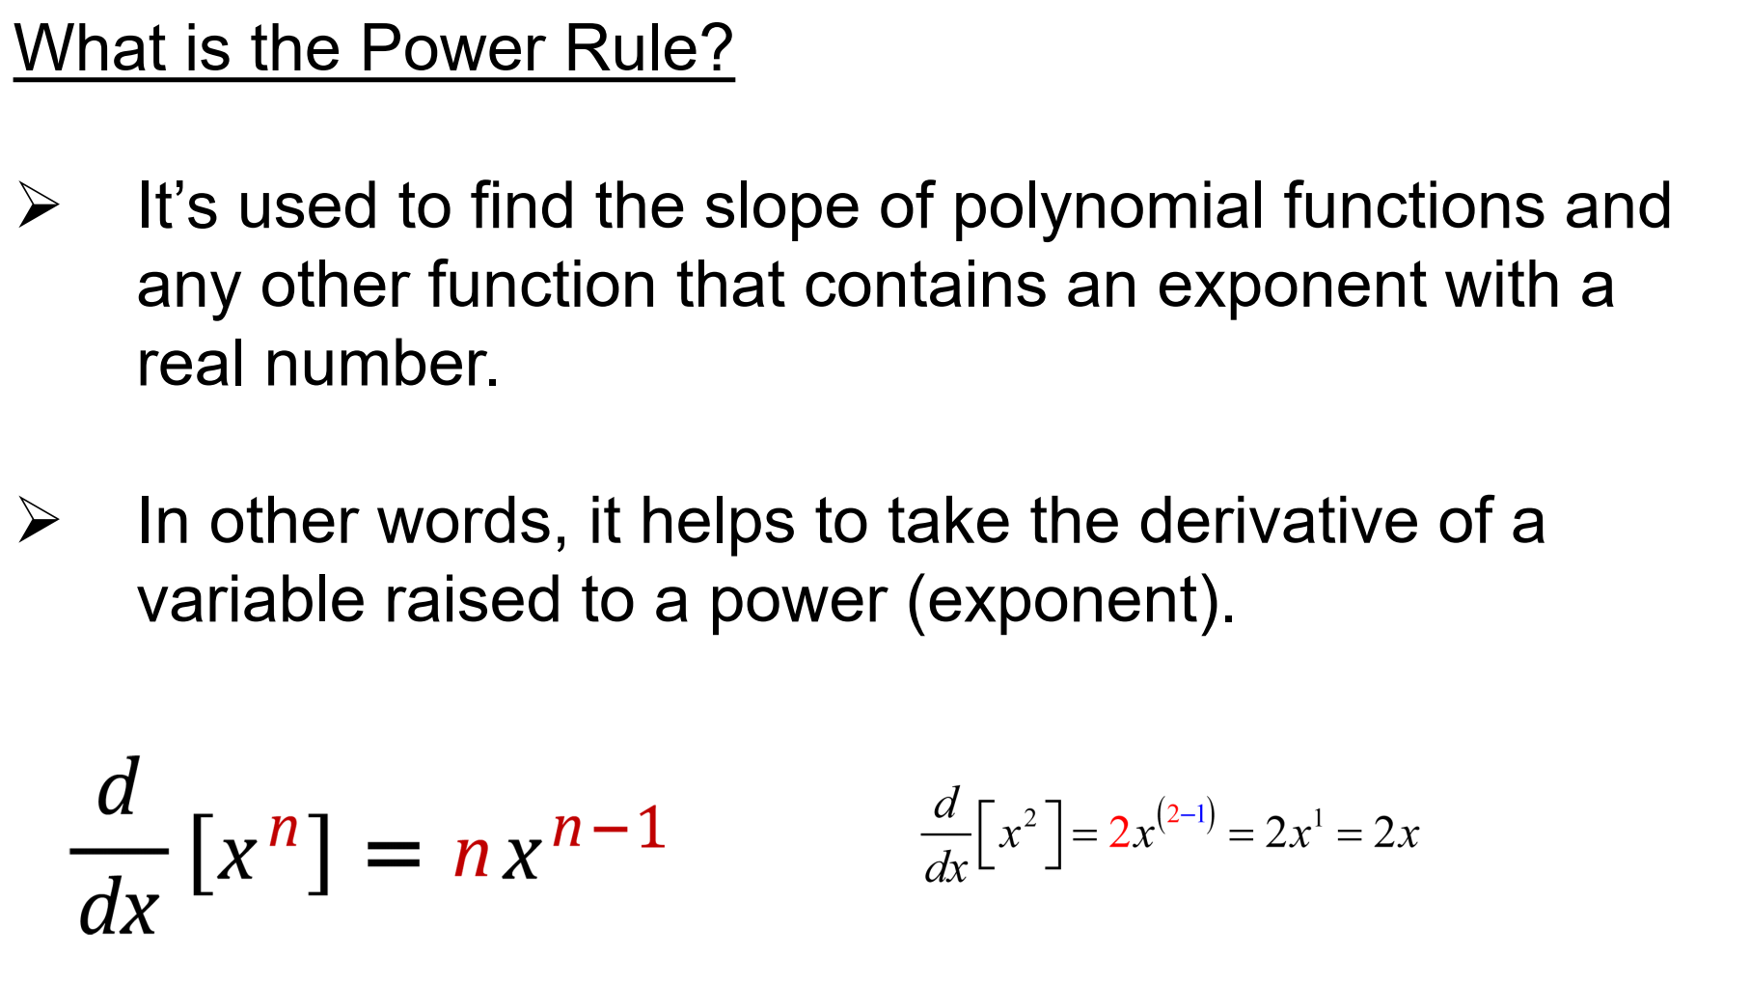

Slide 7
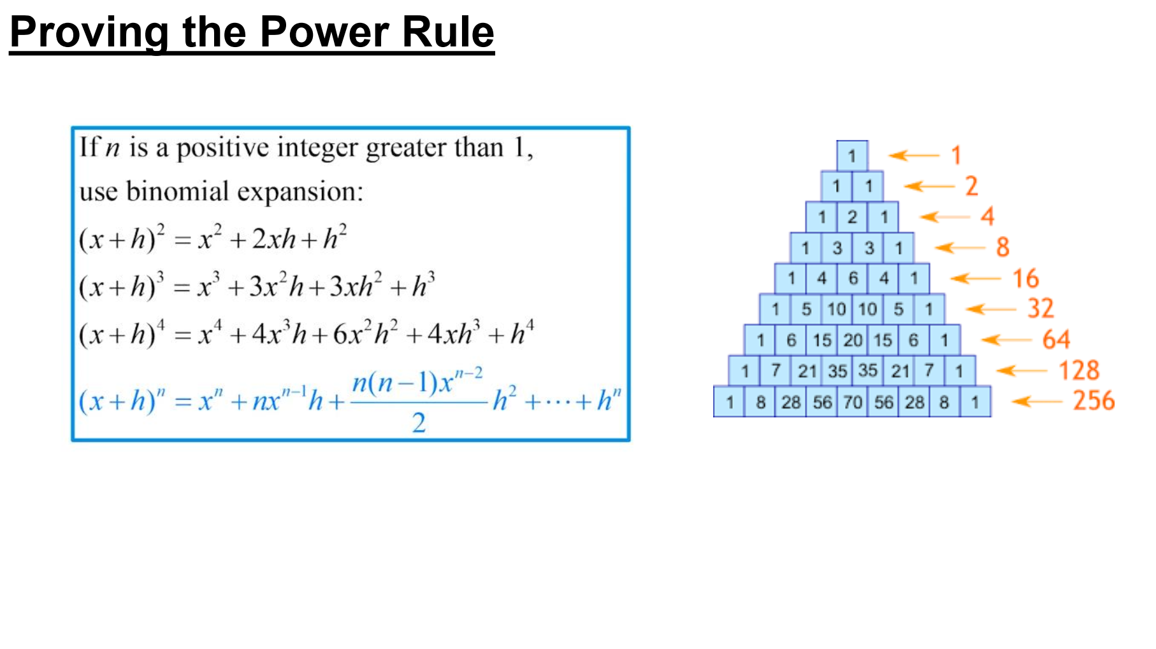

Slide 8
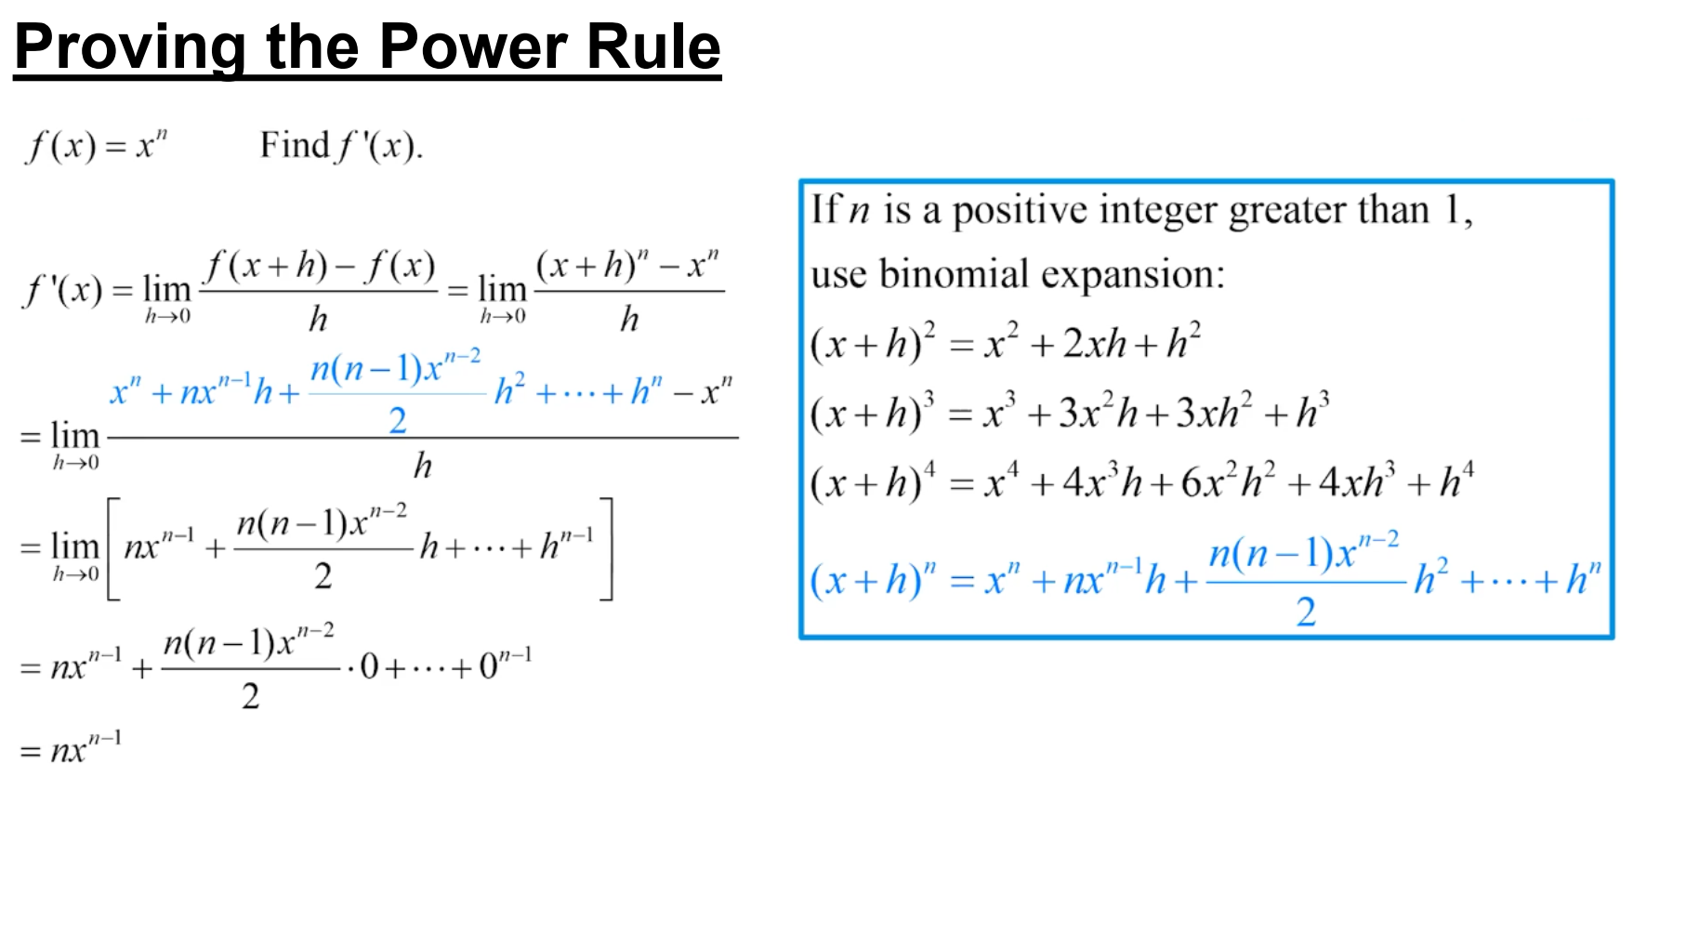

Slide 9
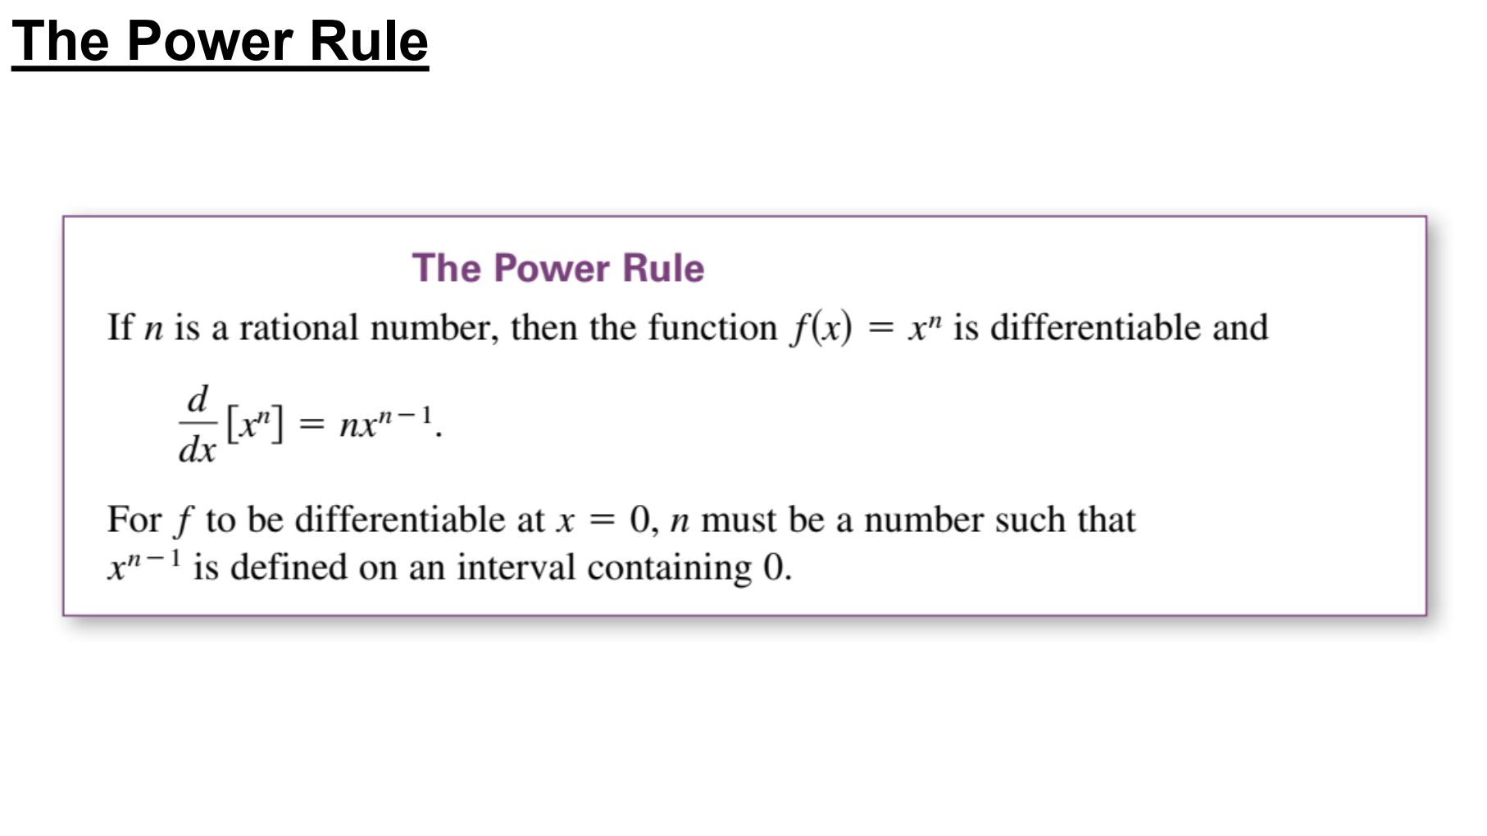

Slide 10
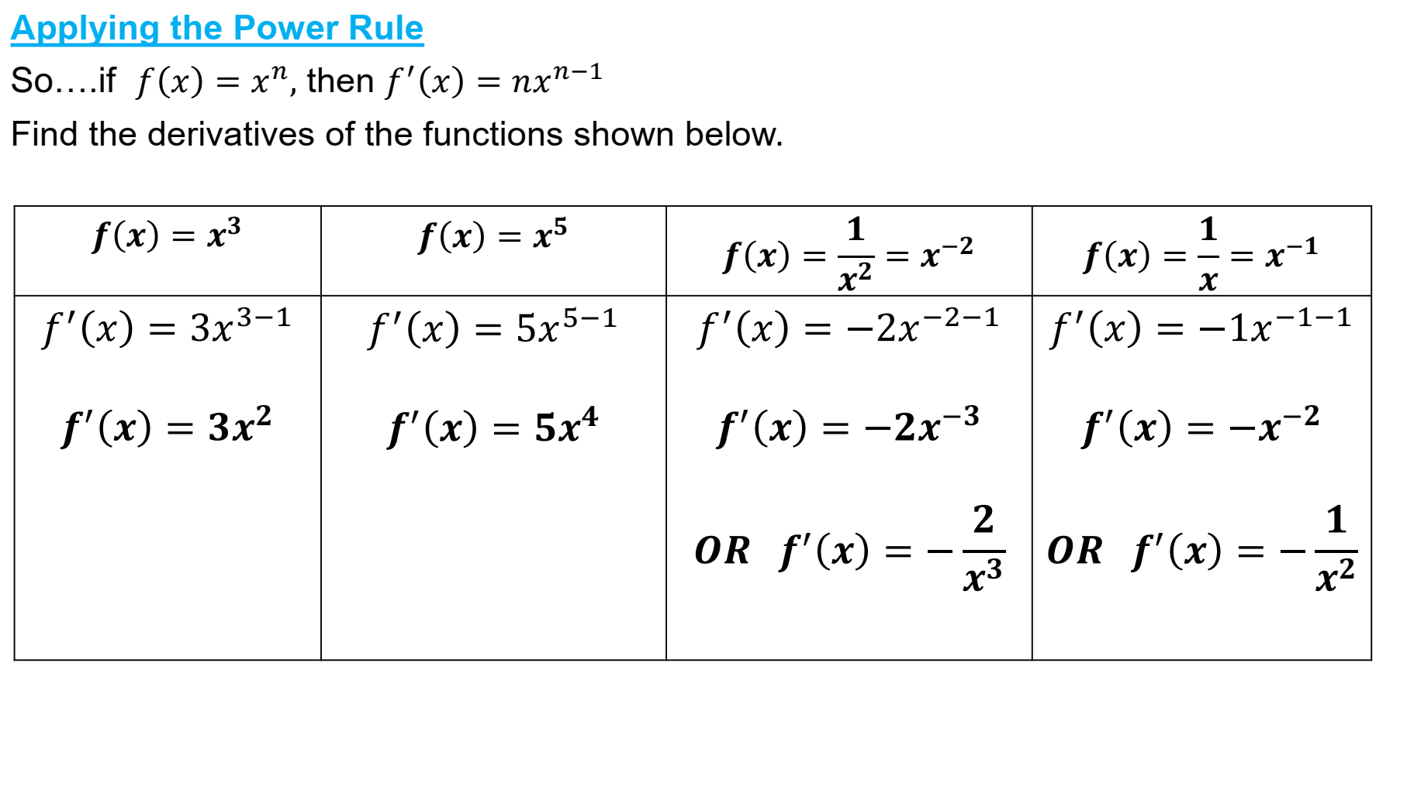

Slide 11
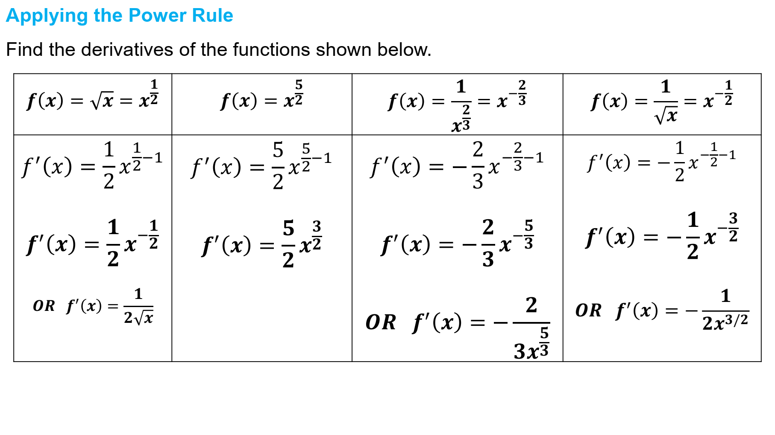

Slide 12
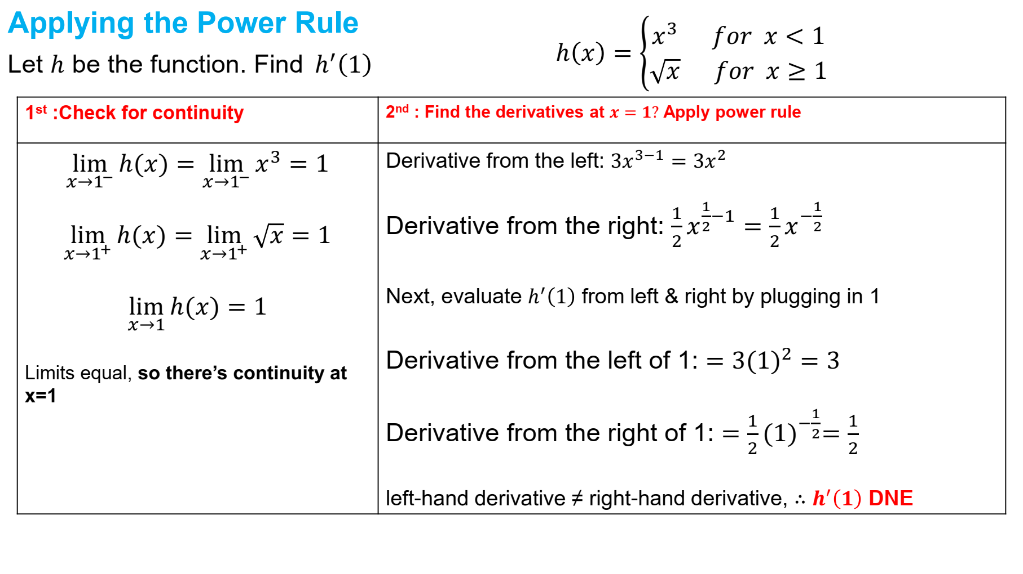

Slide 13
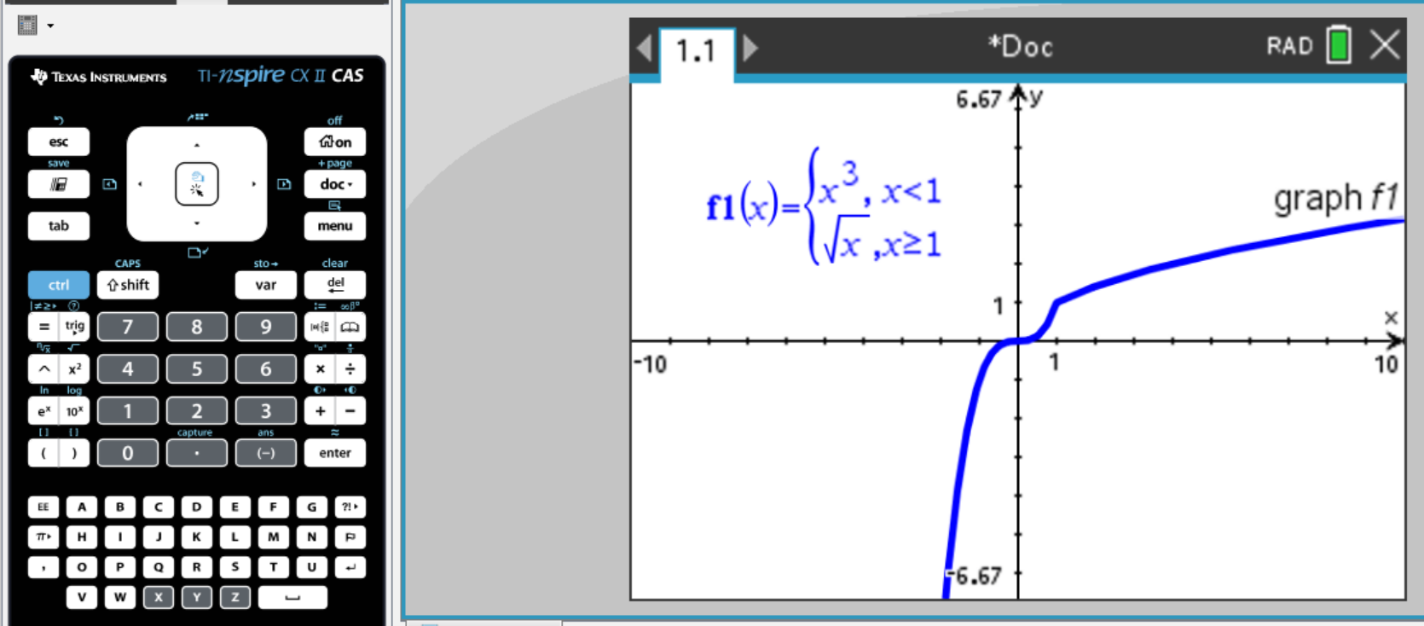
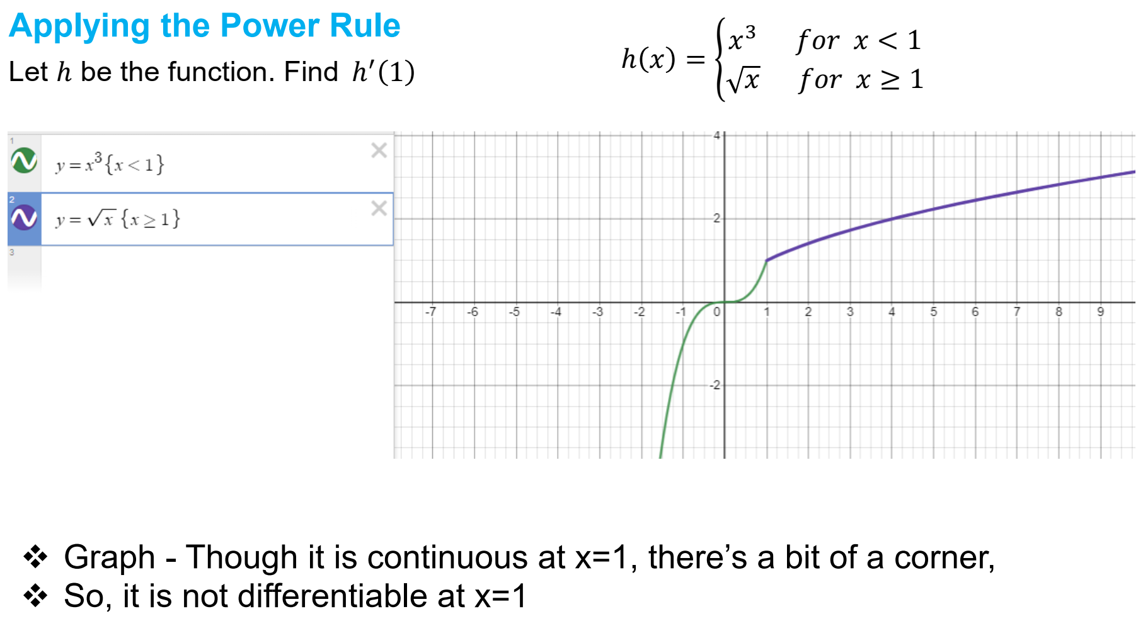

Slide 15
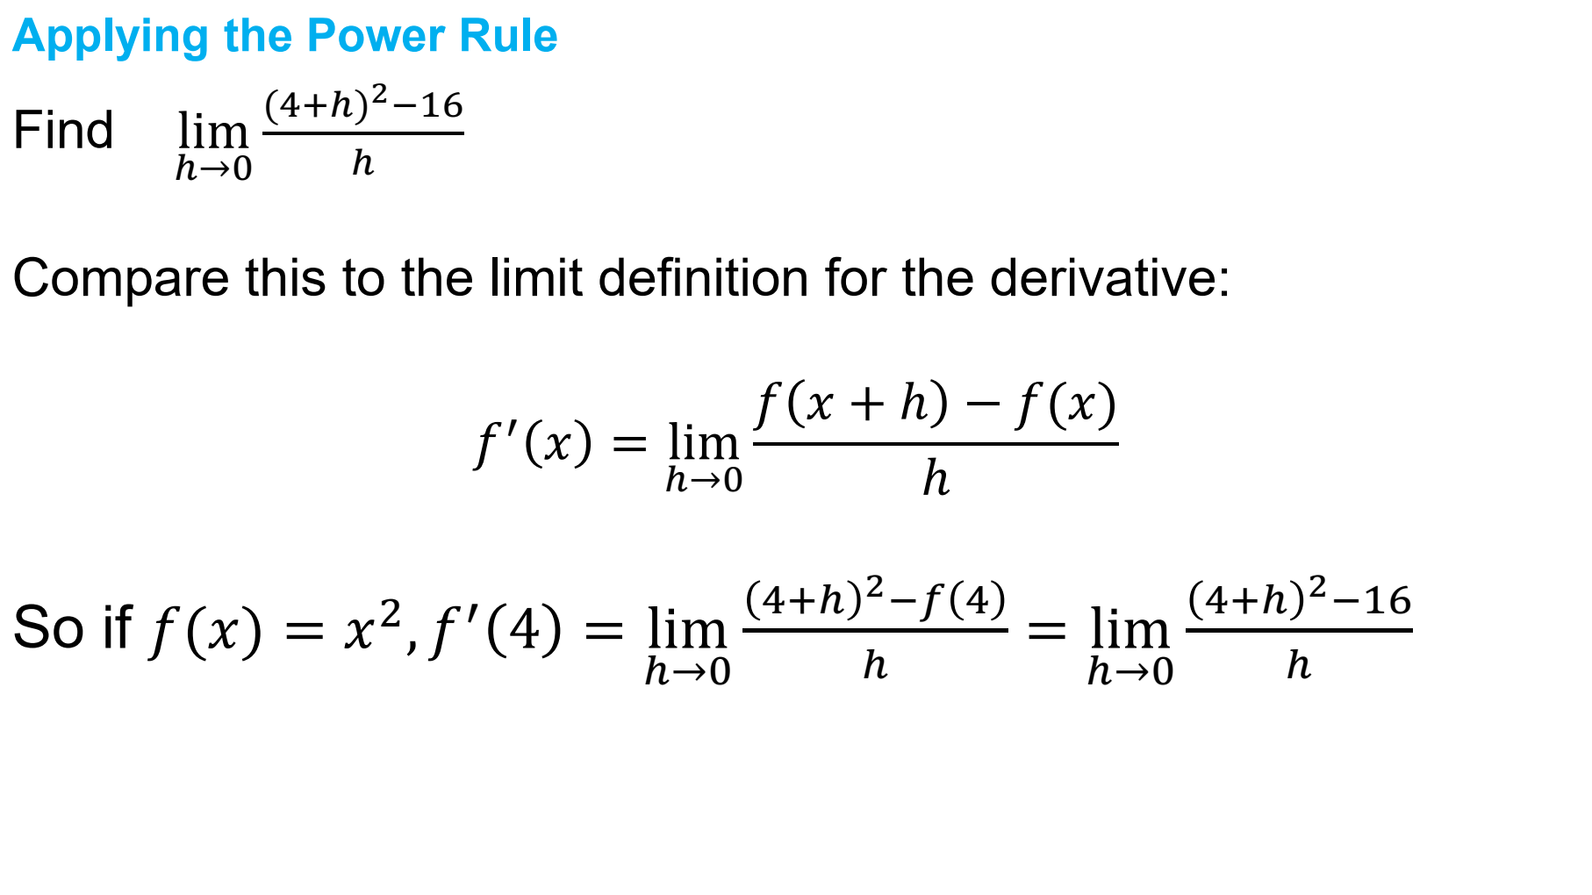

Slide 16
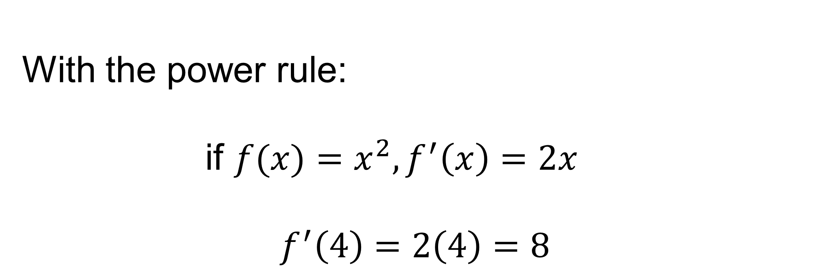
Applying the Power Rule
With the power rule:
if $f({x)=x}^{2},f^{′}\left(x\right)=2x$
$$f^{′}\left(4\right)=2\left(4\right)=8$$

Slide 17
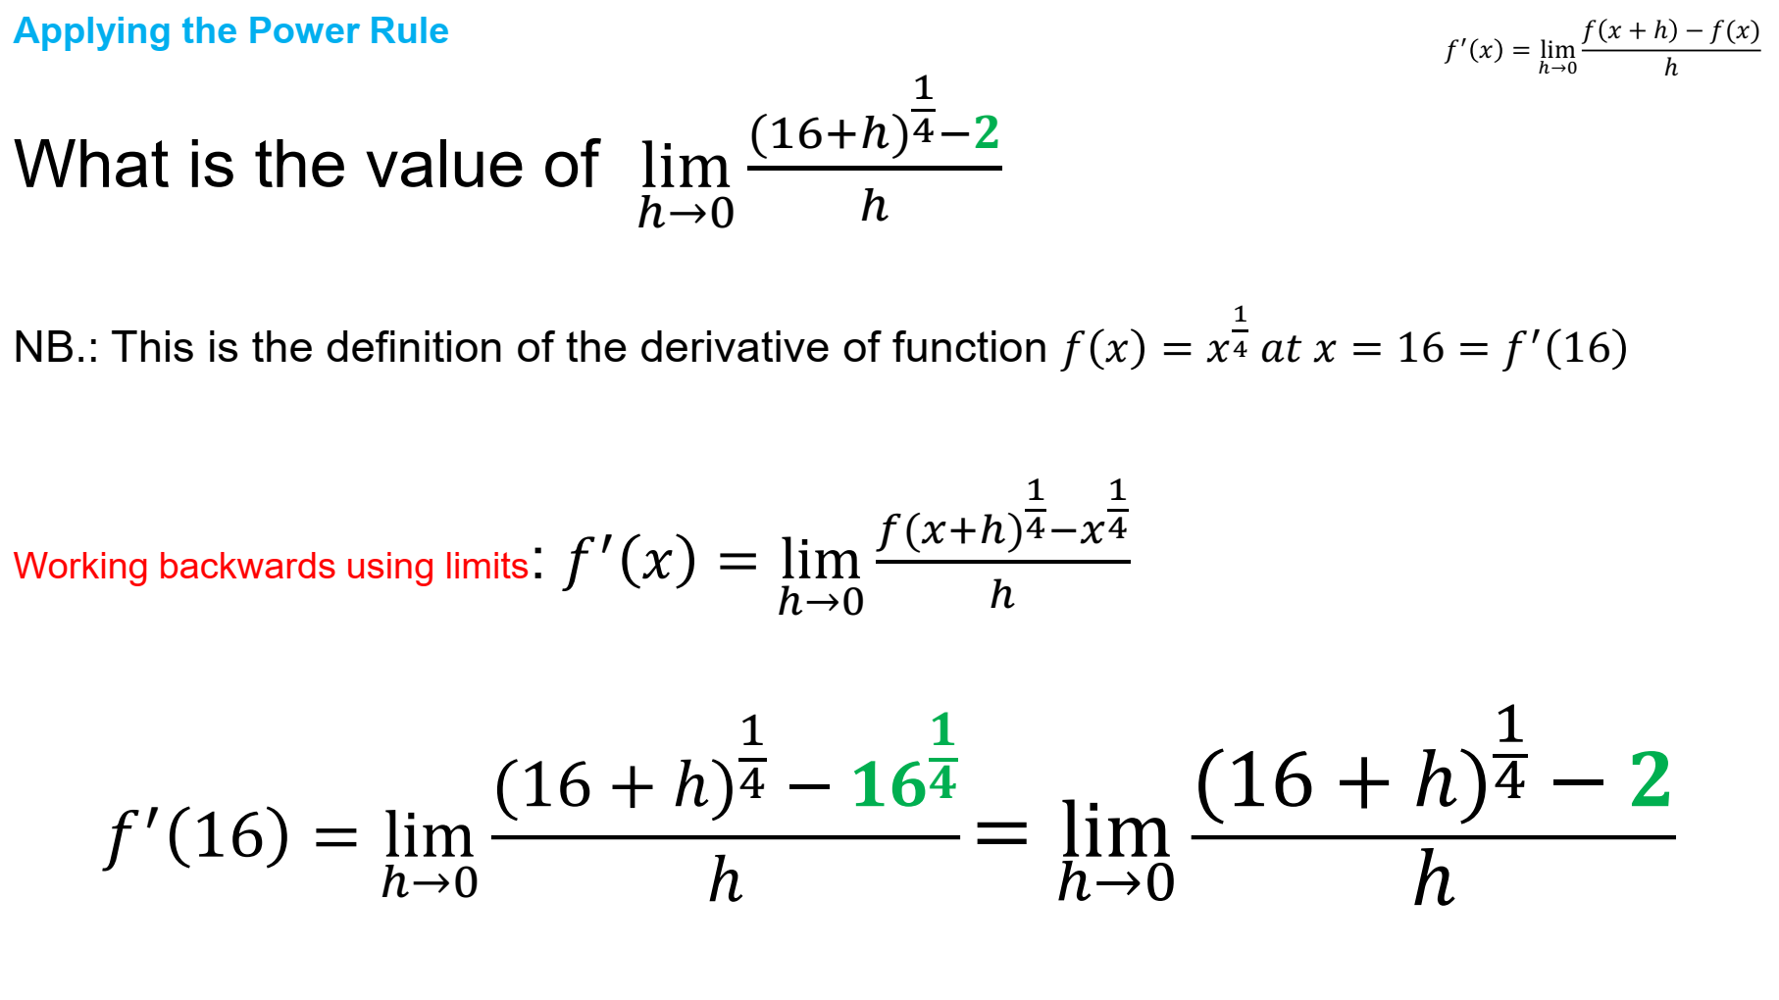

Slide 18
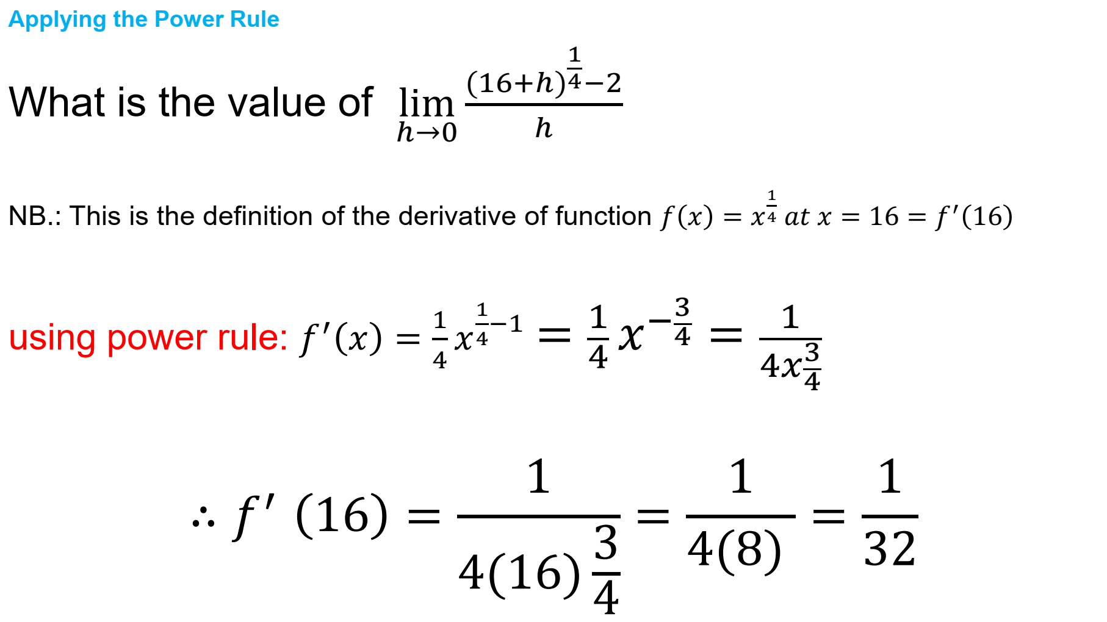

Slide 19
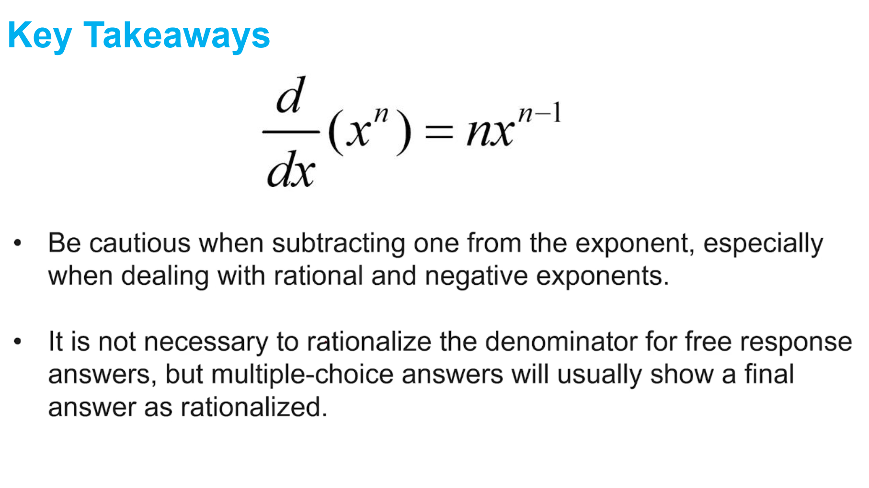

Slide 20
True or False
The power rule reduces the exponent by 1.
True

Slide 21
True or False
The power rule cannot be used on square roots.
FALSE

Slide 22
True or False
The derivative of a constant is 1.
FALSE

