Slide 1
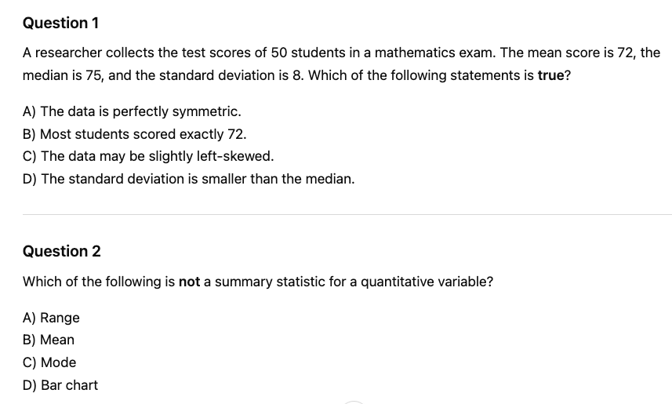
Summary statistics for a quantitative variable

Slide 2
Summary statistics for a quantitative variable
C
D

Slide 3
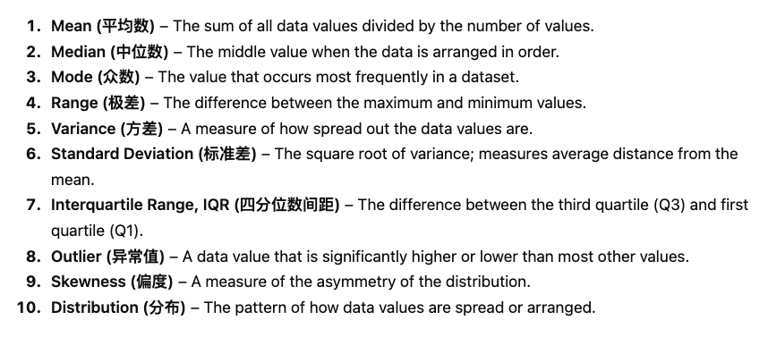

Slide 4
Measures of center describe a typical value (mean, median).
Measures of spread describe variability (range, IQR, standard deviation).
The five-number summary includes minimum, Q1, median, Q3, and maximum.
The mean and standard deviation are sensitive to outliers and skewness.
Summary statistics should be interpreted in context.

Slide 5
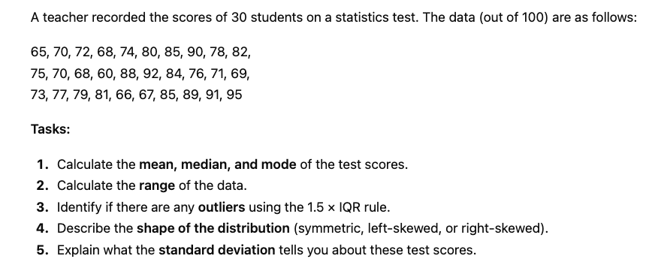

Slide 6
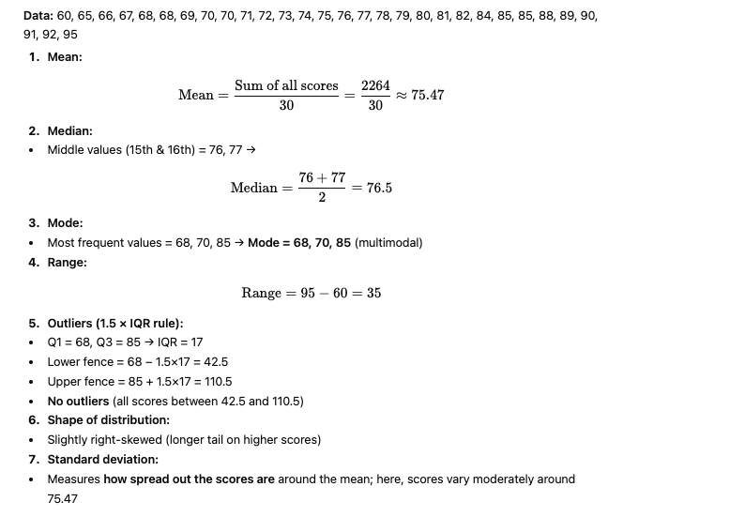

Slide 7
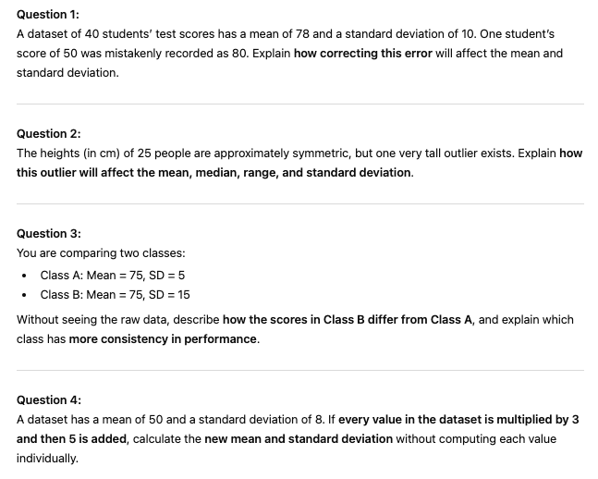
STRETCH and CHALLENGE

Slide 8
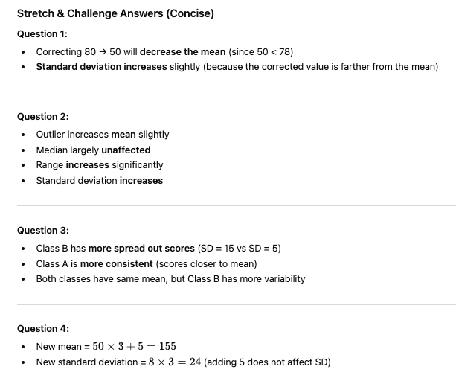

Slide 9
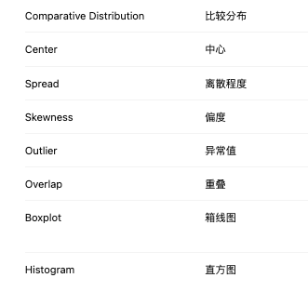
Comparing Distributions

Slide 10
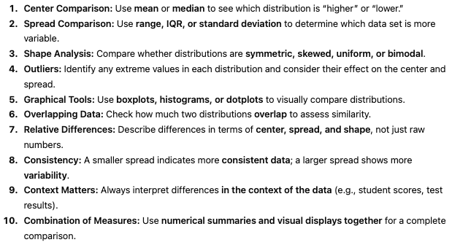
Comparing distributions

Slide 11
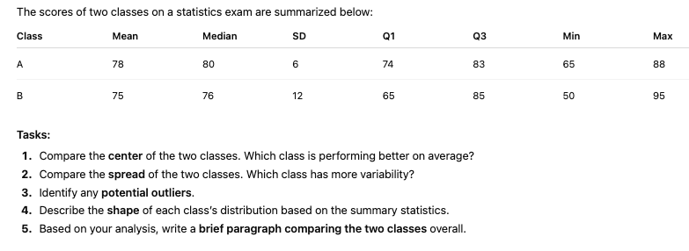
FRQ

Slide 12
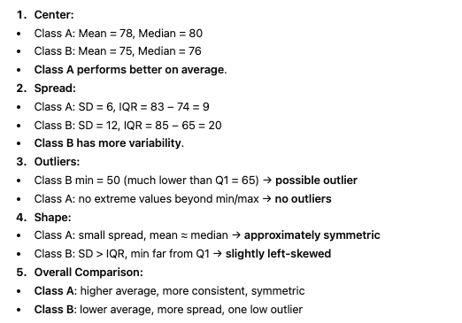
FRQ

Slide 13
TRUE or FALSE
If two distributions have the same mean, they must have the same shape.

Slide 14
TRUE or FALSE
A distribution with a larger standard deviation is always skewed.

Slide 15
TRUE or FALSE
Outliers can affect the mean more than the median.

