Slide 1
Unit 1 knowledge - CALCULUS – limits and continuity
1.1
Introducing Calculus: Can Change Occur at an Instant? ✔
1.2
Defining Limits and Using Limit Notation
1.3
Estimating Limit Values from Graphs
1.4
Estimating Limit Values from Tables
1.5
Determining Limits Using Algebraic Properties of Limits
1.6
Determining Limits Using Algebraic Manipulation
1.7
Selecting Procedures for Determining Limits
1.8
Determining Limits Using the Squeeze Theorem
1.9
Connecting Multiple Representations of Limits
1.10
Exploring Types of Discontinuities
1.11
Defining Continuity at a Point
1.12
Confirming Continuity over an Interval
1.13
Removing Discontinuities
1.14
Connecting Infinite Limits and Vertical Asymptotes
1.15
Connecting Limits at Infinity and Horizontal Asymptotes
1.16
Working with the Intermediate Value Theorem (IVT)

Slide 2
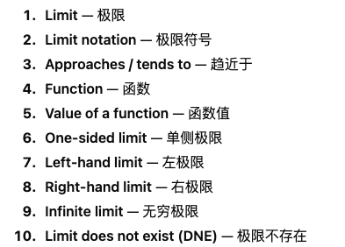
Defining Limits and Using Notation

Slide 3
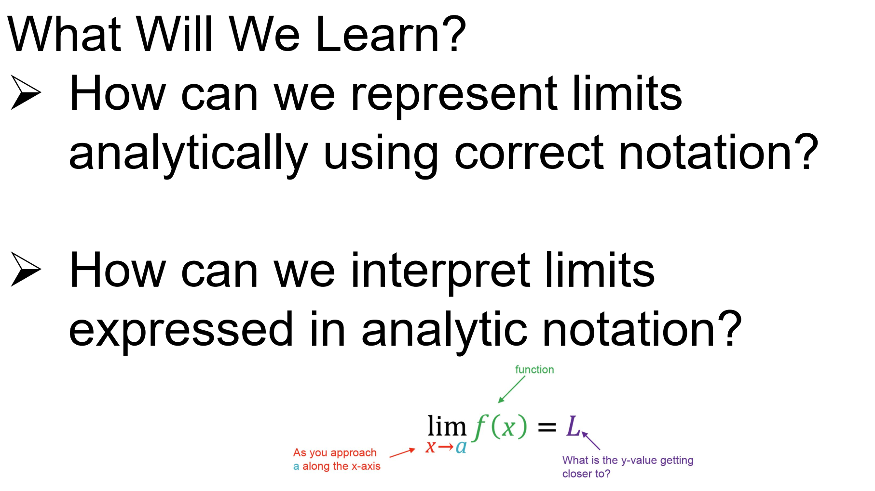

Slide 4
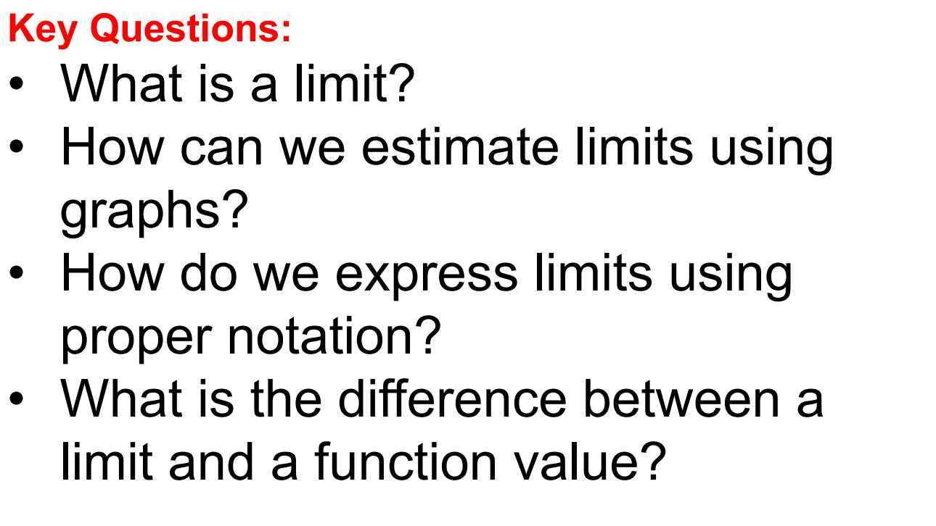

Slide 5
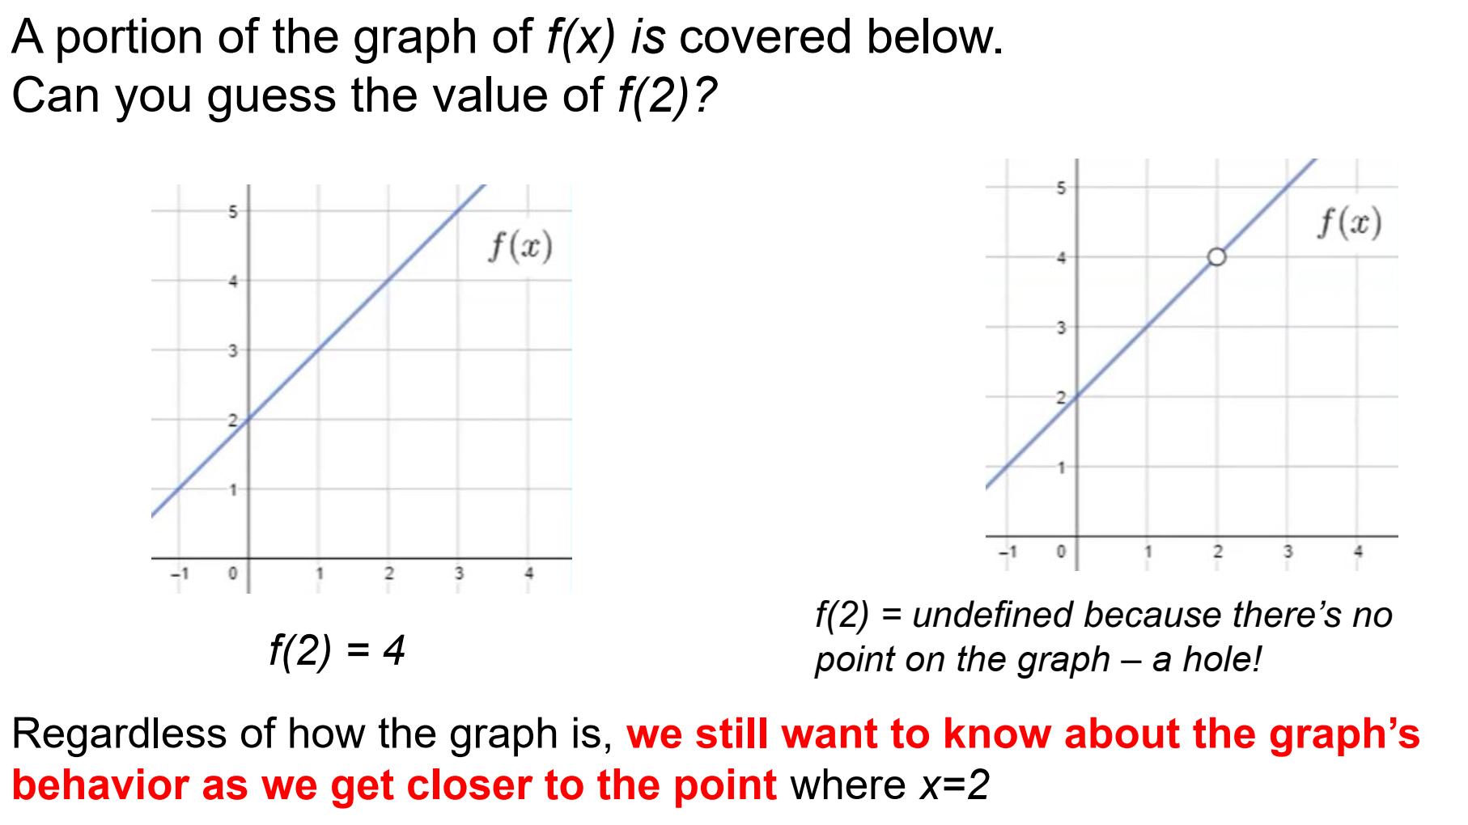

Slide 6
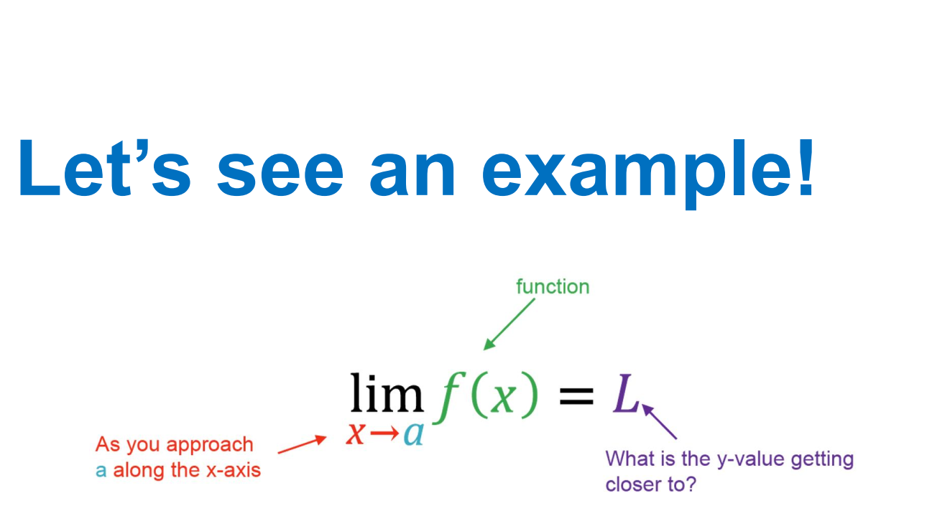

Slide 7
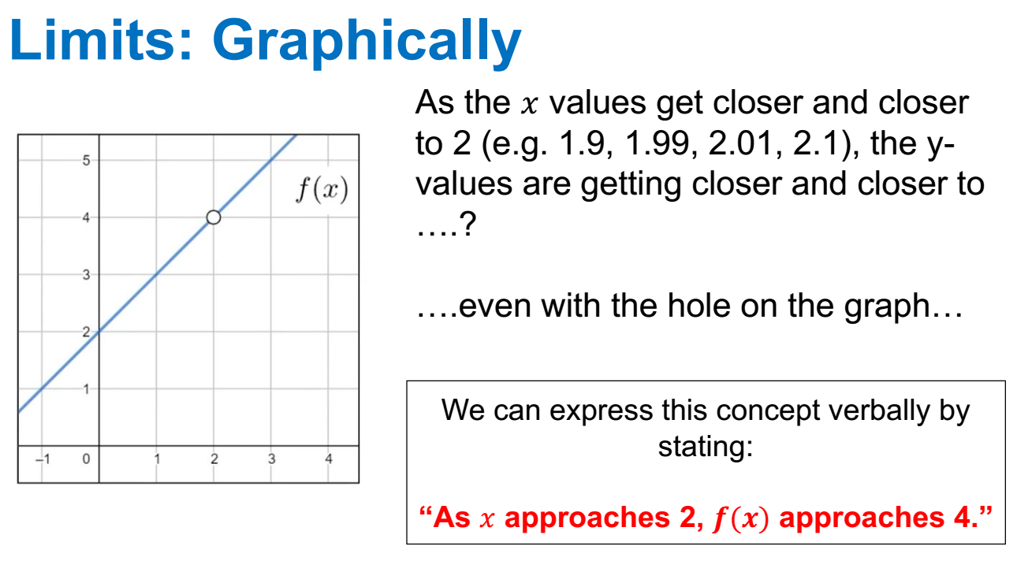

Slide 8
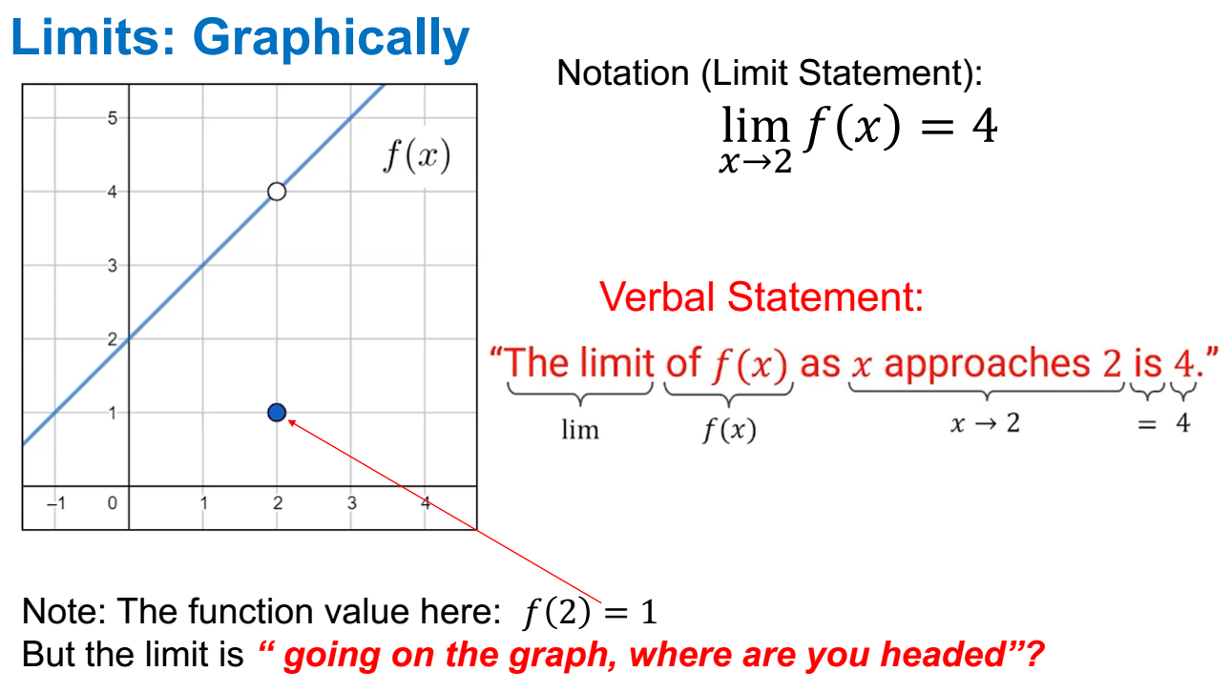

Slide 9
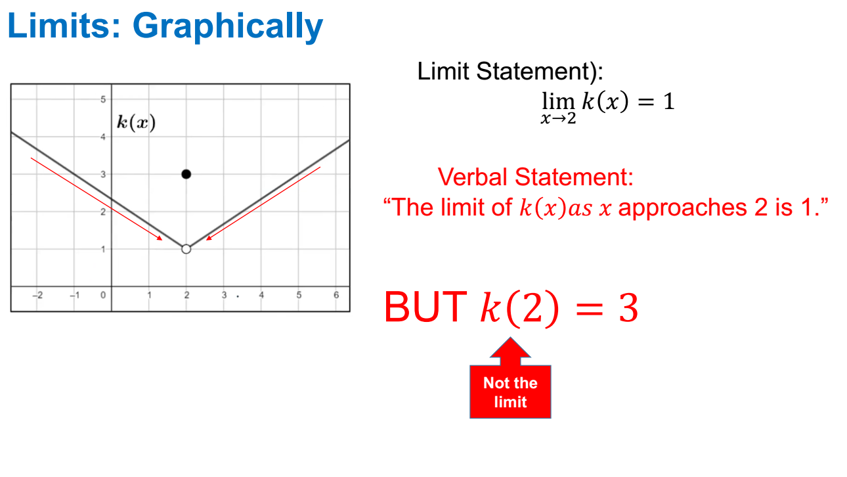

Slide 10
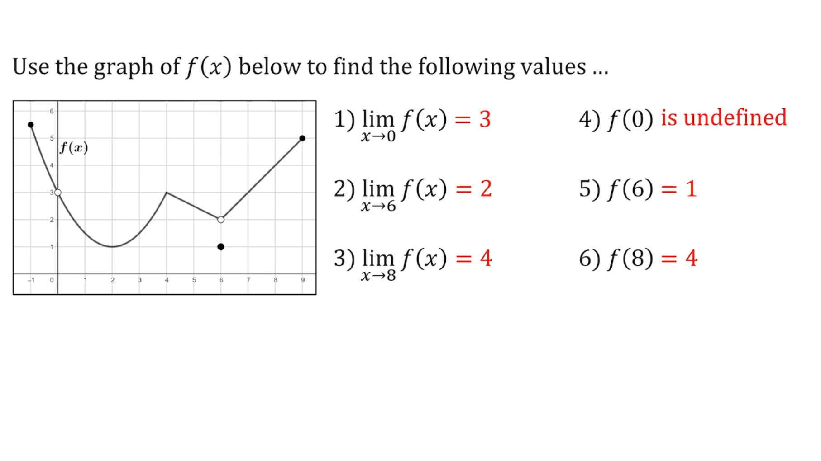

Slide 11
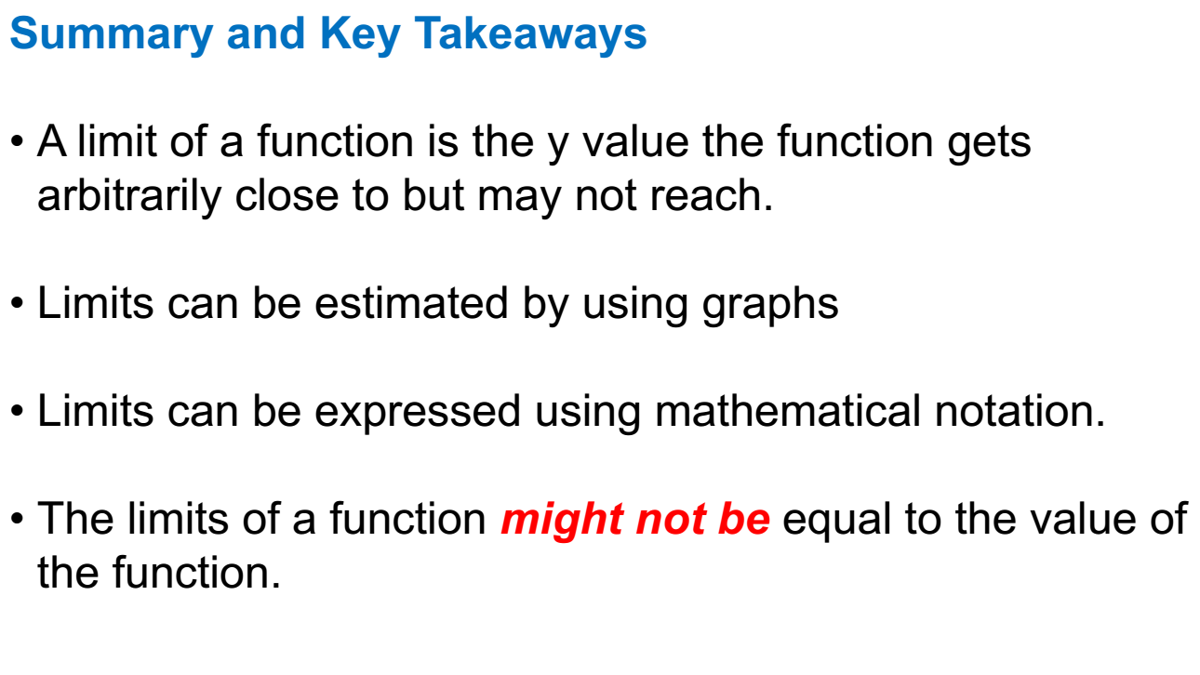

Slide 12
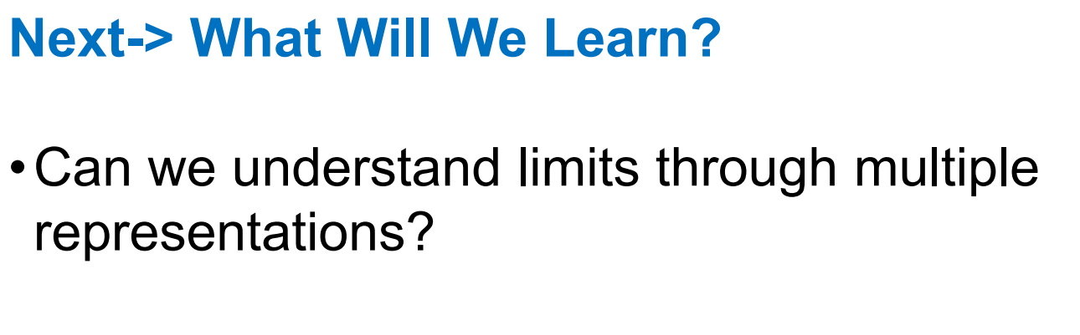

Slide 13
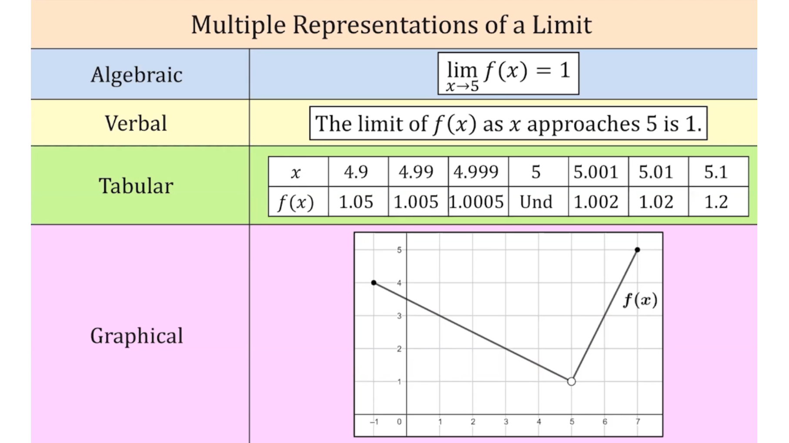

Slide 14
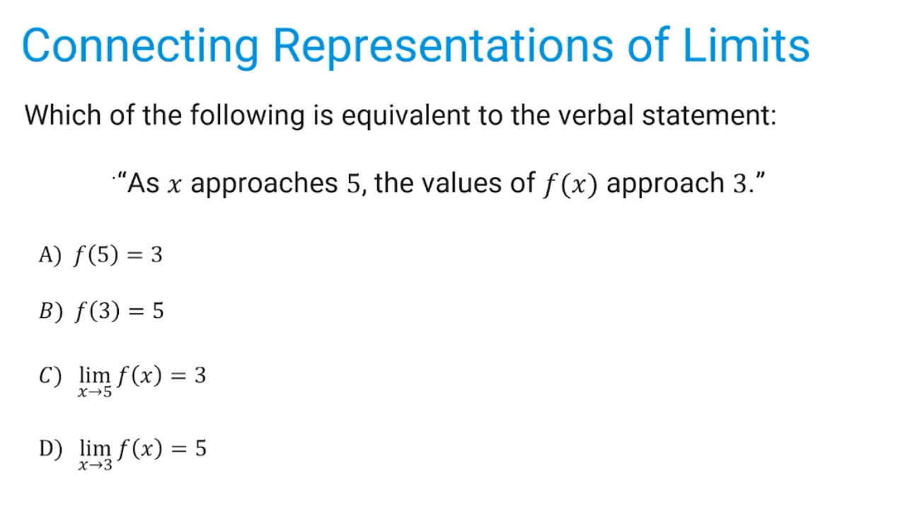
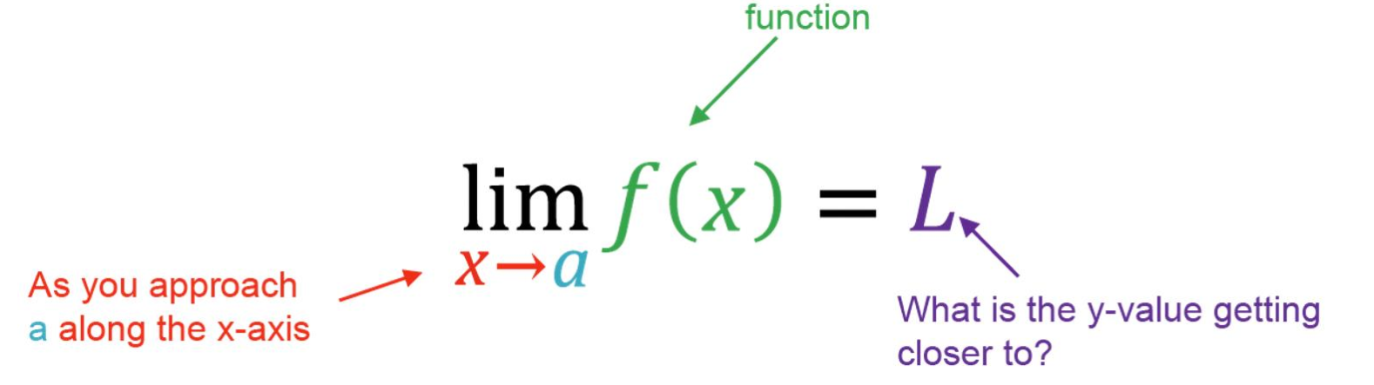

Slide 15
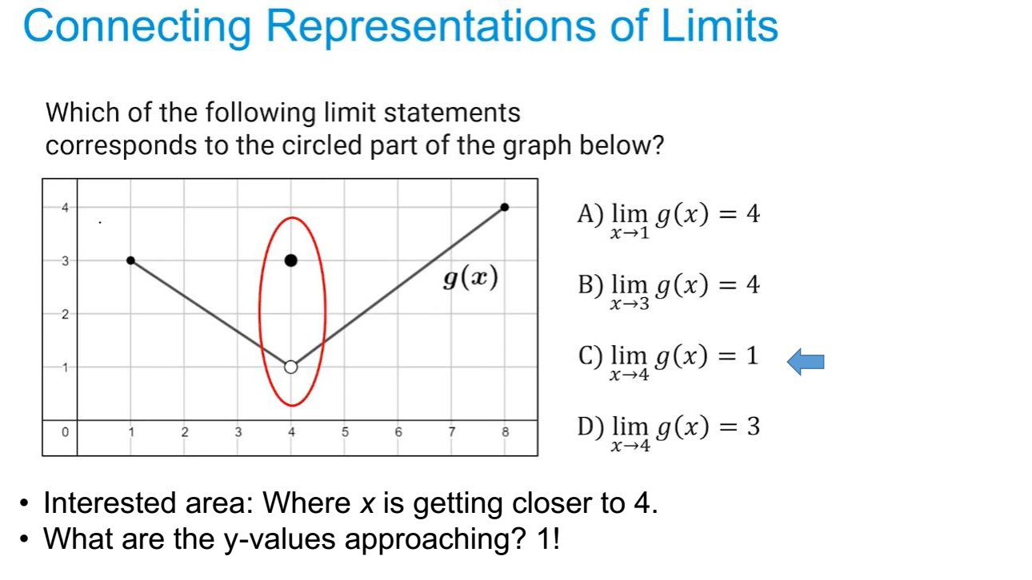

Slide 16
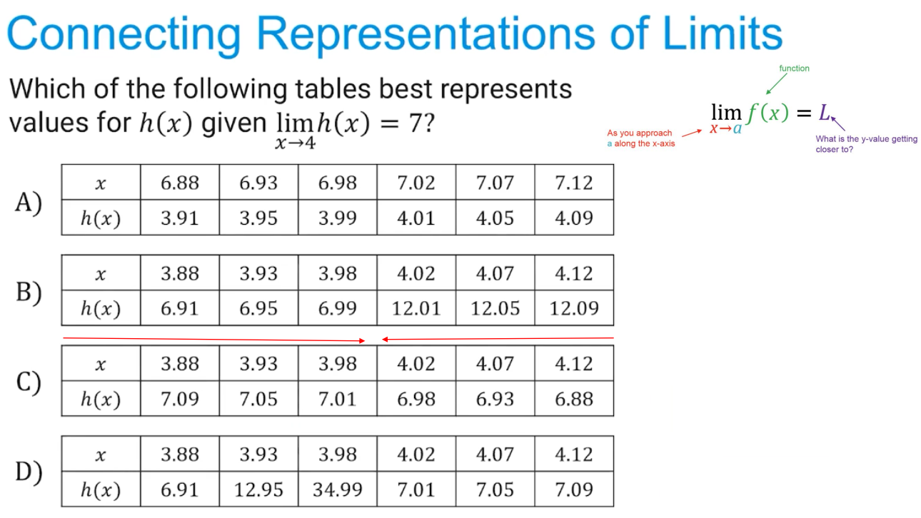

Slide 17
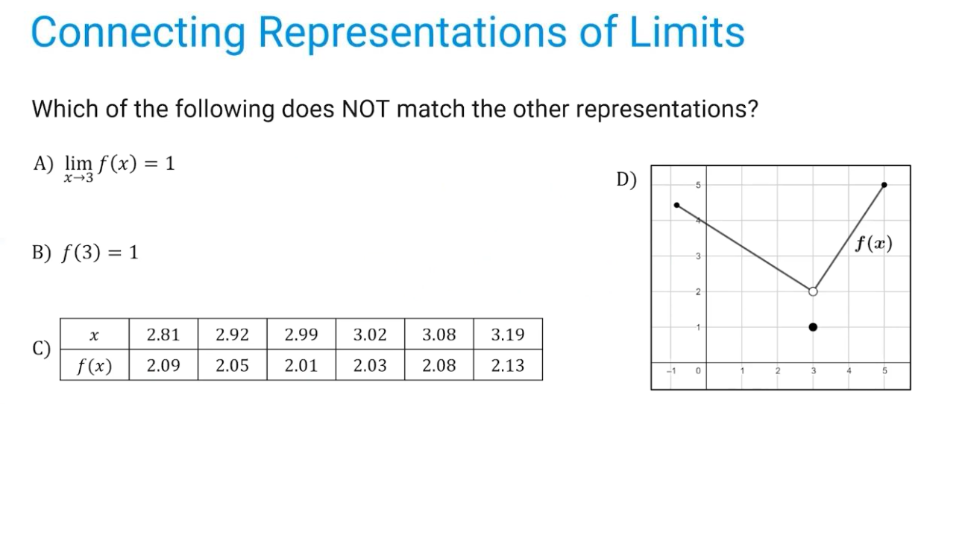

Slide 18


Slide 19
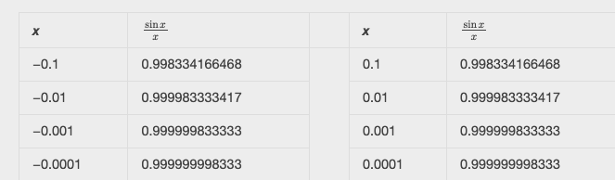

Slide 20
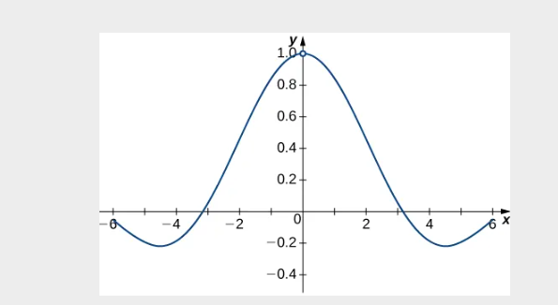

Slide 21

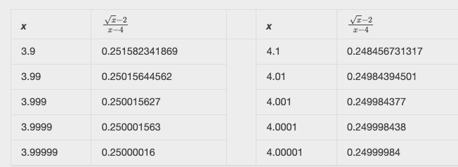

Slide 22
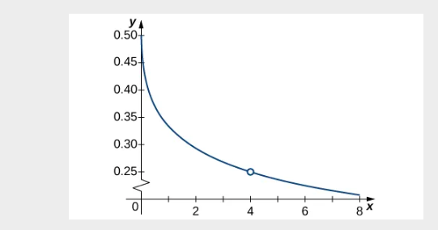

Slide 23
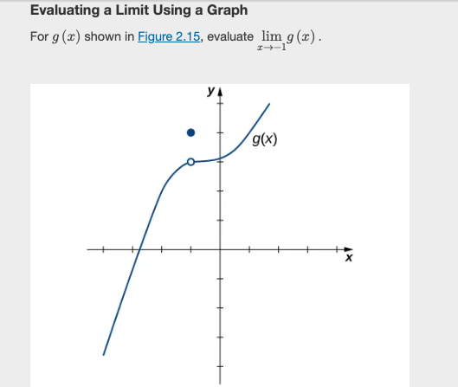

Slide 24


Slide 25

TRUE or FALSE
TRUE

Slide 26
TRUE or FALSE
TRUE

Slide 27
TRUE or FALSE
FALSE

Slide 28
