Slide 1
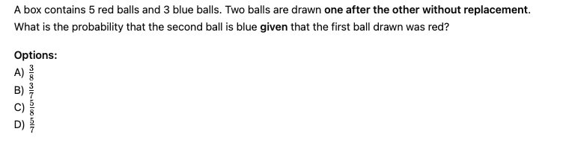
B

Slide 2
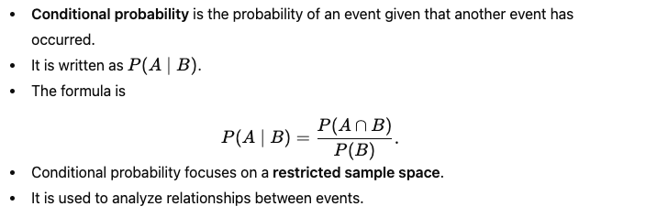
Conditional probability – Posterior probability as dependent on the data

Slide 3
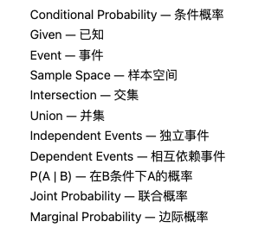

Slide 4
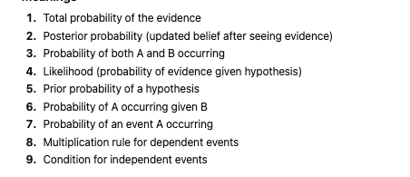
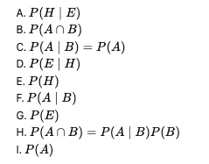
MATCHING

Slide 5

MATCHING

Slide 6
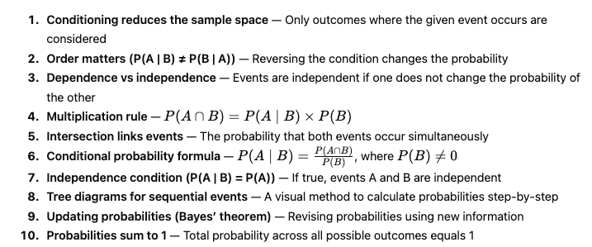

Slide 7
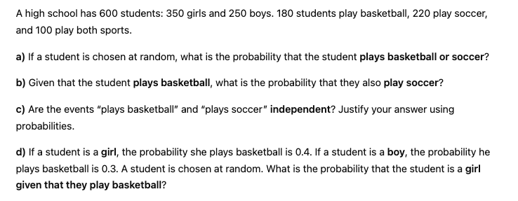

Slide 8
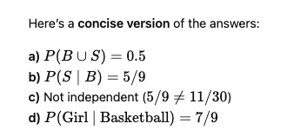

Slide 9
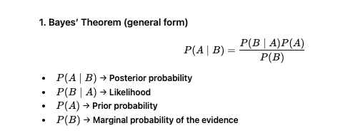
BAYES THEOREM

Slide 10
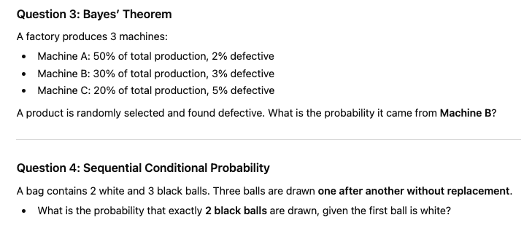
Stretch and Challenge

Slide 11
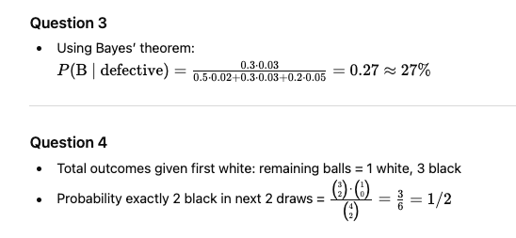

Slide 12
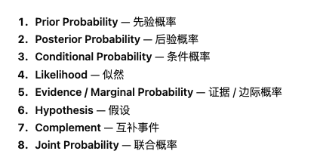
Bayes Theorem

Slide 13
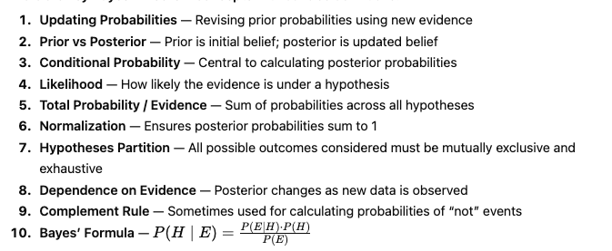

Slide 14
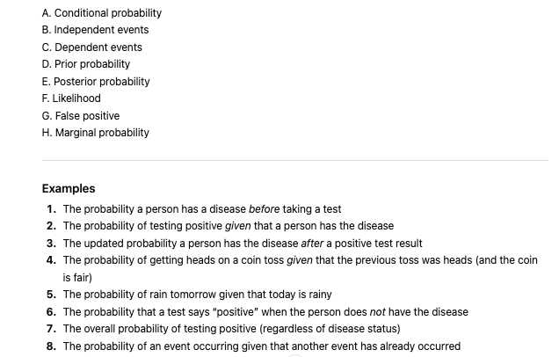

Slide 15
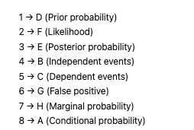

Slide 16
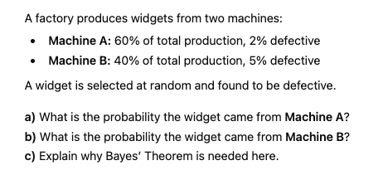

Slide 17


Slide 18
TRUE or FALSE
P(A∣B)=P(B∣A) for all events A and B.
FALSE

Slide 19
TRUE or FALSE
Bayes’ Theorem can be used to update prior probabilities after new evidence.
TRUE

